Slide 1
Engineering for Particle Accelerators
The fundamentals of large scale linear accelerator engineering
Vyacheslav Yakovlev, Fermilab
U.S. Particle Accelerator School (USPAS)
Education in Beam Physics and Accelerator Technology
13 January 2020

Slide 2
Engineering for Particle Accelerators
Instructors: Vyacheslav Yakovlev, Timergali Khabiboulline,
Thomas Nicol, and Vladimir Kashikhin, Fermilab, Batavia
One-week course at USPAS 2020, San Diego, CA
January 13-17, 2020
Purpose and Audience:
The purpose of this course is to give an engineering foundation to the development of modern particle accelerators. This course is suitable for graduate students, senior undergraduate students, and engineers interested in particle accelerator design and development. The course will focus on large-scale proton superconducting linear particle accelerators.
Prerequisites
Undergraduate-level electromagnetism, classical mechanics, RF and mechanical engineering courses.
It is the responsibility of the student to ensure that he or she meets the course prerequisites or has equivalent experience.

Slide 3
Engineering for Particle Accelerators
Objectives
Students will learn basic principles of the engineering design of large-scale proton superconducting linear particle accelerators. Upon completing this course, students will be familiar with the principles, approach, and basic technique of the design of the main components in superconducting linear accelerators, and be able to perform basic analysis on their performance.
Instructional Method
The course will consist of lectures and daily homework assignments on the fundamentals of engineering of superconducting linear particle accelerators.

Slide 4
Engineering for Particle Accelerators
Course Content
* The course will cover the fundamentals of superconducting accelerator engineering and provide examples and exercises in the practical design of the main accelerator components.
* Topics will include:
general accelerator layout and parameter optimization; operational regime dependent technology selection;
general cryomodule design issues, challenges, principles, and approaches;
RF optimization and design of superconducting RF cavities and components;

Slide 5
Engineering for Particle Accelerators
cavity processing recipes and procedures; engineering issues and challenges of SRF cavity mechanical design and fabrication;
problems and techniques for design of focusing elements for superconducting accelerator applications (room-temperature and superconducting);
diagnostics and alignment;
cavity and cryomodule testing and commissioning.

Slide 6
Engineering for Particle Accelerators
Reading Requirements
It is recommended that students re-familiarize themselves with the fundamentals of electrodynamics at the level of
“Classical Electrodynamics” (Chapters 1 through 8) by J. D. Jackson, John Wiley & Sons, 3rd edition (1999).
Additional suggested reference material:
“Handbook of Accelerator Physics and Engineering”, edited by A. W. Chao and M. Tigner, World Scientific, 3rd print (2006);
“RF Superconductivity: Science, Technology, and Applications,” by H. Padamsee, Wiley-VCH (2009).

Slide 7
Engineering for Particle Accelerators
Daily Schedule (cont)
 | Monday | Tuesday
9:00-11:30 | V. Yakovlev, The fundamentals of large scale linear accelerator engineering | T. Khabiboulline, SRF cavity EM and mechanical design, RF measurements and tuning
11:30-13:00
14:00-15:30
15:30-17:30 | V. Kashikhin, Conventional, Permanent, and Superconducting Magnets Design | V. Kashikhin, Conventional, Permanent, and Superconducting Magnets Design
19:00-21:00 | Study | Study

Slide 8
Engineering for Particle Accelerators
Daily Schedule
 | Wednesday | Thusday
9:00-11:30 | Th. Nicol, Mechanical Engineering in Superconducting Magnet and RF Cryomodule Design | V. Yakovlev, The fundamentals of large scale linear accelerator engineering
11:30-13:00 |  | T. Khabiboulline, SRF cavity EM and mechanical design, RF measurements and tuning
14:00-15:30 |  | Th. Nicol, Mechanical Engineering in Superconducting Magnet and RF Cryomodule Design
15:30-17:30 | V. Kashikhin, Conventional, Permanent, and Superconducting Magnets Design | V. Kashikhin, Conventional, Permanent, and Superconducting Magnets Design
19:00-21:00 | Study | Study

Slide 9
Engineering for Particle Accelerators
Daily Schedule (cont)
Friday 1/17
9:00-12:00 Wrap-up

Slide 10
USPAS 2020 Students:
1 | Altinbas | Zeynep | Brookhaven National Lab
2 | Chimalpopoca | Osvaldo | RadiaBeam Technologies
3 | Crahen | William | Jefferson Lab
4 | Dinkel | Holly | Stanford University
5 | Ferradas Troitino | Jose | University of Geneva and CERN
6 | Galarraga | Jorge | Brookhaven National Lab
7 | Gamzina | Arnela | SLAC
8 | Goldberg | Darryl | Brookhaven National Lab
9 | Harvey | Zachary | Lawrence Berkeley National Lab
10 | Izzo | Scott | Argonne National Lab
11 | Jimenez | Sofia | Universite Paul Sabatier
12 | Joshi | Piyush | Brookhaven National Lab
13 | Lange | Tanner | Michigan State University - NSCL
14 | Liu | Zunping | Argonne National Laboratory
15 | Marchlik | Matt | Jefferson Lab
16 | Mardenfeld | Michael | Lawrence Berkeley National Lab
17 | Mazza | Alex | Los Alamos National Lab and Indiana University
18 | McNevin | Jacob | Nusano
19 | Nes | Thomas | University of Twente and CERN
20 | Olander | Michael | Fermilab and Indiana University
21 | Palmer | Dennis | SLAC
22 | Soezeri | Sultan | Lawrence Berkeley National Lab
23 | Wesley | Michael | Fermilab
24 | Williamson | Matthew | Oak Ridge National Lab
25 | Wren | Michael | Fermilab and Indiana University
26 | Younger | Sean | Michigan State Universtiy / FRIB

Slide 11
Chapter 1.
Accelerators for High Energy Physics and other scientific applications.

Slide 12
Accelerators for High Energy Physics and other scientific applications.
High – Energy Electron accelerators: High Energy Physics, Nuclear Physics, Free-Electron Lasers
High – Energy Proton accelerators: High Energy Physics, Nuclear Physics, source of secondary particles (neutrons, pions, muons, neutrinos), material science, Accelerator-Driven Subcritical reactors (ADS).
Specifics of proton accelerators: protons are non- or weekly relativistic up to high energies: rest mass for protons is 0.938 GeV (compared to 0.511 MeV for electrons).

Slide 13
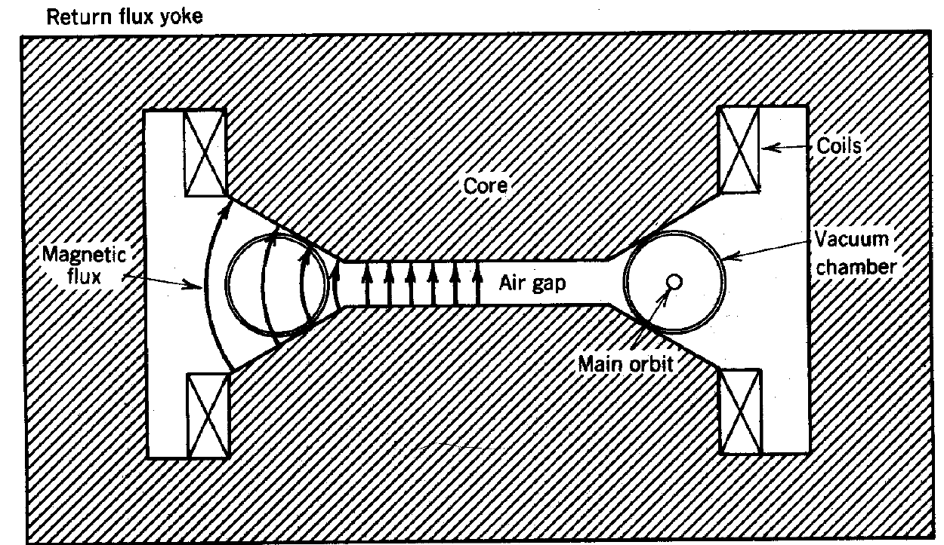

Types of the accelerators
Electrostatic accelerators – acceleration in DC field
- Van de Graaff (moving belt to charge the high –voltage electrode)
- Cockcroft-Walton (diode-capacitor voltage multiplier).
Electrodynamic accelerators – acceleration in changing EM field.
Induction accelerators – acceleration in pulsed eddy electric field
Linear induction accelerator
Cyclic induction accelerator
- Betatron

Slide 14
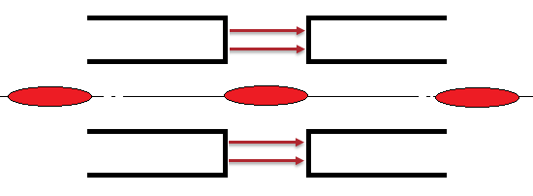
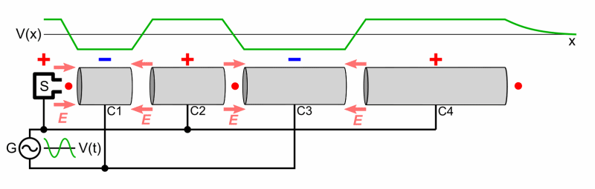
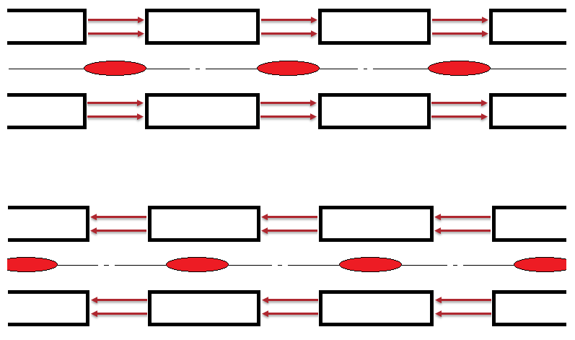
Types of the accelerators
RF accelerators – acceleration in RF field
Bunched beam (no particles when the field is decelerating);
Accelerating RF field is excited in an accelerating gap;
Bunches
Accelerating gap
Particle energy gain ΔU ~ E₀
RF field: E =E₀ cos(ωt)
L = nvT=2πnv/ω, v is the bunch velocity, T is RF period and ω is RF cyclic frequency; n is integer, n=1,2…
ωt=2πm, m=0,1,2…
ωt=(2m+1)π, m=0,1,2...
Animation from Wikipedia
(https://en.wikipedia.org/wiki/Particle_accelerator)

Slide 15
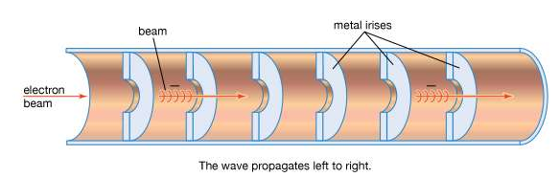
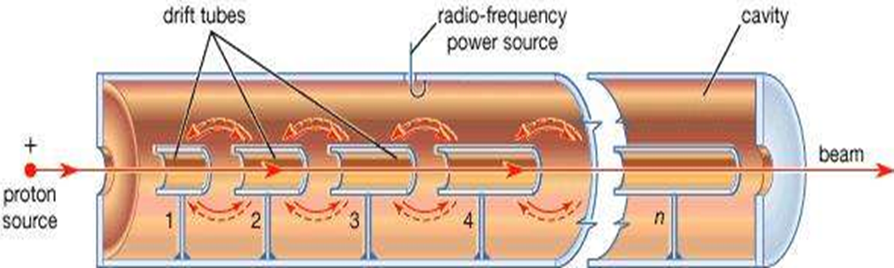
Types of the accelerators.
RF linear accelerators
Travelling wave accelerators.
Standing wave accelerators.
Room Temperature linear accelerators
Superconducting linear accelerators
Specific acceleration technology and operation mode – pulsed or CW - are determined primarily by the facility purposes, which demand in turn specific properties of the beam – energy, power, timing structure, beam quality, etc.

Slide 16
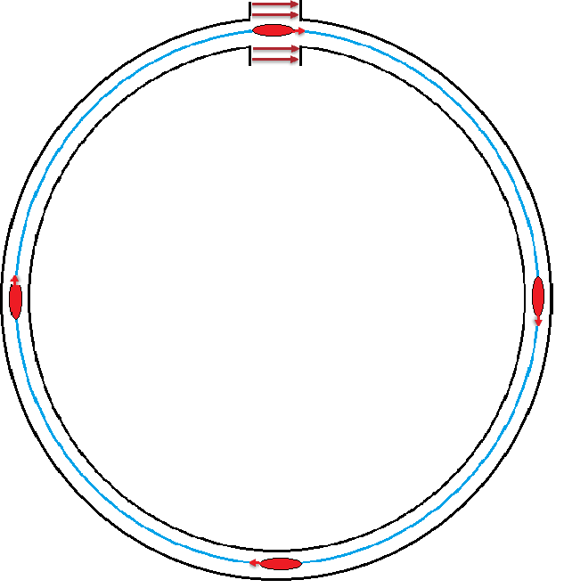
Types of the accelerators
An accelerated particle passes the same gap many times (cyclic accelerator).
RF fields in the gap(s): E(t) =E₀ cos(ωt)
Accelerating gap
ω = ΩNq;
ω is RF frequency,
Ω is the bunch revolution frequency,
N is number of bunches
q=1,2,3…
Bunches
ωt=2πm, m=0,1,2…

Slide 17
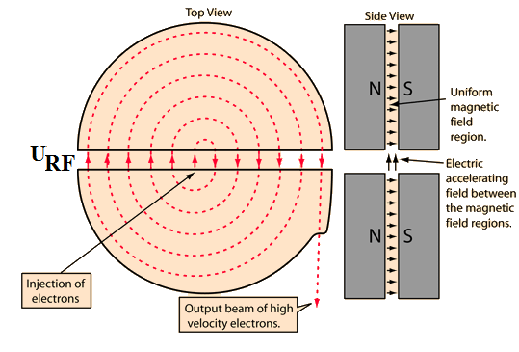
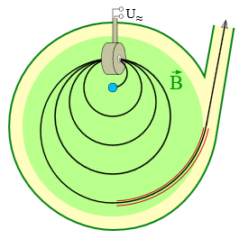
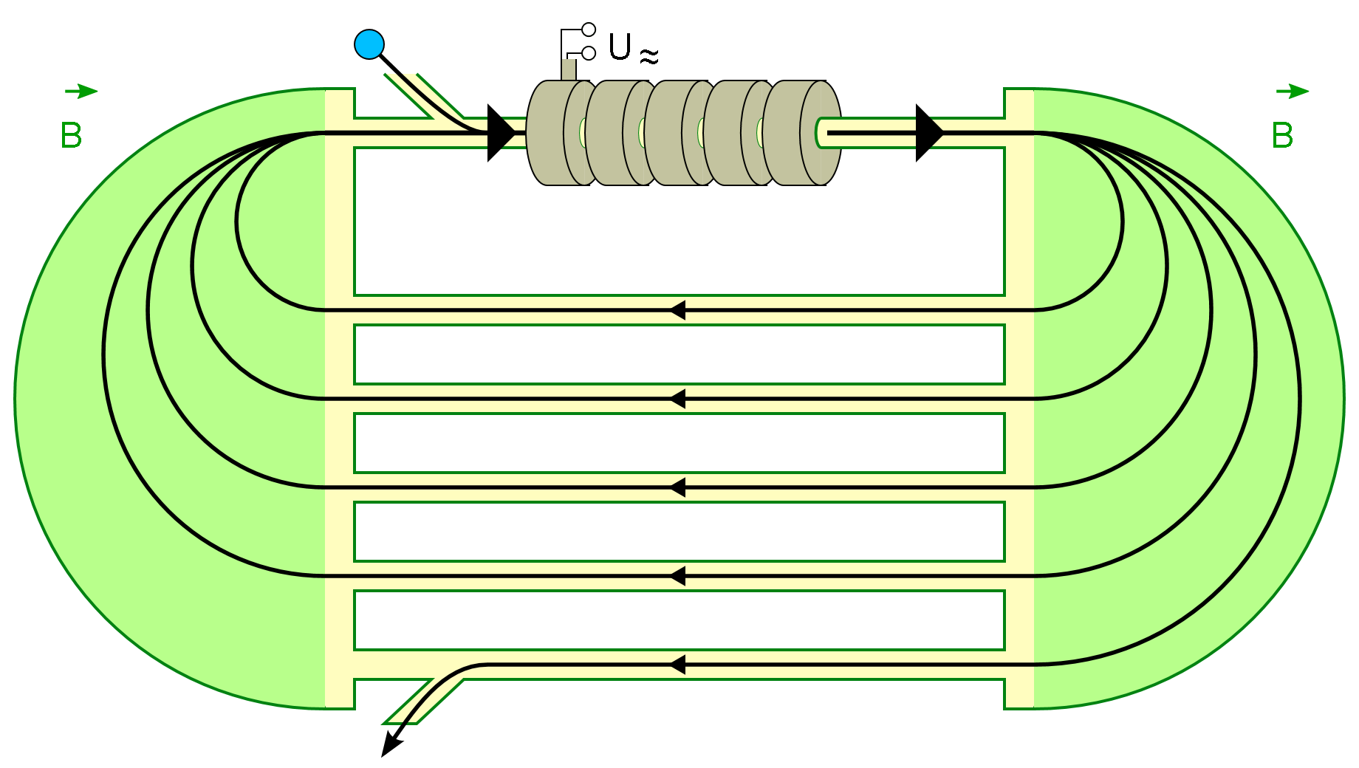
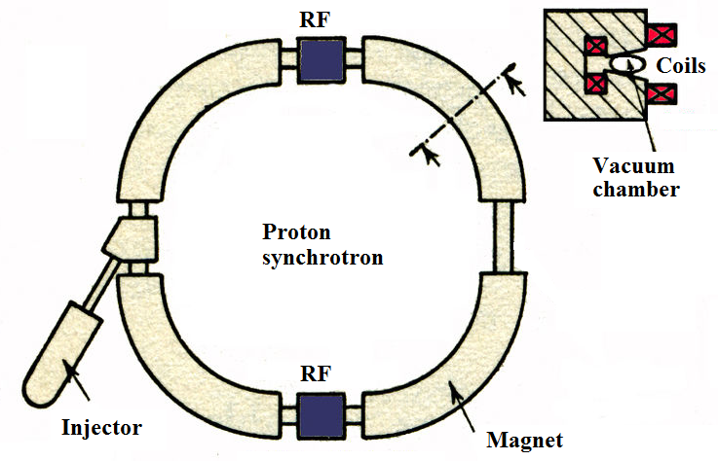
Cyclic accelerators
Cyclotron Microtron Racetrack
B= const, f_{rf} = const
Proton synchrotron:
B=B(t), f_{rf}=f_{rf}(t)

Slide 18
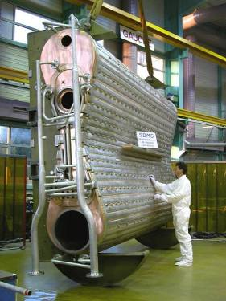
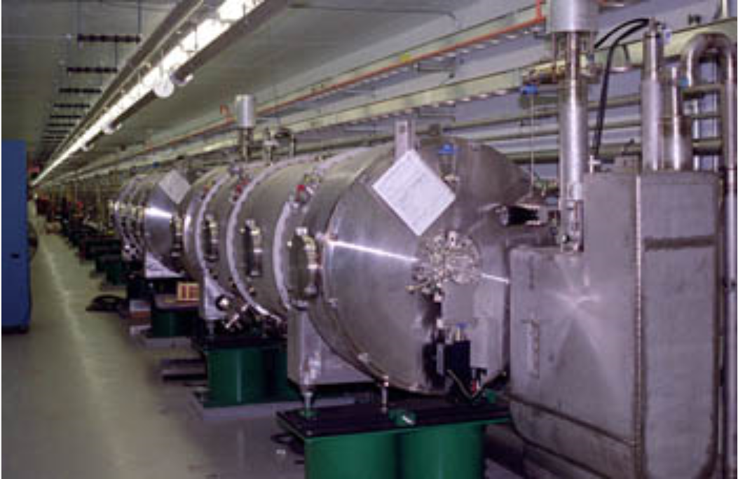
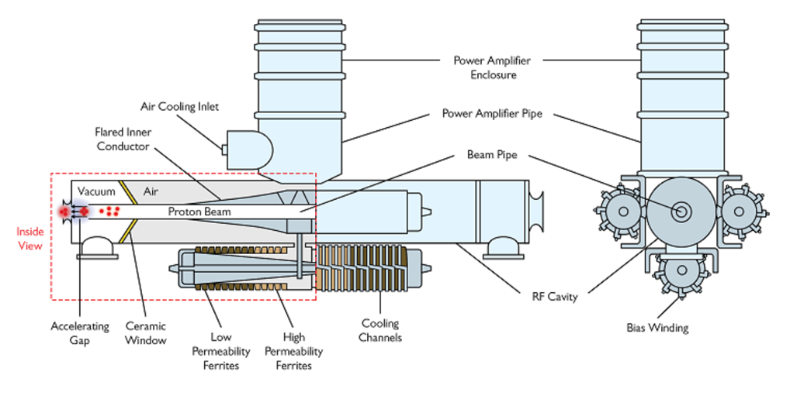
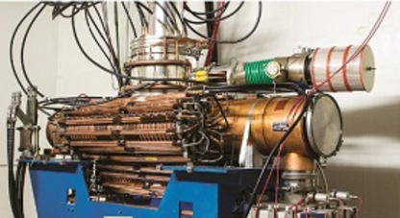
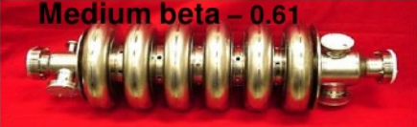
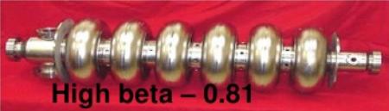
RF cavities for accelerators
To achieve high accelerating filed in the gap resonant RF cavities are used. In all modern RF accelerators the beam acceleration take place in a resonance wave (standing or travelling) electromagnetic field excited in an RF cavities.
CW 50.6 MHz cavity of
PSI cyclotron. V =1.2 MV
Superconducting 805 MHz multi-cell cavities of SNS linac. V=10-15 MV, DF = 6%.
Tunable cavity for FNAL Booster Synchrotron
F=37.8-52.8 MHz. V=60 kV, DF =50%

Slide 19
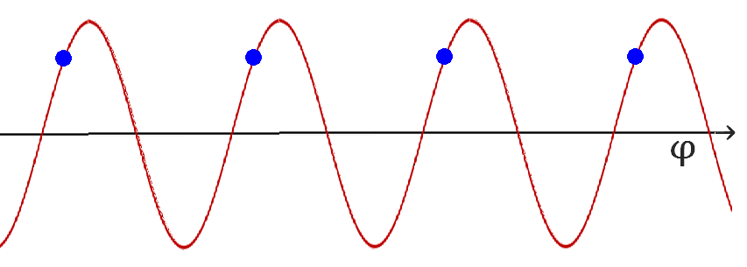
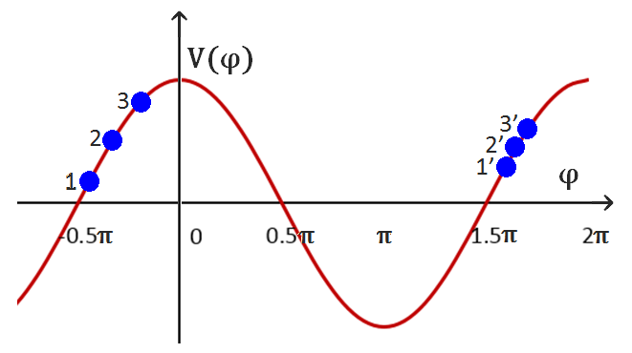
Acceleration principles:
If the charged particle reaches the center of the accelerating gap in arbitrary phase φ, its energy gain is
V(φ) = Vcos(φ )
Acceleration: -π/2< φ < π/2
Synchronism: the bunches should reach
the center of the acceleration gaps in the same accelerating phase.
Autophasing: longitudinal dynamics should be stable (no bunch lengthening). For linear accelerator -π/2 < φ_{s} < 0 (φ_{s} is the phase of the bunch center)
(linear accelerator)

Slide 20
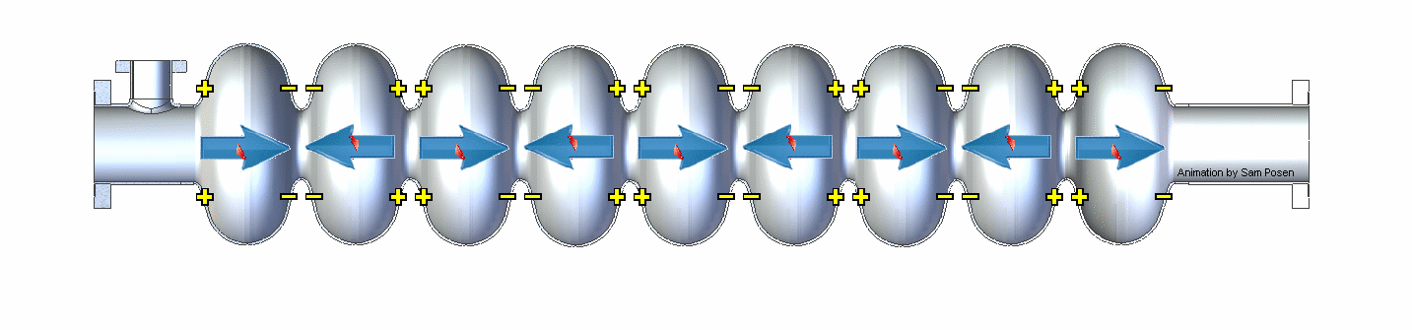
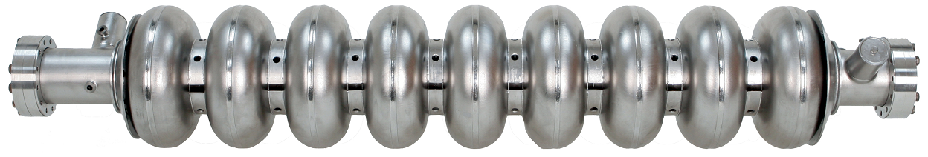
Illustration of synchronism :
1.3 GHz ILC cavity (animation by Sam Posen, FNAL)
Input RF power
Slowed down by factor of approximately 4x10⁹
~1 m

Slide 21
Big SRF Linear Accelerator Facilities:
Linac | Laboratory | Application | Acc. Particle | Operation | Status
SNS | ORNL, USA | Neutron Source | H⁻ | pulsed | Operation
ESS | ESS, Sweden | Neutron Source | p | pulsed | Construction
MYRRHA | SCK-CEN, Belgium | ADS | p | CW | R&D
CIADS | IMP, China | ADS | p | CW | R&D
ISNS | Indore, India | Neutron Source | p | pulsed | R&D
ADSS | BARC, India | ADS | p | CW | R&D
JADS | JPARC, Japan | ADS | p | CW | R&D
PIP II | FNAL, USA | Neutrino/Muons | H⁻ | CW/pulsed | R&D
FRIB | MSU, USA | Nucellar physics | Ions | CW | Construction
RAON | RISP, S.Korea | Nucellar physics | Ions | CW | Construction
CEBAF | JLAB, USA | Nucellar physics | e⁻ | CW | Operation
XFEL | DESY, Germany | FEL | e⁻ | pulsed | Operation
SHINE | SINAP, China | FEL | e⁻ | CW | Construction
LCLS II | SLAC, USA | FEL | e⁻ | CW | Construction

Slide 22
Chapter 2.
Accelerating and focusing properties of RF field. a. Acceleration of charged particles in electromagnetic field; b. Focusing properties of RF field; c. Bunching properties of RF field; d. Summary.

Slide 23







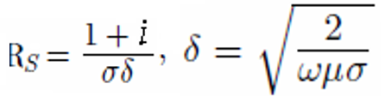
Acceleration and focusing of charged particles in electromagnetic field
Electromagnetic fields in RF cavities are described by Maxwell equations:
Harmonic oscillations:
For vacuum:
Boundary conditions on the conductive wall:
For normal-conducting metal:
- skin depth

Slide 24





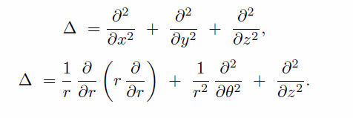
Acceleration and focusing of charged particles in electromagnetic field
From Maxwell equations:
For or
Same for magnetic field:
Cartesian
Cylindrical

Slide 25
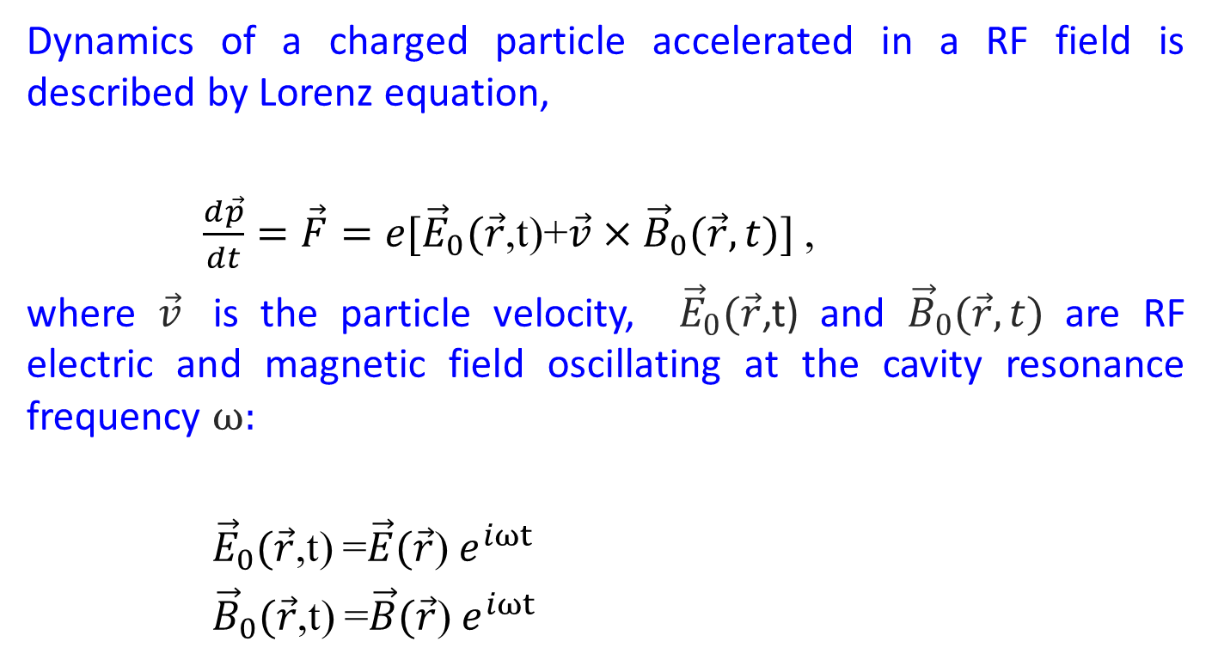
Acceleration and focusing of charged particles in electromagnetic field
Dynamics of a charged particle accelerated in a RF field is described by Lorenz equation,
$\frac{d\vec{p}}{dt}=\vec{F}=e[{\vec{E}}_{0}(\vec{r}$,t)+$\vec{v}×{\vec{B}}_{0}(\vec{r},t)]$,
where $\vec{v}$ is the particle velocity, ${\vec{E}}_{0}(\vec{r}$,t) and ${\vec{B}}_{0}(\vec{r},t)$ are RF electric and magnetic field oscillating at the cavity resonance frequency ω:
${\vec{E}}_{0}(\vec{r}$,t) =$\vec{E}(\vec{r}$)$e^{iωt}$
${\vec{B}}_{0}(\vec{r}$,t) =$\vec{B}(\vec{r}$)$e^{iωt}$

Slide 26
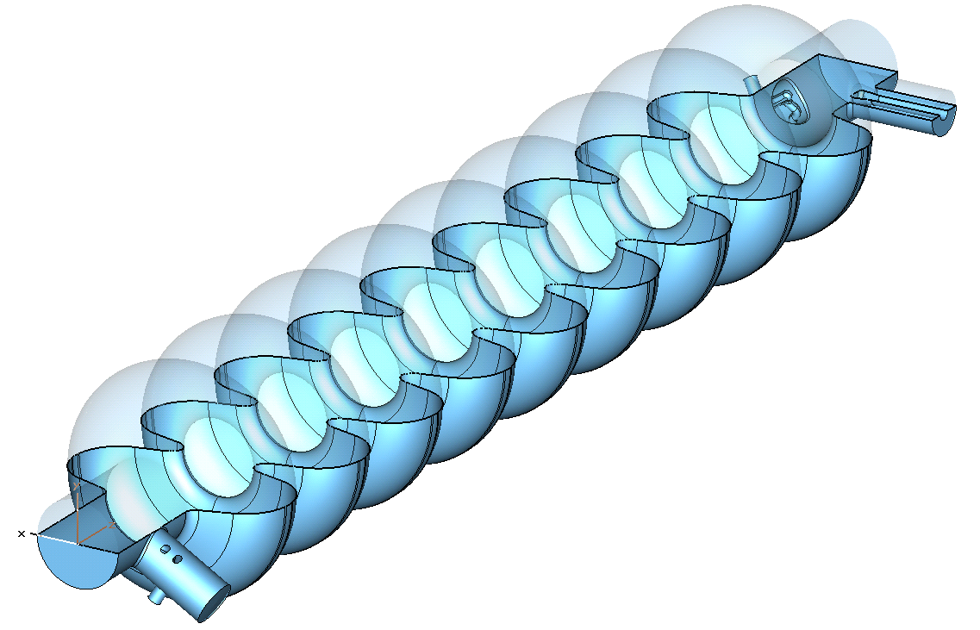
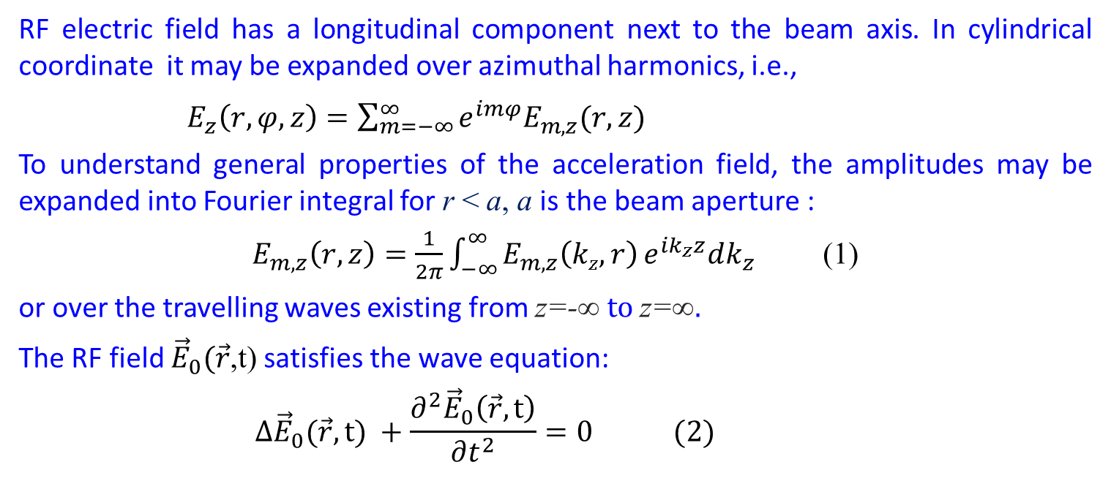
Acceleration and focusing of charged particles in electromagnetic field
RF electric field has a longitudinal component next to the beam axis. In cylindrical coordinate it may be expanded over azimuthal harmonics, i.e.,
$E_{z}\left(r,φ,z\right)=\sum_{m=−∞}^{∞}{e^{imφ}E_{m,z}(r,z)}$
To understand general properties of the acceleration field, the amplitudes may be expanded into Fourier integral for r < a, a is the beam aperture :
$E_{m,z}\left(r,z\right)=\frac{1}{2π}\int_{−∞}^{∞}{E_{m,z}\left(kz,r\right)}e^{ik_{z}z}dk_{z}$(1)
or over the travelling waves existing from z=-∞ to z=∞.
The RF field ${\vec{E}}_{0}(\vec{r}$,t) satisfies the wave equation:
$$∆{\vec{E}}_{0}(\vec{r},t) +\frac{∂^{2}{\vec{E}}_{0}\left(\vec{r},t\right)}{∂t^{2}}=0 (2)$$
|E_{0,z}(0,z)|
XFEL 9-cell 1.3 GHz SW cavity

Slide 27
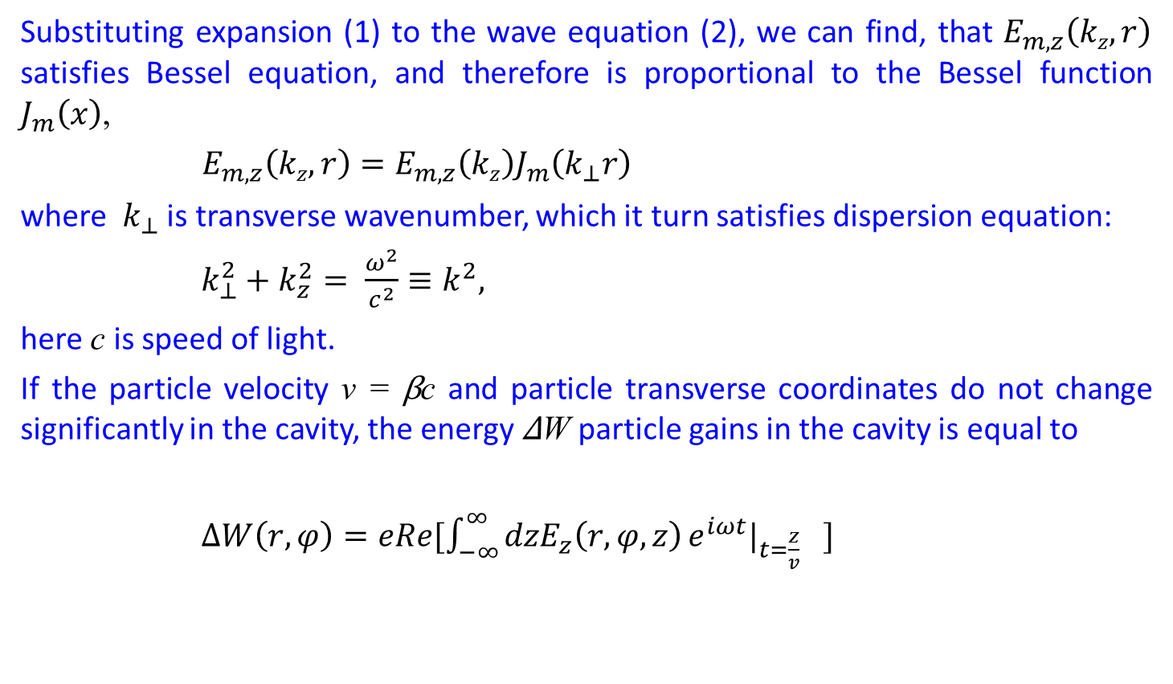
Acceleration of charged particles in electromagnetic field
Substituting expansion (1) to the wave equation (2), we can find, that $E_{m,z}\left(kz,r\right)$ satisfies Bessel equation, and therefore is proportional to the Bessel function $J_{m}\left(x\right)$,
$E_{m,z}\left(kz,r\right)=E_{m,z}\left(kz\right)J_{m}\left(k_{⊥}r\right)$
where $k_{⊥}$ is transverse wavenumber, which it turn satisfies dispersion equation:
$k_{⊥}^{2}+k_{z}^{2}= \frac{ω^{2}}{c^{2}}≡k^{2},$
here c is speed of light.
If the particle velocity v = βc and particle transverse coordinates do not change significantly in the cavity, the energy ΔW particle gains in the cavity is equal to
$ΔW\left(r,φ\right)=eRe[\int_{−∞}^{∞}{{dzE}_{z}\left(r,φ,z\right)}e^{iωt}|_{t=\frac{z}{v}} ]$

Slide 28
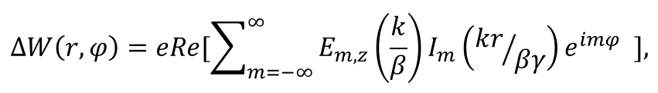
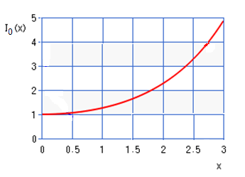
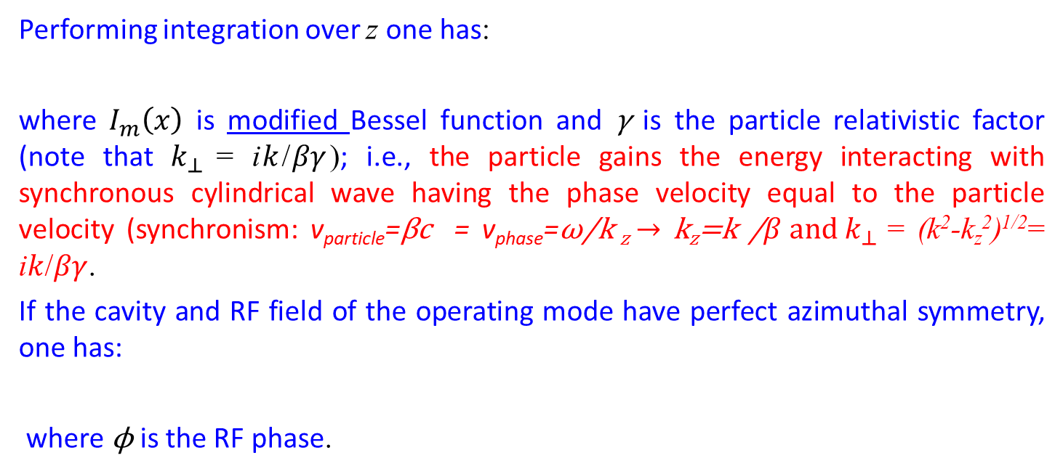
Acceleration of charged particles in electromagnetic field
Performing integration over z one has:
where $I_{m}\left(x\right)$ is modified Bessel function and γ is the particle relativistic factor (note that $k_{⊥ }$= i$k$/$βγ$); i.e., the particle gains the energy interacting with synchronous cylindrical wave having the phase velocity equal to the particle velocity (synchronism: v_{particle}=βc = v_{phase}=ω/k _{z} → k_{z}=k /${β and k}_{⊥ }$= (k²-k_{z}²)^{1/2}= i$k$/$βγ$.
If the cavity and RF field of the operating mode have perfect azimuthal symmetry, one has:
where ϕ is the RF phase.

Slide 29
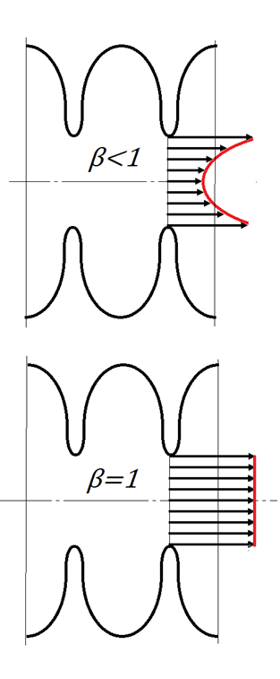
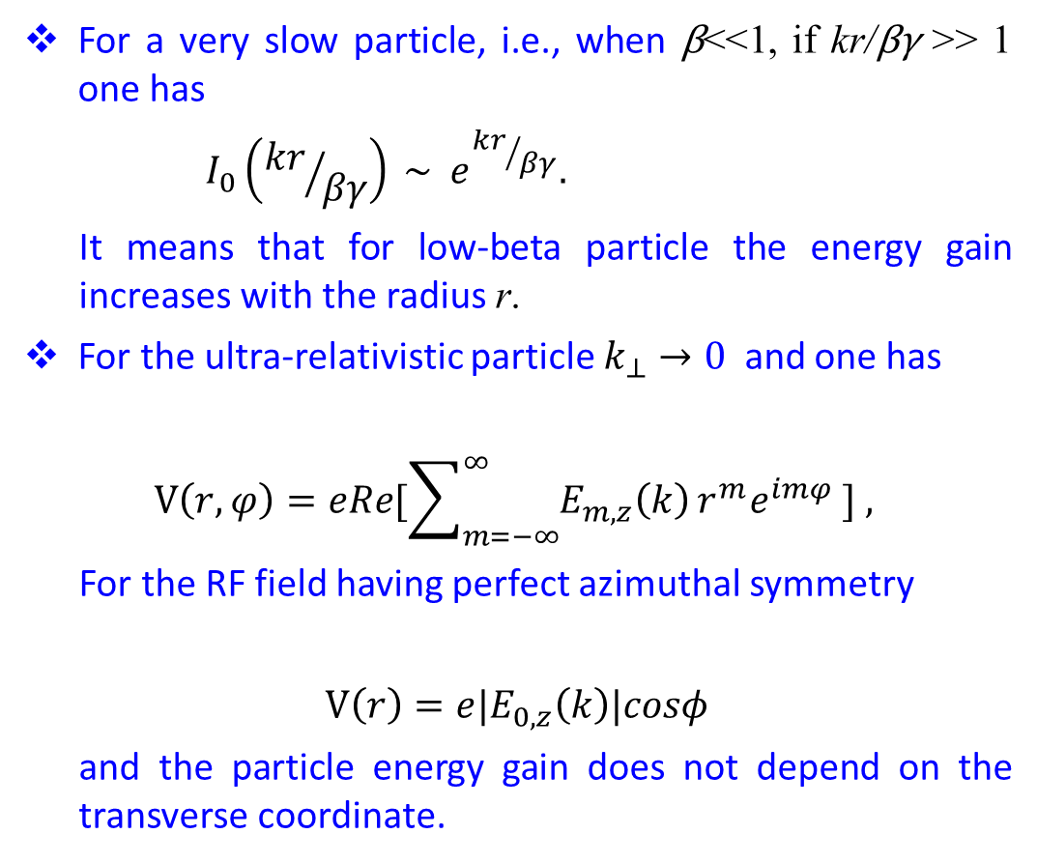
Acceleration of charged particles in electromagnetic field
For a very slow particle, i.e., when β<<1, if kr/βγ >> 1 one has
$$I_{0}\left({kr}/{βγ}\right) \sim e^{{kr}/{βγ}}.$$
It means that for low-beta particle the energy gain increases with the radius r.
For the ultra-relativistic particle $k_{⊥}→0$ and one has
$$V\left(r,φ\right)=eRe[\sum_{m=−∞}^{∞}{E_{m,z}\left(k\right)}r^{m}e^{imφ} ] ,$$
For the RF field having perfect azimuthal symmetry
$$V\left(r\right)=e{|E}_{0,z}\left(k\right)|cosφ$$
and the particle energy gain does not depend on the transverse coordinate.

Slide 30
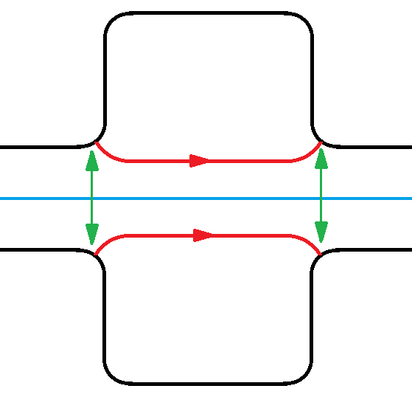
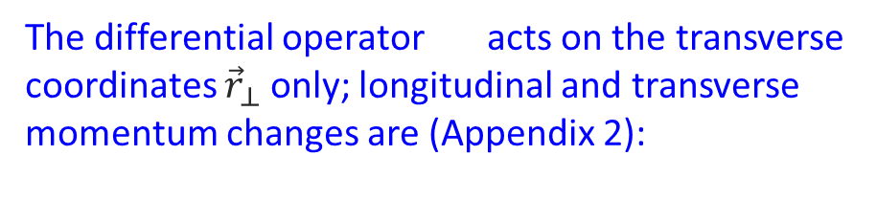
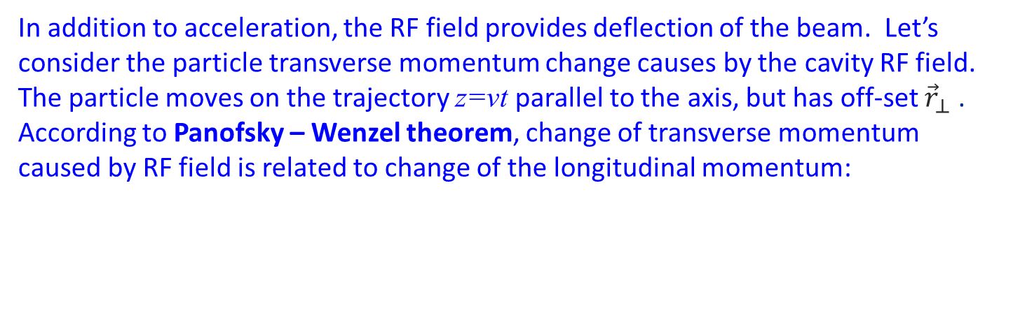
Focusing properties of RF field
In addition to acceleration, the RF field provides deflection of the beam. Let’s consider the particle transverse momentum change causes by the cavity RF field. The particle moves on the trajectory z=vt parallel to the axis, but has off-set ${\vec{r}}_{⊥}$ .
According to Panofsky – Wenzel theorem, change of transverse momentum caused by RF field is related to change of the longitudinal momentum:
output
lens
input lens
The differential operator acts on the transverse coordinates ${\vec{r}}_{⊥}$ only; longitudinal and transverse momentum changes are (Appendix 2):
No acceleration → no deflection!

Slide 31
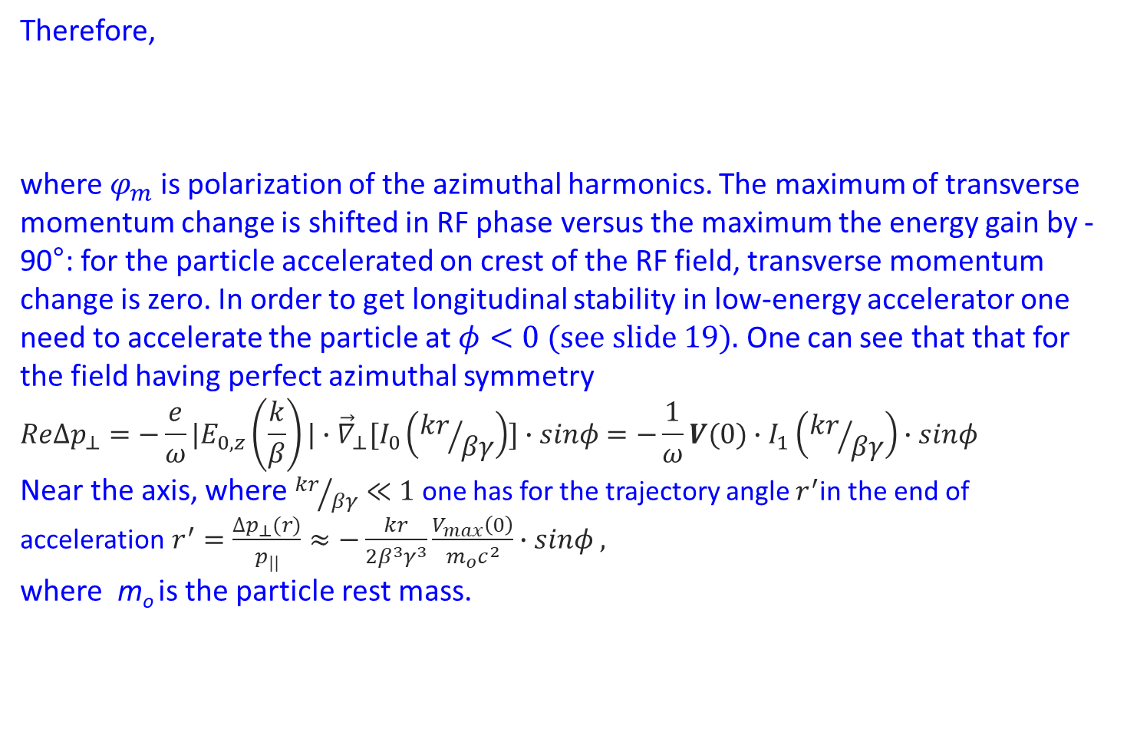
Focusing properties of RF field
Therefore,
where $φ_{m}$is polarization of the azimuthal harmonics. The maximum of transverse momentum change is shifted in RF phase versus the maximum the energy gain by -90°: for the particle accelerated on crest of the RF field, transverse momentum change is zero. In order to get longitudinal stability in low-energy accelerator one need to accelerate the particle at $φ<0 (see slide 19).$ One can see that that for the field having perfect azimuthal symmetry
$$ReΔp_{⊥}=−\frac{e}{ω}{|E}_{0,z}\left(\frac{k}{β}\right)|∙{\vec{∇}}_{⊥}[I_{0}\left({kr}/{βγ}\right)]∙sinφ=−\frac{1}{ω}V(0)∙I_{1}\left({kr}/{βγ}\right)∙sinφ$$
Near the axis, where ${kr}/{βγ}≪1$ one has for the trajectory angle $r^{′}$in the end of acceleration $r^{′}=\frac{∆p_{⊥}(r)}{p_{||}}≈−\frac{kr}{2β^{3}γ^{3}}\frac{V_{max}\left(0\right)}{m_{o}c^{2}}∙sinφ ,$
where m_{o} is the particle rest mass.
$$ReΔp_{⊥}=−\frac{e}{ω}\sum_{m=−∞}^{∞}{{|E}_{m,z}\left(\frac{k}{β}\right)}|∙{\vec{∇}}_{⊥}[I_{m}\left({kr}/{βγ}\right)∙cos\left(m\left(φ−φ_{m}\right)\right)]∙\sin{φ }$$

Slide 32
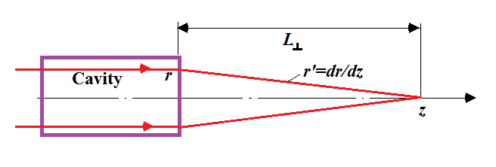
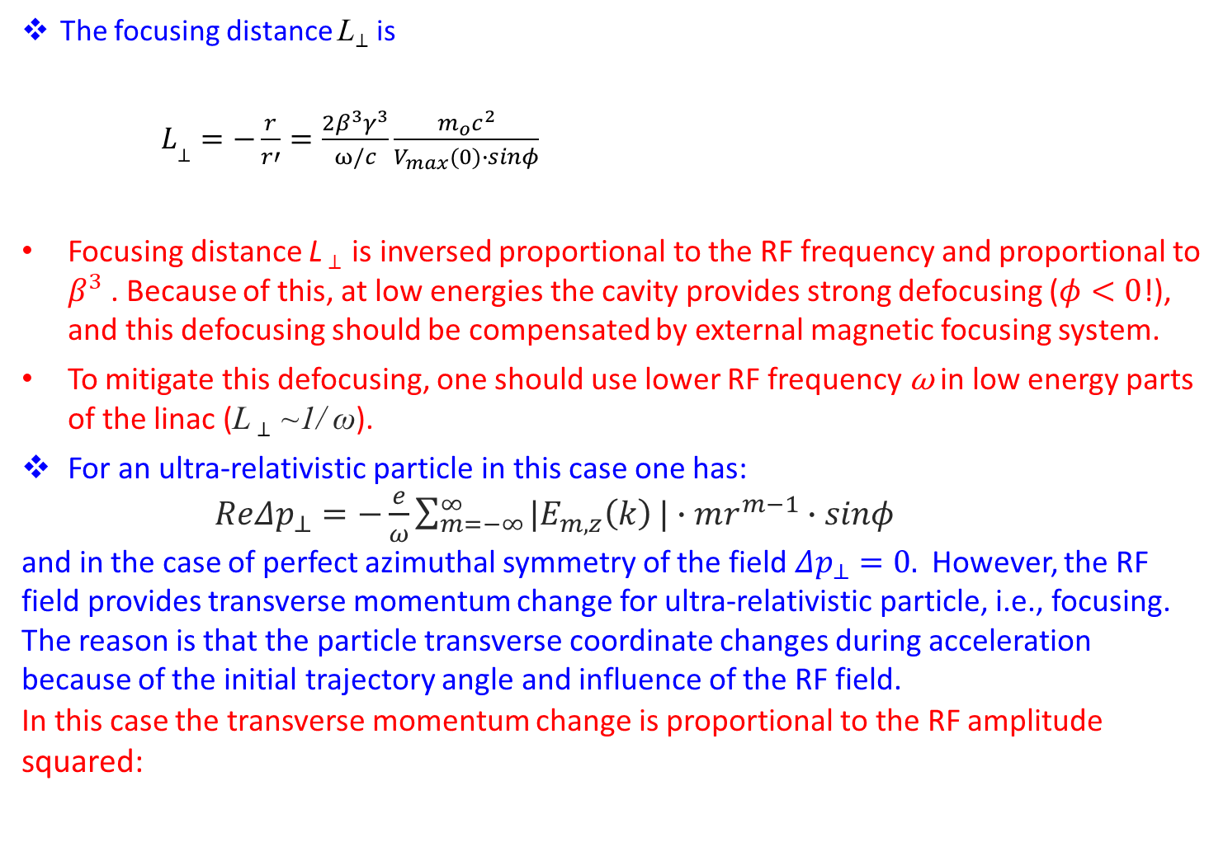
Focusing properties of RF field
The focusing distance L⊥ is
$L_{\text{⊥}}=−\frac{r}{r′}=\frac{2β^{3}γ^{3}}{ω/c}\frac{m_{o}c^{2}}{V_{max}(0)∙sinφ}$
Focusing distance L ⊥ is inversed proportional to the RF frequency and proportional to $β^{3}$ . Because of this, at low energies the cavity provides strong defocusing ($φ<0$!), and this defocusing should be compensated by external magnetic focusing system.
To mitigate this defocusing, one should use lower RF frequency ω in low energy parts of the linac (L ⊥ ~1/ ω).
For an ultra-relativistic particle in this case one has:
$ReΔp_{⊥}=−\frac{e}{ω}\sum_{m=−∞}^{∞}{{|E}_{m,z}\left(k\right)}|∙mr^{m−1}∙sinφ$
and in the case of perfect azimuthal symmetry of the field $Δp_{⊥}=0.$ However, the RF field provides transverse momentum change for ultra-relativistic particle, i.e., focusing. The reason is that the particle transverse coordinate changes during acceleration because of the initial trajectory angle and influence of the RF field.
In this case the transverse momentum change is proportional to the RF amplitude squared:

Slide 33
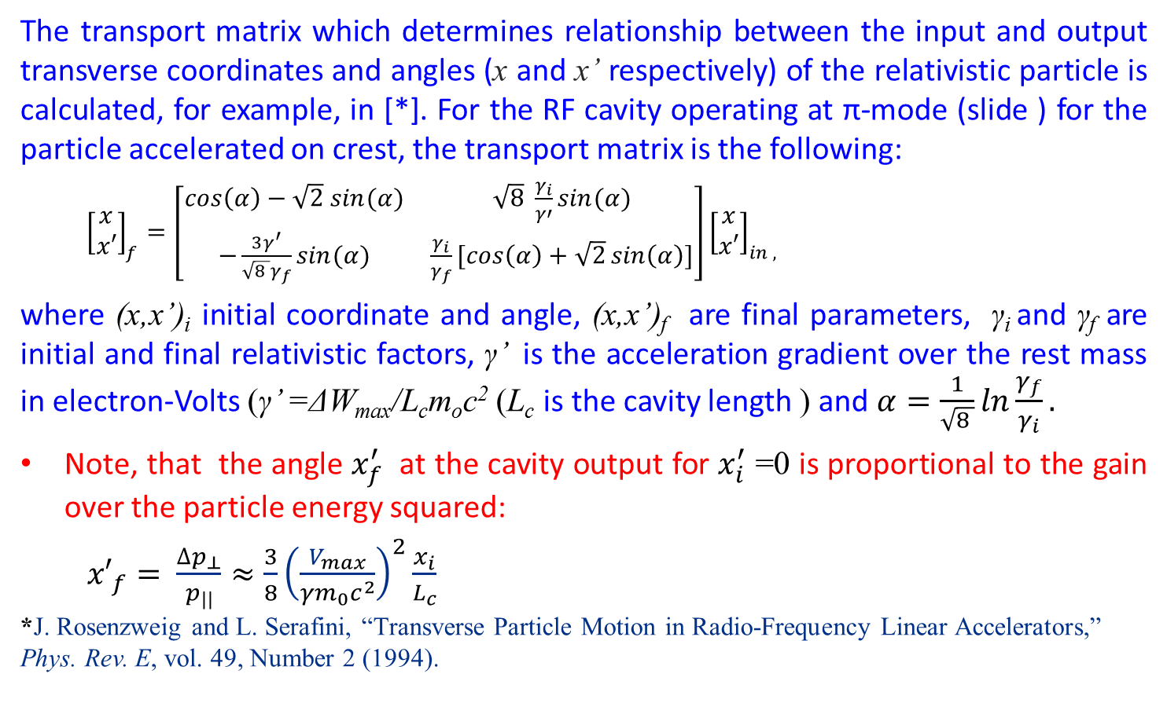
Focusing properties of RF field
The transport matrix which determines relationship between the input and output transverse coordinates and angles (x and x’ respectively) of the relativistic particle is calculated, for example, in [*]. For the RF cavity operating at π-mode (slide ) for the particle accelerated on crest, the transport matrix is the following:
${\left[\begin{aligned}x \\ x′\end{aligned}\right]}_{f}=\left[\begin{matrix}\cos\left(α\right)−\sqrt{2} sin⁡(α) & \sqrt{8} \frac{γ_{i}}{γ′}sin⁡(α) \\ −\frac{3γ^{′}}{\sqrt{8 }γ_{f}}sin⁡(α) & \frac{γ_{i}}{γ_{f}}[\cos\left(α\right)+\sqrt{2}\sin\left(α\right)]\end{matrix}\right]{\left[\begin{aligned}x \\ x′\end{aligned}\right]}_{in ,}$
where (x,x’)_{i} initial coordinate and angle, (x,x’)_{f} are final parameters, γ_{i} and γ_{f} are initial and final relativistic factors, γ’ is the acceleration gradient over the rest mass in electron-Volts (γ’ =ΔW_{max}/L_{c}m_{o}c² (L_{c} is the cavity length ) and $α=\frac{1}{\sqrt{8 }}ln\frac{γ_{f}}{γ_{i}}.$
Note, that the angle $x_{f}^{′}$ at the cavity output for $x_{i}^{′}$ =0 is proportional to the gain over the particle energy squared:
${x′}_{f}= \frac{∆p_{⊥}}{p_{||}}≈\frac{3}{8}{\left(\frac{V_{max}}{γm_{0}c^{2}}\right)}^{2}\frac{x_{i}}{L_{c}}$
*J. Rosenzweig and L. Serafini, “Transverse Particle Motion in Radio-Frequency Linear Accelerators,” Phys. Rev. E, vol. 49, Number 2 (1994).

Slide 34
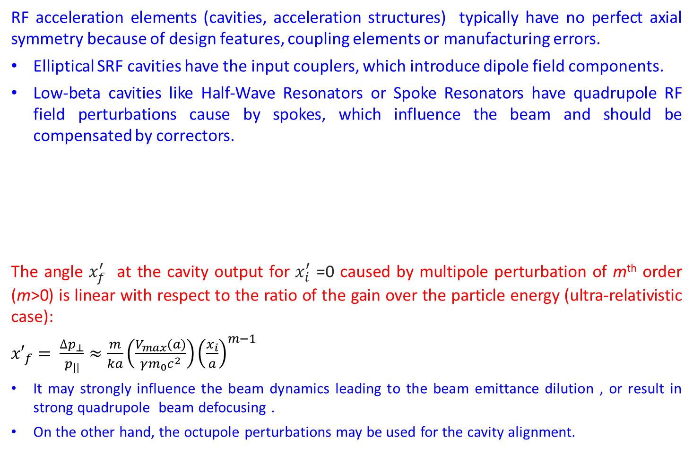
Focusing properties of RF field
RF acceleration elements (cavities, acceleration structures) typically have no perfect axial symmetry because of design features, coupling elements or manufacturing errors.
Elliptical SRF cavities have the input couplers, which introduce dipole field components.
Low-beta cavities like Half-Wave Resonators or Spoke Resonators have quadrupole RF field perturbations cause by spokes, which influence the beam and should be compensated by correctors.
The angle $x_{f}^{′}$ at the cavity output for $x_{i}^{′}$ =0 caused by multipole perturbation of m^{th} order (m>0) is linear with respect to the ratio of the gain over the particle energy (ultra-relativistic case):
${x′}_{f}= \frac{∆p_{⊥}}{p_{||}}≈\frac{m}{ka}\left(\frac{V_{max}(a)}{γm_{0}c^{2}}\right){\left(\frac{x_{i}}{a}\right)}^{m−1}$
It may strongly influence the beam dynamics leading to the beam emittance dilution , or result in strong quadrupole beam defocusing .
On the other hand, the octupole perturbations may be used for the cavity alignment.

Slide 35
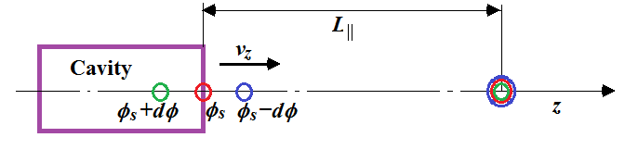
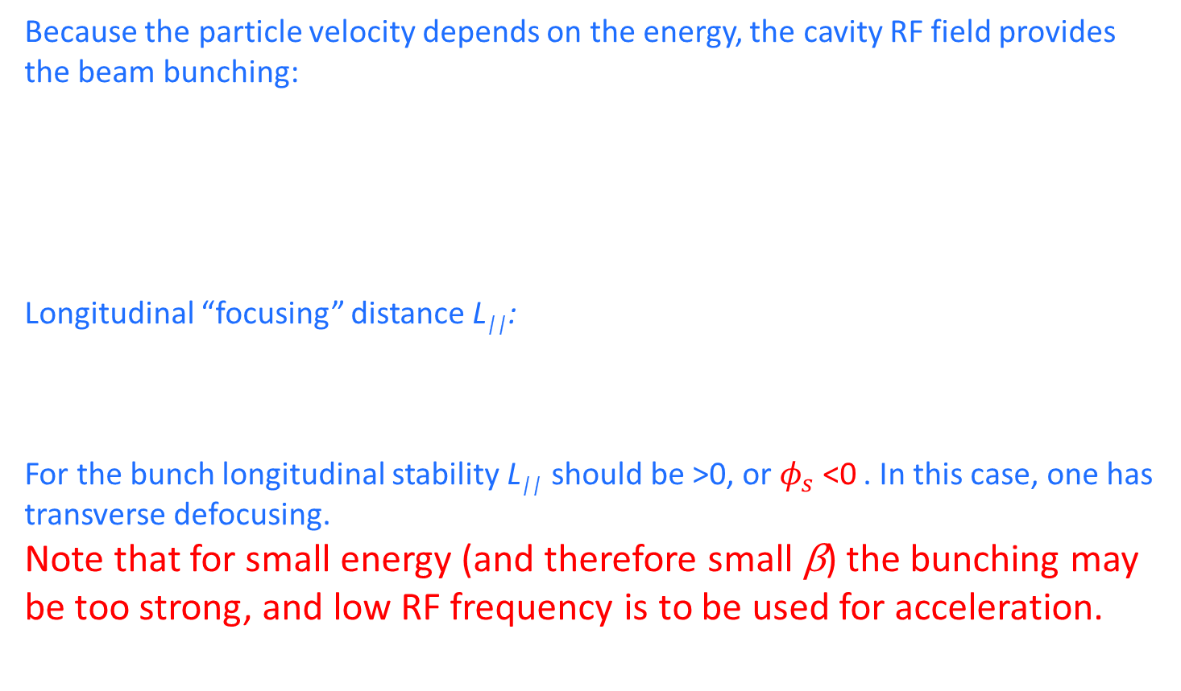
Bunching of charged particles in electromagnetic field
Because the particle velocity depends on the energy, the cavity RF field provides the beam bunching:
Longitudinal “focusing” distance L||:
For the bunch longitudinal stability L|| should be >0, or $φ_{s}$ <0 . In this case, one has transverse defocusing.
Note that for small energy (and therefore small β) the bunching may be too strong, and low RF frequency is to be used for acceleration.
$L_{\text{||}}=−\frac{2β^{3}γ^{3}}{ω/c}\frac{m_{o}c^{2}}{V_{max}(0)∙sinφ_{s}}=−\frac{1}{2}$ $L_{\text{⊥}}$

Slide 36
Summary:
Acceleration of a charged particle moving in axisymmetric RF field parallel to the axis at the radius r is proportional to I₀(kr/βγ);
- for non-relativistic particle it increases with the radius → for low-energy particles one should use low frequency;
- for ultra-relativistic particle it does not depend on the radius.
Focusing of the accelerating particle is related to acceleration;
- the maximum of transverse momentum change of the non-relativistic particle is shifted in RF phase versus the maximum the energy gain by -90°
- The focusing distance of the non-relativistic particle is propositional to β³γ³λ/V_{max} → for low-energy particles one should use low frequency.

Slide 37
Summary (cont):
- The focusing distance for ultra-relativistic particles is quadratic versus the ratio of particle energy over the voltage.
- The focusing distance for ultra-relativistic particles in multipole fields is linear versus the ratio of particle energy over the voltage; multipole perturbations may strongly affect the beam dynamics.
- The bunching “focusing” distance of the non-relativistic particle is propositional to β³γ³λ/V_{max} → for low-energy particles one should use low frequency. The sign is opposite to the focusing: if the bunch is focused, it is de-bunched, and vice versa. In low-energy accelerators external focusing is necessary!

Slide 38
Chapter 3.
RF Cavities for Accelerators. a. Resonance modes – operation mode, High-Order Modes; b. Pillbox cavity c. Cavity parameters:
- Acceleration gradient;
- R/Q;
- Q₀ and G-factor;
- Shunt Impedance;
- Field enhancement factors (electric and magnetic);
- Transverse impedance. d. Cavity excitation e. Types of the cavities and their application f. Tools for cavity simulations

Slide 39
RF cavity:
ω₀=(LC)^{-1/2}
An LC circuit, the simplest form of RF resonator:
This circuit and a resonant cavity share common aspects:
Energy is stored in the electric and magnetic fields
Energy is periodically exchanged between electric and magnetic field
Without any external input, the stored power will turn into heat
L
C
From LC circuit to an accelerating cavity:
Electric field used for acceleration is concentrated near the axis
Magnetic field is concentrated near the cavity outer wall

Slide 40


Modes in an RF cavity:
where
Boundary conditions
There are an infinite number of orthogonal solutions (eigen modes) with different field structure and resonant frequencies (eigen frequencies).
For acceleration in longitudinal direction the lowest frequency mode having longitudinal electric field component is used.

Slide 41
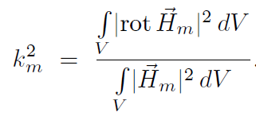

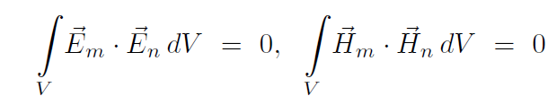

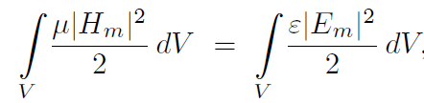

Properties of resonance modes:
Relation between eigen frequency k_{m} and eigen function H_{m}:
The eigen functions are orthogonal
if
The average energies stored in electric and magnetic fields are equal:
The eigenmode variation property: for small cavity deformation one has*:
W₀ us stored energy, ω₀ is the mode cyclic resonance frequency.
*see Appendix 3

Slide 42
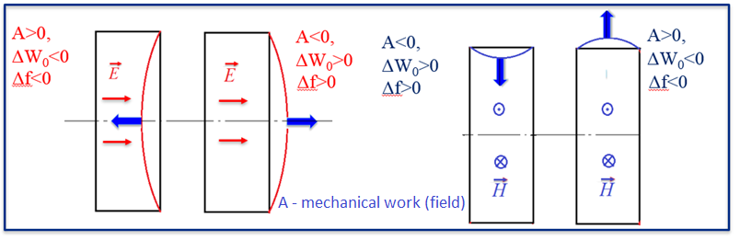
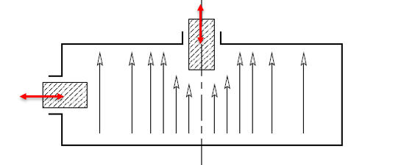
Properties of resonance modes :
Cavity mechanical tuning is based on the eigenmode variation property:

Slide 43
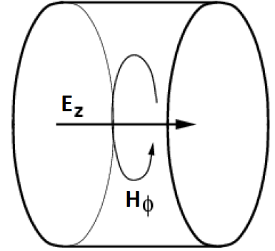
Resonance modes and pillbox cavity:
Most of acceleration cavities have axial symmetry (slightly violated by perturbations – coupling units, manufacturing errors, etc).
The modes in the axisymmetric cavity of arbitrary shape have azimuthal variations, E, H ~exp(imϕ):
-For acceleration TM-modes with m=0 (“monopole”) are used;
-Dipole (m=1) TM-modes are used for the beam deflection.
The simplest cavity is a pillbox one:

Slide 44
Resonance modes and pillbox cavity:
For pillbox cavities there are two families of the eigen modes:
- TM –modes, which have no longitudinal magnetic fields;
TE-modes, which have no longitudinal electric fields.
The modes are classified as TM_{mnp} (TE_{mnp}), where integer indices m, n, and p correspond to the number of variations E_{z} (H_{z}) has in φ, r, and z directions respectively (see Appendix 5).
For “monopole” modes in the axisymmetric cavity of arbitrary shape
- TM-modes have only azimuthal magnetic field component;
- TE –modes have only azimuthal electric field component.
For acceleration, lowest TM-mode is used, which has longitudinal electric filed on the axis.

Slide 45
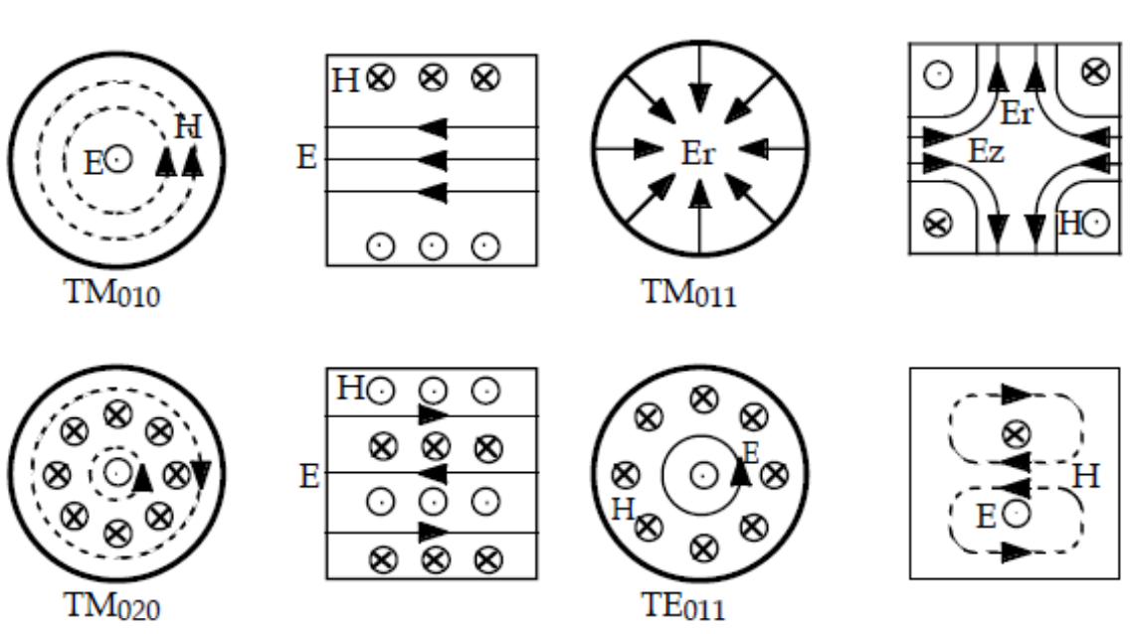
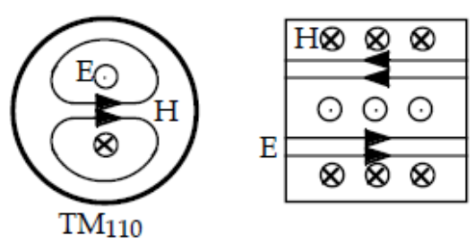

Resonance modes and pillbox cavity:
Modes with m=0 (“monopole modes”)
Modes with m=1 (dipole modes)

Slide 46


Modes in a pillbox RF cavity:
While TM₀₁₀ mode is used for acceleration and usually is the lowest frequency mode, all other modes are “parasitic” as they may cause various unwanted effects. Those modes are referred to as High-Order Modes (HOMs). Modes with m=0 – “monopole”, with m=1 – “dipole”, etc.
b
d
Note that electric and magnetic fields are shifted by 90 deg.
For vacuum Z₀=120π Ohms; b is the pillbox radius, d is its length.

Slide 47



Accelerating voltage and transit time factor:
Assuming charged particles moving along the cavity axis, and the particle velocity change is small, one can calculate maximal accelerating voltage V as
b
a
For the pillbox cavity one can integrate this analytically:
where T is the transit time factor,

Slide 48


Acceleration gradient
T
E_{z}(t)
ψ
entrance
exit
ωt/π
Cavity center
ψ/π
Note that maximal acceleration takes place when the RF field reaches maximum went the particle is the cavity center.
In order to “use” all the field for acceleration , ψ=π (or d = βλ/2) and T = 2/π for the pill box cavity.
λ = 2π c/ω₀ – wavelength.
Acceleration gradient E is defined as E=V/d=E₀T

Slide 49




RF cavity parameters:
Stored energy U:
Losses in the cavity. There are the losses P_{c} in a cavity caused by finite surface resistance R_{s}:
For normal conducting metal at room temperature (no anomalous skin effect)
where σ is conductivity and δ is skin depth,
Example:
For copper at room temperature σ=59.6 MS/m; R_{s}= 9.3 mOhm@1.3 GHz
Simple formula for estimation: δ = 0.38· (30/f(GHz))^{1/2} [mkm]

Slide 50



RF cavity parameters:
Unloaded quality factor Q₀:
Quality factor Q₀ roughly equals to the number or RF cycles times 2π necessary for the stored energy dissipation.
One can see that
where G is so-called geometrical factor (same for geometrically similar cavities),

Slide 51




RF cavity parameters:
For a pillbox cavity:
and
ψ/π

Slide 52


RF cavity parameters:
For a room-temperature pillbox cavity
For pillbox having ψ=π and β=1 (d = λ/2 = π b/2.405), G =257 Ohms.
Therefore, 1.3 GHz RT copper pillbox cavity has Q₀ = 2.6e4.
For 1.3 GHz SRF Nb cavity at 2K one has Q₀ = 3e10 (R_{s}= 8.5 nOhm).
For geometrically similar RT cavities Q₀ scales as f^{-1/2} or λ^{1/2}!

Slide 53









RF cavity parameters:
Estimation of the unloaded Q₀ for an arbitrary room-temperature cavity:
Taking into account that one has:
One may introduce the average surface and volume fields:
for accelerating mode A~1
For convex figures V/S ~a_{av}/6 (cube: V/S=a/6. sphere: V/S=2R/6) and
Note, that , , , and
,

Slide 54



RF cavity parameters:
An important parameter is the cavity shunt impedance R, which determines relation between the cavity accelerating voltage V and power dissipation:
Another important parameter is (R/Q), which is necessary to estimate the mode excitation by the accelerated beam. It does not depend on the surface resistance and is the same for geometrically similar cavities:
Note, that sometimes they use a “circuit definition:

Slide 55



RF cavity parameters:
For a pillbox cavity:
and
For pillbox having ψ=π and β=1 (d=λ/2=π b/2.405), R/Q =196 Ohms.
R/Q is maximal for for ψ≈2π/3.
ψ/π

Slide 56


RF cavity parameters:
The power loss in the cavity walls is
Therefore, the losses are determined by G·R/Q.
For pillbox:
ψ/π
G·R/Q is maximal for ψ≈0.9π

Slide 57
RF cavity parameters:
Gradient limitations are determined by surface fields:
RT cavities:
-breakdown (determined mainly by E_{peak})
-metal fatigue caused by pulsed heating (determined by B_{peak})
SRF cavities:
-quench (determined by B_{peak})
Field enhancement factors:
Surface electric field enhancement: K_{e} = E_{peak}/E, E_{peak} is maximal surface electric field. K_{e} is dimensionless parameter.
Surface magnetic field enhancement: K_{m} = B_{peak}/E, B_{peak} is maximal surface magnetic field. K_{m} is in mT/(MeV/m)
Here E is acceleration gradient.

Slide 58
RF cavity parameters:
Field enhancement factors – example:
9-cell TESLA structure
K_{e} = E_{peak}/E =2;
K_{m} = B_{peak}/E=4.16 mT/MV/m
Geometry of an inner half-cell of a multi-cell cavity and field distribution along the profile line.

Slide 59


RF cavity parameters:
For a pillbox cavity:
Surface electric field enhancement: K_{e} = E_{peak}/E =1/T (ψ)
(E_{peak}=E₀, E= E₀ T(ψ), see slide 29)
Surface magnetic field enhancement: K_{m} = B_{peak}/E =
= 1.94/T(ψ) [mT/(MeV/m)]
(B_{peak} = E₀·J₁(2.405r/b)_{max} /c = 0.582E₀ /c, see slide 29)
K_{e}
K_{m},mT/(MeV/m)
ψ/π
ψ/π

Slide 60




The cavity coupled to the line:
Let’s consider the cavity coupled to the feeding line.
If the incident wave is zero (i.e., if the RF source is off), the loss in the cavity is a sum of the wall P₀ loss and the loss coasted by the radiation to the line P_{ext}:
Where we have defined an external quality factor associated with an input coupler. Such Q factors can be identified with all external ports on the cavity: input coupler, RF probe, HOM couplers, beam pipes, etc. The total power loss can be associated with the loaded Q factor, which is

Slide 61




Coupling parameter:
For each port a coupling parameter β can be defined as
and, therefore,
It tells us how strongly the couplers interact with the cavity. Large implies that the power leaking out of the coupler is large compared to the power dissipated in the cavity walls:
In order to maintain the cavity voltage, the RF source should compensate both wall loss and radiation to the line. Therefore, the RF source should deliver the power to the cavity which is

Slide 62


Cavity excited by the beam*:
If the cavity is excited by the beam with the average current I having the bunches separated by the length equal to integer number of RF periods, i.e, in resonance, the excited cavity voltage provides maximal deceleration. The beam power loss is equal to the cavity loss, i.e., radiation and wall loss:
$−VI=\frac{V^{2}}{\left(\frac{R}{Q}\right)Q_{L}}$ (1)
or
$$V=−I\left(\frac{R}{Q}\right)Q_{L}$$
The cavity excited by the beam off the resonance, the
voltage is $V≈−\frac{I\left(\frac{R}{Q}\right)Q_{L}}{1+iQ_{L}\frac{2∆f}{f}}$
where Δf is the distance between the beam spectrum
line and the cavity resonance frequency f.
Cavity bandwidth:
δf =f/Q_{L};
For the acceleration voltage V and the beam current I the cavity
should have (see (1)) Q_{L} = V/[I(R/Q)] and the bandwidth δf =f·I(R/Q)/V
*Appendix 6
L=(R/Q)/2ω;
C=2/ω(R/Q);
R= (R/Q)Q_{L}/2;
ω =2πf

Slide 63

Cavity operating in pulse regime:
Coupling element
Energy conservation law:
dW/dt = P₀ –P_{backward} – P_{diss} - P_{beam}
P₀ = Y⋅E₀² ; P_{backward} = Y⋅(E₀ - E_{rad})², β = P_{rad}/P_{diss}, P_{rad} = Y⋅E_{rad}, P_{beam} =V(t)I
W=V²/(R/Q)ω; τ=2Q_{L}/ω.
If β>>1 and Q_{L}=V/(R/Q)I:
RF on:
dV/dt=(2V-V(t))/τ, filling, no beam, V(t)=2V(1-exp(-t/τ)); t_{f}= τln2
dV/dt=(V-V(t))/τ, acceleration, the beam is on, V(t)=V;
RF is off:
dV/dt=-V(t)/τ, the cavity discharge, V(t)=Vexp(-t/τ).

Slide 64


High-Order Modes in cavities:
Possible issues:
Trapped modes;
Resonance excitation of HOMs;
Collective effects:
Transverse (BBU) and longitudinal (klystron-type instability) in linear accelerators;
Additional losses;
Emittance dilution (longitudinal and transverse)
Beam current limitation.
x
E
Beam
Longitudinal modes;
Transverse modes.
HOM dampers;
x
x
y
Beam
Near axis: E_{z}~x, E_{x} ~ const, H_{y} ~ const

Slide 65

High-Order Modes in cavities:
Longitudinal modes:
V_{HOM} = I_{beam}·R_{HOM}, Longitudinal impedance: R_{HOM}=(R/Q)_{HOM}·Q_{ext}
Design of the cavities with small R/Q (poor beam-cavity interaction)
HOM dampers – special coupling elements connected to the load (low Q_{ext}) .
LHC main cavity LHC HOM coupler, Q_{ext} <200
Long wide waveguides between the cavity cells: for most “dangerous” modes
HOMs propagate in the WGs and interact with the beam;
No synchronism in the WGs (phase velocity >speed of light) → reduced R/Q_{HOM} for HOMs

Slide 66







High-Order Modes in cavities:
Transverse modes:
The beam interacts with the longitudinal component of the HOM electric field and provides transverse kick. For axisymmetric cavity for dipole TM-mode longitudinal field is proportional to the transverse coordinate next to the cavity axis.
Let’s consider a cavity excited by a beam current I₀ having offset x₀. The kick caused by the dipole mode excited by the beam*:
where
is transverse impedance, k= ω₀/c and - stored energy.
Compare to “longitudinal” (R/Q):
β=1 is considered.
Note that $\left(\frac{r_{⊥}}{Q}\right)$ is measured in Ohm/m.
*Note that sometimes they use other transverse impedance, that is determined as:
In this case, ; ${ , \left(\frac{r_{⊥}}{Q}\right)}_{1}$ is measured in Ohm.
*Appendix 7

Slide 67

RF cavity types
Pillbox RT cavities:
2b
Drift tubes
T improvement
Rounding
R_{sh} improvement
Pillbox with the beam pipes
2b⪞ 3/4λ

Slide 68










RF cavity types
One-gap QWR
Quarter-wave resonator (QWR)
concept:
Resonance:
or
Compact (L ⪝ λ/4) compared to pillbox (D⪞ 3/4λ).
Z₀ here is the coaxial impedance
λ/2
Two-gap QWR
Half-wave resonator (HWR)

Slide 69
Summary:
To create acceleration RF field, resonance RF cavities are used;
The cavities typically have axisymmetric field distribution near the beam axis. Most of cavities have geometry close to axisymmetric.
There are infinite number of resonance modes in an RF cavity having different radial, azimuthal and longitudinal variations. The modes are orthogonal;
In axisymmetric cavities there are two types of modes, TM and TE;
For acceleration, TM₀₁₀ mode is used, which has axial electric field on the axis.
Other modes, HOMs, are parasitic, which may caused undesirable effects.

Slide 70
Summary (cont):
The cavity mode is characterized by the following parameters:
Resonance frequency;
Acceleration gradient (energy gain/cavity length);
Unloaded quality factor, Q₀ , which characterize the losses in the cavity;
G-factor, which relates Q₀ and surface resistance;
(R/Q), which relates the acceleration voltage and the energy stored in the cavity;
Shunt impedance R, which relates the gain and total losses in the cavity;
Electric and magnetic field enhanced factors, which relate maximal surface fields and the acceleration gradient;
Dipole modes are characterized by transverse impedance, (r⊥/Q), which relates transverse kick and stored energy.
Coupling to the feeding line, β (do not mix with the relative particle velocity)
External Q, Q_{ext}
Loaded Q, Q_{load}

Slide 71
Chapter 4.
Periodic acceleration structures. a. Coupled cavities and periodic structure; b. Travelling waves in a periodic structure; c. Dispersion curve; d. Phase and group velocities; e. Parameters of the TW structures; f. Equivalent circuit for a travelling – wave structure; g. Losses in the TW structure; h. Types of the TW structures; i. Examples of modern TW structures.

Slide 72

Periodic acceleration structures:
Single – cell cavities are not convenient to achieve high acceleration: a lot of couplers, tuners, etc.
Especially it is important for electron
acceleration:
R_{sh} = R/Q·Q₀ ~ ω^{1/2}, low Ohmic losses at high frequency;
v=c, focusing is quadratic and does not depend on frequency (see Lecture 5,
slide 24).
high frequencies are preferable (typically up to few tens of GHz).
small cavity size, ~ 1 cm for RT, ~20 cm for SRF
periodic structure of coupled cells.
cells
beam
coupling holes
To provide synchronism with the accelerated particle, the particle velocity v_{p}=βc=v_{ph}=ω/ k_{z} and the structure period d = φ/k_{z}= φλ/(2πβ); φ is phase advance per period, φ= k_{z}d.

Slide 73






Periodic acceleration structures:
Each previous cell excites EM filed in a current cell, which in turn excites the field in the next cell.
Pillbox cells with thin walls
- field in the j^{th} cell;
- eigen function
- synchronism
where K is the coupling, dimensionless parameter:
d
$${\vec{E}}_{j}=X_{j}{\vec{E}}_{0}$$
2a
$${\vec{E}}_{0}$$
(1)
j-3 j-2 j-1 j j+1 j+2 j+3

Slide 74




Periodic acceleration structures:
$${\vec{E}}_{j}=X_{j}{\vec{E}}_{0}$$
Why?
Excitation of a cavity by surface electric field:
$$X_{j}=\frac{\int_{S_{j−1}}{K_{j−1}H_{φ0}dS}}{W\left(1−\frac{ω_{0}^{2}}{ω^{2}}\right)}+\frac{\int_{S_{j}}{K_{j}H_{φ0}dS}}{W\left(1−\frac{ω_{0}^{2}}{ω^{2}}\right)}$$
Here K is “magnetic” current* on the aperture, $K_{j}=E_{rj}$.
$div\vec{E}=0 →i$n paraxial approximation $E_{r}=−\frac{r}{2}\frac{∂E_{z}}{∂z}$ $→K_{j−1}≈\frac{rE_{z0}}{4a}\left(X_{j}−X_{j−1}\right)$;
$\int_{S_{j−1}}{K_{j−1}H_{φ0}dS}=\frac{1}{2}K\frac{ω_{0}^{2}}{ω^{2}}\left(X_{j}−X_{j−1}\right),$ K depending on the aperture as a³
($E_{z0}$does not depend on $r$, $H_{φ0}\sim r, and \int_{S_{j−1}}{K_{j−1}H_{φ0}dS}\sim a^{3}$). Therefore,
$X_{j}\left(1−\frac{ω_{0}^{2}}{ω^{2}}\right)−\left(K\frac{ω_{0}^{2}}{ω^{2}}X_{j}−\frac{1}{2}K\frac{ω_{0}^{2}}{ω^{2}}X_{j−1}−\frac{1}{2}K\frac{ω_{0}^{2}}{ω^{2}}X_{j+1}\right)=0$, or
$$X_{j}\left(1−(1+K)\frac{ω_{0}^{2}}{ω^{2}}\right)+\frac{1}{2}K\frac{ω_{0}^{2}}{ω^{2}}=0$$
*Surface electric current density is $\vec{J}=\vec{H}×\vec{n}$; surface magnetic current density is $\vec{K}=\vec{E}×\vec{n}$
(Exact derivation is in the Appendix 8)

Slide 75








Periodic acceleration structures
Equivalent circuit:
Note that the electrodynamics in the periodic structure is described by the equivalent circuit
For j^{th} cell we have from Kirchhoff theorem:
For the capacity voltage we have the same equation as for EM model:
Here

Slide 76






Periodic acceleration structures:
In the infinite chain of cavities equation (1) has solution (travelling wave):
and
For small K we have:
One can see that

Slide 77





Periodic Travelling–Wave acceleration structure:
P_{in} =P_{ref} +P_{out} + P_{loss} +P_{beam}
P_{in} << P_{out}
Aperture has elliptical shape to minimize surface electric field
HOM dampers
Input waveguide
Tuning
channels
Coupling iris
Acceleration cell
Acceleration cells
Beam pipe
Acceleration cells
NLC structure with
HOM damping

Slide 78

Travelling–Wave acceleration structures :
In the arbitrary infinitely long periodic structure, or in the finite structure matched on the ends, there are travelling waves (TW) having arbitrary phase shift per cell φ. Longitudinal wavenumber, therefore, is k_{z}= φ/d. Dispersion equation is the same:
$$ω(k_{z})≈ω_{π/2}\left(1−\frac{K}{2}cos(φ)\right)=ω_{π/2}\left(1−\frac{K}{2}cos(k_{z}d)\right)$$
Therefore, the phase velocity v(φ) is:
$$vph\left(φ\right)=\frac{ω\left(k_{z}\right)}{k_{z}}=c\frac{2πd}{φλ}$$
For acceleration of the particle having velocity $vp$=βc, the cavity cell length d should be equal to
$$d=\frac{βλφ}{2π},$$
because for synchronism we need $vp$= $vph$
For example, for φ = π the cell should have the length of βλ/2.

Slide 79

Travelling–Wave acceleration structures :
The group velocity v_{gr}(φ) is
${ v}_{gr}\left(φ\right)=\frac{dω}{dk_{z}}≈c\frac{πKd}{λ}sin(φ)$
For φ=π and φ=π group velocity is zero. For φ=π/2 group velocity is maximal:
${ v}_{gr}\left(π/2\right)=c\frac{πKd}{λ}$.
For small K group velocity is small compared to the speed of light.
In contrast to a waveguide, v_{ph}·v_{gr} ≠ c².

Slide 80

Travelling–Wave acceleration structures
Tolerances:
If the cell frequencies have resonant frequency deviation δω₀, it changes the longitudinal wave number k_{z} and violates synchronism.
It means that it is necessary to operate in the middle of dispersion curve, when group velocity is maximal, φ ~ π/2 - 2π/3.
If φ close to π, the structure is unstable.

Slide 81
Travelling–Wave acceleration structures
TW structure parameters:
For TW stricture R and R/Q are calculated per unit length of the structure.
Shunt impedance R is measured in MOhm/m. R is proportional to ω₀ . For geometrically similar RT cells scales R as ω₀ ^{½}.
R/Q is measured in Ohm/m. For geometrically similar cells R/Q scales R as ω₀

Slide 82
Travelling–Wave acceleration structures
TW structures for acceleration of electrons are widely used is different fields.
High – energy physics:
SLAC (1968): 3 km, 47 GeV (max), 2π/3 2856 MHz (S-band) , 3 m structures.
SLC (1987) – first e⁺e⁻ linear collider based on SLAC linac.
CLIC collider (R&D): up to 50 km, up to 3 TeV c.m., 2π/3 12 GHz
FELS:
SwissFEL (PSI) X-band linac (2017), 0.74 km, 5.8 GeV, 2π/3 6 GHz
Industrial and medical accelerators
Varian S-band and X-band linacs for medical applications
Industrial linacs

Slide 83

Travelling–Wave acceleration structures
Modern TW structures: 12 GHz CLIC structure*
*V. Dolgashev, SLAC, EAAC 2015

Slide 84

Travelling–Wave acceleration structures
Modern TW structures: 12 GHz CLIC structure*

Slide 85
Summary:
Single – cell cavities are not convenient in order to achieve high acceleration: a lot of couplers, tuners, etc. Especially it is important for acceleration of electrons.
Periodic structures are used for acceleration, where travelling wave is excited.
Phase advance per cell, and therefore, phase velocity depend on the phase advance per cell. The accelerating wave has the same phase velocity as the accelerated particles.
Average energy of magnetic field is equal to average energy of electric field (the 1st Bell theorem); Power flaw is equal to the product of the group velocity to the average stored energy per unit length (the 2^{d} Bell theorem).
The passband depends on the value of coupling between the cells K ; it depends on the coupling hole radius a as ~ a³-a⁴ ;
Group velocity is maximal if phase advance per cell is ~π/2;
Maximal shunt impedance per unit length is at the phase shift of ~2π/3;
Losses may change the field distribution. To achieve field flatness along the structure, group velocity (coupling) should increase from the structure beginning to the end.

Slide 86
Chapter 5.
Standing –Wave acceleration structures. a. Standing - wave structures; b. Equivalent circuit for a SW structure; c. Dispersion curve; d. Normal modes; e. Perturbation theory for SW structures; e. Parameters of SW structures; f. Bi-periodic SW structures; g. Inductive coupling; h. Types of the SW structures;

Slide 87
Standing–Wave acceleration structures
TW structures work very good for RT electron accelerators:
High frequency → lower power (R~ f^{1/2});
A lot of cells (many tens) → high efficiency (all the power is consumed in the structure, and small fraction is radiated through the output port).
TW structures are not good for RT proton accelerators:
High frequency is not practical (defocusing is proportional to f)
Low beam loading → large number of cells (impractical from the point of view of focusing and manufacturing, especially if the cell diameter is large because of low frequency);
TW structures are not good for SRF accelerators:
High frequency is not practical (BCS surface resistance is proportional to f²)
Small decay in the cavities
Very large number of cells + large cell size (impractical from the point of view of manufacturing and processing);
Feedback waveguide - still under R&D

Slide 88

Standing–Wave acceleration structures
Standing Wave structures:
Conductive walls
Forward
Backward
P_{in}
coupling
holes
cells
Input port
Putting reflective conductive walls in the middle of the end cells, we do not violate boundary conditions for EM field for TM₀₁₀-like modes.
Forward and backward travelling waves form standing wave.
N may be small, even N=2;
Frequency may be small, up to hundreds of MHz→ proton acceleration
Suitable for SRF
P_{in} << P_{forward} ≈ P_{backward}

Slide 89


Standing–Wave acceleration structures
Equivalent circuit of the SW structure containing half-cells on the ends:
(1)
Here ω₀ corresponds to the center of dispersion curve.

Slide 90








Standing –Wave acceleration structures
Eigenvectors and eigenvalues: 3-cell cavity (N=2)
Phase advance per cell: $φ=\frac{πq}{N}, q=0,1,..N$
Orthogonality:

Slide 91







Standing –Wave acceleration structures
Perturbation of the cell resonance frequencies causes perturbation of the mode resonance frequencies δω_{q};
the field distribution δX _{q}.
Variation of the equation (1), see previous
slide, gives where
^
→

Slide 92



Standing –Wave acceleration structures
π/2-mode (q=N/2):
N-even, N is the number of cells in the cavity
π
π-mode (q=N):
π/2
SW π-mode is much less stable
than π/2-mode !
For π/2-mode problems with
Tuning
Temperature stability at RT

Slide 93



Standing –Wave acceleration structures
Solutions:
Operate at π/2 mode;
Operate at π mode:
Small number of cells N;
Increase K .
1. Operating at π/2 mode:
odd even
βλ/4
Periodic
Accelerating cells (odd)
Coupling cells (even)
Even cells are empty!
Solution – biperiodic structures:
Narrow even cells (coupling cells)
Long odd cells (acceleration cells)
Same length of the period containing 2 cells, βλ/2
The structure is “π/2 for RF” and “π for the beam”
βλ/2
Biperiodic

Slide 94


Standing –Wave acceleration structures
2. Increase K:
Coupling through the aperture holes does not provide high K;
Aperture is limited by surface eclectic field
At β<c acceleration gain on the axis drops as ~exp (ka/β)*
In this case, R_{sh} is modest (the drift tubes cannot be used)
Solution: inductive coupling through the side slots.
Aperture may be small in this case, which provides
Small field enhancement factors;
High R/Q and R_{sh}.
Coupling slots
beam
*See slide 16
Accelerating cells

Slide 95




Standing–Wave acceleration structures
TEM wave in the slot → high electric field → high coupling
Induction coupling gives negative K
Slot E
h
H
Slot resonance: h =λ/2. Typically, h <λ/2
Equivalent circuit below the slot resonance

Slide 96



Standing–Wave acceleration structures
Combination:
Inductive coupling
Biperiodic structure
Biperiodic structures with induction coupling
Coupling cells between accelerating cells
Side coupling cells

Slide 97


Standing–Wave acceleration structures
Inductive coupling slots cause multipole perturbation of the acceleration
field, which may influence the beam dynamics:
$${x′}_{f}= \frac{∆p_{⊥}}{p_{||}}≈\frac{m}{ka}\left(\frac{V_{max}(a)}{γm_{0}c^{2}}\right){\left(\frac{x_{i}}{a}\right)}^{m−1}$$
Accelerating cell. Coupling cell.
Coupling slot orientation:
Wrong! Strong quadrupole defocusing in one of transverse directions.
beam
Coupling slots
Right! Strong quadrupole focusing in both directions.

Slide 98




Standing–Wave acceleration structures
Different types of the RT SW acceleration structures:
h
a
e
i
b
f
c
j
g
d
k

Slide 99
Summary:
TW structures are not practical for RT proton accelerators (low beam loading).
TW structures are not practical for SRF accelerators, proton and electron.
The cure is a standing – wave structure.
In the SW structure the cell operating mode is split, the number of resulting modes is equal to the number of cells.
π/2 - mode is the most stable versus cell frequency perturbation, field distribution perturbation is proportional to the number of cells.
0- mode and π- mode are less stable versus cell frequency perturbation, field distribution perturbation is proportional to the number of cells squared, which does not allow large number of cells.
Remedy:
- biperiodic structures;
- inductive coupling.

Slide 100
Chapter 5.
Why SRF cavities?

Slide 101
Why SRF?
For copper cavity at RT (σ = 5.96e7 S/m) for f=1.3 GHz one has R_{s} = 9.5 mOhm.
For SRF Nb cavity at 2K on has R_{s} = 8.5 nOhm (ILC –type cavity,
electropolishing),
It is 1.e6 times less!
Therefore, CW and high Duty Factor are possible at high gradient, even taking into account “conversion factor” for heat removal at 2K (~1000-1200W/W)

Slide 102


The surface resistance
Why SRF?
The radio-frequency surface resistance can be described in terms of three different contributions:
Where:
$$R_{BCS}\left(T,ω,l\right)≅\frac{A(l)ω^{2}}{T}e^{−\frac{∆}{κ_{B}T}}$$
BCS resistance is caused by electron inertia;
$R_{fl}\left(B,l\right)$ ⇒ trapped flux surface resistance
$R_{0}$ ⇒ intrinsic residual resistance, due to:
  Sub-gap states
  Niobium hydrides
  Damaged layer
  …
$$R_{s}\left(T,ω, B,l\right)=R_{BCS}\left(T,ω,l\right)+R_{fl}\left(B,l\right)+R_{0}$$
J. R. Delayen, SRF1987

Slide 103

Standard SRF cavity surface treatments
Why SRF?
Conventional Nb Cavities Surface Treatment (main steps):
Cavity after welding
3 h at 800 C UHV baking
48 h at 120 C baking
EP 140 μm
EP cavities
120C bake
cavities
Medium field
Q-slope
High field
Q-slope
Treatment proposed for the ILC
Buffered Chemical Polishing –BCP: HNO₃+HF+H₃PO₄
Electro-polishing –EP: H₂SO₄+HF+ 10-12V→ smooth surface
M. Martinello, M. Checchin

Slide 104
Why SRF?
Thus, SC provides the following benefits for proton linacs:
1. Power consumption is much less
- operating cost savings, better conversion of AC power to beam power
- less RF power sources
2. CW operation at higher gradient possible
shorter building, capital cost saving
need fewer cavities for high Duty Factor (DF) or CW operation
less beam disruption
3. Freedom to adapt better design for specific accelerator requirements
large cavity aperture size
less beam loss, therefore less activation
HOMs are removed more easily, therefore better beam quality

Slide 105

Why SRF?
Different mechanisms limiting acceleration gradient:
Room Temperature:
•Breakdown;
•Metal fatigue caused by pulse heating;
•Cooling problems.
Breakdown limit:
Ea~ 20 MV/m (Epk~40 MV/m) @ 1ms or
Ea~ 7 MV/m (Epk~14 MV/m) @ 1sec (CW)
Superconducting:
Breakdown usually is not considered for SC cavity;
Thermal breakdown (quench)

Slide 106

Why SRF?
Achieved Limit of SRF electric field
• No known theoretical limit
• 1990: Peak surface field ~130 MV/m in CW and 210 MV/m in 1ms pulse.
J.Delayen, K.Shepard,”Test a SC rf quadrupole device”, Appl.Phys.Lett,57 (1990)
• 2007: Re-entrant cavity: E_{acc}= 59 MV/m (E_{pk}=125 MV/m,B_{pk}=206.5mT).
(R.L. Geng et. al., PAC07_WEPMS006) – World record in accelerating gradient

Slide 107
Why SRF?
“Practical” gradient limitations for SC cavities:
•Surface magnetic field ~ 200 mT (absolute limit?) – “hard” limit
•Field emission, X-ray, starts at ~ 40 MeV/m surface field – “soft” limit
•Thermal breakdown ( limits max surface field for f>2GHz for typical thickness of material, can be relaxed for thinner niobium) - “hard” limit
SRF allows significantly higher acceleration gradient than RT at high Duty Factor and CW!

Slide 108

Why SRF?
Q₀ Improvement:
-Improvement of cavity processing recipes;
-High Q₀ preservation in CM.
  The goal is to achieve Q₀ >2.5e10- 4e10 in CM

Slide 109
Recent breakthrough in Q₀ increase: N-doping.
“Standard” XFEL technology provides ~1.4e10@2K, 20-23 MeV/m (CM);
N-doping: discovered in the frame of R&D on the Project-X SC CW linac (A. Grassellino).
A. Grassellino, N-doping: progress in development and understanding, SRF15

Slide 110
Origin of the anti-Q-slope for N-doping
N-doping
$$R_{S}\left(2 K\right)={R_{BCS} \left(2 K\right)+R}_{0}+R_{fl}$$
Anti-Q-slope
Anti-Q-slope emerges from the BCS surface resistance decreasing with field
A. Grassellino et al, Supercond. Sci. Technol. 26 102001 (2013) - Rapid Communications
A. Romanenko and A. Grassellino, Appl. Phys. Lett. 102, 252603 (2013)
M. Martinello, M. Checchin

Slide 111
N-doping:
Provides Q₀ 2.5-3 times higher than “standard” processing.
Trade-off:
Lower acceleration gradient, 20-22 MeV/m – not an issue for proton linacs;
Higher sensitivity to the residual magnetic field.
Remedy:
Magnetic hygiene and shielding improvement
Fast cooldown
VTS test results of dressed prototype cavities
A. Grassellino, N-doping: progress in development and understanding, SRF15

Slide 112
Fast cooldown
Q₀=G/R_{s}; R_{s}=10 nOhm for Q₀=2.7e10
R_{s}=R₀+R_{BCS}+R_{TF} ,
R_{TF}=s*η*B_{res} , s is sensitivity to residual magnetic field B_{res}, η is flux expulsion efficiency.
η is material-dependent!
For pCM Nb (Wah Chang):
R_{BCS}=4.5 nOhm, R₀=1-2 nOhm, R_{TF}≈1 Ohm for 5mG → Q₀=3.5e10
For production material:
Change heat treatment temperature from 800 C to 900 C+ deeper EP (S. Posen):
R_{BCS}=4.5 nOhm, R₀ ≈ 2 nOhm, R_{TF} ≈2 Ohm for B_{res} ≈ 5mG → Q₀ >3e10
“Fast”: 2 – 3 K/minute ,“slow”: < 0.5 K/minute
A. Grassellino, N-doping: progress in development and understanding, SRF15

Slide 113
Impact of Modified LCLS-II Recipe on Q₀
Cavities 17, 18, 19: modified recipe - 900 C degas, ~200 μm EP,
2min/6min N doping at 800 C
Cavities 03…16: First production tests at Fermilab, baseline LCLS-II recipe - 800 C degas, ~130 μm EP,
2min/6min N doping at 800 C
Studies leading to modified recipe:
S. Posen, M. Checchin, A. C. Crawford, A. Grassellino, M. Martinello, O. S. Melnychuk, A. Romanenko, D. A. Sergatskov and Y. Trenikhina, Efficient expulsion of magnetic flux in superconducting radiofrequency cavities for high Q₀ applications, J. Appl. Phys. 119, 213903 (2016), dx.doi.org/10.1063/1.4953087 .
A. Romanenko, A. Grassellino, A. C. Crawford, D. A. Sergatskov and O. Melnychuk, Ultra-high quality factors in superconducting niobium cavities in ambient magnetic fields up to 190 mG, Appl. Phys. Lett. 105, 234103 (2014); http://dx.doi.org/10.1063/1.4903808 .
A. Grassellino, A. Romanenko, S Posen, Y. Trenikhina, O. Melnychuk, D.A. Sergatskov, M. Merio, N-doping: progress in development and understanding, Proceedings of SRF15, http://srf2015proc.triumf.ca/prepress/papers/moba06.pdf .

Slide 114


Ambient Magnetic Field Management Methods
2-layer passive magnetic shielding
  Manufactured from Cryoperm 10
Strict magnetic hygiene program
  Material choices
  Inspection & demagnetization of components near cavities
  Demagnetization of vacuum vessel
  Demagnetization of assembled cryomodule / vessel
Active longitudinal magnetic field cancellation
Magnetic field diagnostics:
4 cavities instrumented with fluxgates inside helium vessel (2 fluxgates/cavity)
5 fluxgates outside the cavities mounted between the two layers of magnetic shields
Fluxgates monitored during cryomodule assembly
A. Crawford, arXiv:1507.06582v1, July 2015; S. Chandrasekaran, TTC Meeting, Saclay 2016

Slide 115



Ambient Magnetic Field Management Methods
Helmholtz coils wound onto vessel directly
2-layer magnetic shields
manufactured from Cryoperm 10
S. Chandrasekaran, Linac 2016, TUPLR027

Slide 116
Prototype Cryomodule Latest Preliminary Results
Cryomodule remnant field ≈ 1 mG
Fast cool down in a cryomodule demonstrated
Q0 ≈ 2.7e10 in a CW cryomodule
 | VTS |  | pCM after RF_Conditioning
Cavity | Max Gradient [MV/m] | Q0 @16MV/m | Max Gradient*** [MV/m] | Usable Gradient* [MV/m] | FE onset [MV/m] | Q0 @16MV/m 2K** extrapolated
TB9AES021 | 23 | 3.1E+10 | 19.6 | 18.2 | 14.6 | 2.6E+10
TB9AES019 | 19.5 | 2.8E+10 | 19 | 18.8 | 15.6 | 2.6E+10
TB9AES026 | 21.4 | 2.6E+10 | 17.3 | 17.2 | 17.4 | 2.7E+10
TB9AES024 | 22.4 | 3.0E+10 | 21 | 20.5 | 21 | 2.5E+10
TB9AES028 | 28.4 | 2.8E+10 | 14.9 | 14.2 | 13.9 | 2.4E+10
TB9AES016 | 18 | 2.8E+10 | 17.1 | 16.9 | 14.5 | 2.9E+10
TB9AES022 | 21.2 | 2.8E+10 | 20 | 19.4 | 12.7 | 3.2E+10
TB9AES027 | 22.5 | 2.8E+10 | 20 | 17.5 | 20 | 2.5E+10
Average | 22.1 | 2.8E+10 | 18.6 | 17.8 | 16.2 | 2.7E+10
Total Voltage | 183.1 MV |  | 154.6 | 148.1
*Usable Gradient: demonstrated to stably run CW, FE < 50 mR/h, no dark current
**Fast cooldown from 45K, >40 g/sec, extrapolated from 2.11K
G. Wu, FNAL SRF Department meeting, 24 October 2016, https://indico.fnal.gov/conferenceDisplay.py?confId=13185

Slide 117

650 MHz elliptical cavity performance testing at FNAL
*A. M. Rowe, et al , CAVITY PROCESSING AND PREPARATION OF 650 MHz ELLIPTICAL CELL CAVITIES FOR PIP-II, LINAC 2016

Slide 118


Microphonics and LFD:
Narrow bandwidth of the cavities caused by low beam loading:
- Q_{load} = U/(R/Q)/I_{beam} - very high for small beam current of few mA,
Q_{load} ~1e7-1e8;
Cavity bandwidth: f/ Q_{load} ~tens of Hz.
Pressure variation in the surrounding He bath:
Δf_{He} = df/dP×δP, δP~0.05-0.1 mbar at 2 K.
df/dP =30-130 Hz/mbar (ILC)
Internal and external vibration sources
(microphonics);
Radiation pressure from the RF field, Lorentz Force Detuning (in pulsed mode).
Δf_{LFD} = k_{L}E², k_{L}- Lorentz coefficient,
For typical elliptical cavities k_{L}~ -1 Hz/(MeV/m)².

Slide 119

Microphonics :
Detuned cavities require more RF power to maintain constant gradient
Providing sufficient reserve increases both the capital cost of the RF plant and the operating cost of the machine
PEAK detuning drives the RF costs
    Beam will be lost if RF reserve is insufficient to overcome PEAK detuning

Slide 120
Microphonics Control Strategies
Microphonics can be mitigated by taking some combination of any or all of the following measures:
Providing sufficient reserve RF power to compensate for the expected peak detuning levels.
Improving the regulation of the bath pressure to minimize the magnitude of cyclic variations and transients.
Reducing the sensitivity of the cavity resonant frequency to variations in the helium bath pressure (df/dP).
Minimizing the acoustic energy transmitted to the cavity by external vibration sources.
Actively damping cavity vibrations using a fast mechanical or electromagnetic tuner driven by feedback from measurements of the cavity resonant frequency.
The optimal combination of measures may differ for different cavity types.

Slide 121




Multipacting (MP) in SRF cavities
eV
Multipactor discharge with an electric field oscillating between two metal electrodes.
Two point MP in 1.3GHz TESLA cavity. 2D simulations
Typical one-point multipactor trajectories for orders 1, 2 and 3.

Slide 122




Multipacting in SRF cavities
SSR1 cavity
3.9 GHz HOM coupler failure due to overheating caused by MP: redesigned to shift MP barriers above operating gradients
QWR, HWR and SSR are prone to MP, need up to 10 -15 hours to process;
Elliptical cavities have much better performance.
at SNS
Good agreement between MP conditioning data (Pmp weighted histogram) and MP simulation (growth rate)

Slide 123

Field emission (FE) and dark currents in SRF cavities
FE in SRF cavities is originated from localized sites on the inner cavity surface.
The predominant source emitters are microscopic particulates adhering to the inner cavity surface, chemical residuals, and geometrical flaws.
Field emitters introduced by the necessary chemical surface processing → post chemistry ultrasonic cleaning and high pressure water rising.
Field emitters introduced through the cavity opening ports onto the cavity surface, at a time beyond the completion of final cleaning, from external sources → SRF cavities are assembled in large-sized high-quality Class 10 cleanliness clean rooms into cavity strings; critical assembly steps are done with the opening port facing down; cavity strings are evacuated slowly etc.
Diagnostics:
X-ray monitoring/mapping
Temperature monitoring/
mapping
Electron detecting
Optical imaging:
Effect of dark current
heat and RF loading of the cavity
production of avalanches of secondary electrons
accelerating to hundreds of MeV before being kicked out by down stream quadrupoles
originating electromagnetic cascade showers in the surrounding materials
FE onset

Slide 124
Summary:
SRF technology allows 1.e6 less surface losses than RT technology and consequently, much high acceleration gradient at high duty cycle or in CW regime;
Losses at SRF are determined mainly by BCS resistance (inertia). flux trapping and intrinsic residual resistance;
The acceleration gradient is limited mainly by thermal breakdown, field emission, etc., but not by breakdown.
Modern cavity processing techniques (N-doping, N-infusion) allow very high Q₀.
To achieve high Q₀ small residual magnetic field may be required, and therefore, good shielding and degaussing. The cryo-system should allow fast cooling for flux expulsion.
Resonance discharge (multipacting) may be an issue; cavity processing is required; the cavity shape should be optimized.
Field emission may limit the gradient; large-scale clean rooms are necessary among other means.

Slide 125
Chapter 6.
Standing –wave SRF cavities. a. Multi-cell SRF cavities; b. Why π-mode? c. Equivalent circuit and normal modes; d. Parameters of the SRF SW cavity; c. Cavity efficiency at different particle velocity versus the number of cells; d. Why elliptical multi-cell cavity does not work at low particle velocity.

Slide 126
Multi-cell SRF cavity:
Single – cell cavities are not convenient in order to achieve high acceleration: a lot of couplers, tuners, etc.
Multi-cell cavities are used in both RT
and SRF accelerators.
Multi-cell SRF cavity is a standing–wave
periodic acceleration structure, operating
at the phase advance per period equal to π
(i.e, the fields in neighboring cells have the same distribution,
but opposite sign).
In order to provide synchronism with the accelerated particle, period is βλ/2 (in general case it is φβλ/2π; φ is phase advance per period).
The end cells have special design (full length, not half ) in order to provide field flatness along the structure for operation mode with the phase advance π.

Slide 127

Why SW π – mode?
The SW modes except π have small acceleration efficiency because most of cavities have small field (in ideal case X_{ni} ~ cos (πqj/N), q – mode number, j- cell number).
Bi-periodic structure π/2-mode does not work because it is prone to multipacting in the empty coupling cells and difficult for manufacturing (different cells) and processing (narrow coupling cells).
π -mode structure is simple, easy for manufacturing and processing.
Drawback:
Big aperture to provide big coupling;
Considerably small number of cells N (5-9).
Elliptical cavity is not prone to multipacting in contrast to a pillbox.
MP in the corners
MP electrons drift from equator to
the axis

Slide 128

Why SW π – mode?
Schematic of the SRF multi-cell cavity
The cells have elliptical shape to get rid of multipacting;
The end cells have full length, but the shape is different;
The coupler is placed in the beam pipe.

Slide 129


Why SW π – mode?
Equivalent circuit of the SRF multi-cell cavity
C_{b} represents the fringing
fields in the beam pipe.
The shape of the 0th and N^{th} cell are selected to achieve flat field distribution for π-mode only.

Slide 130

Multi-cell RF cavity:
An example of calculated eigen modes amplitudes in a 9-cell TESLA cavity compared to the measured amplitude profiles. Also shown are the calculated and measured eigen frequencies.
The cavity has full size end cells especially tuned in order to get filed flatness for the operating mode.

Slide 131







Normal modes in a standing-wave elliptical cavity:
PIP II 650 MHz cavity
Mode 1
“0”
“Brillouin diagram”:
Mode 2
“π/4”
Mode 3
“π/2”
$$f\left(q\right)≈f_{0}\left(1−\frac{k}{2}cos\frac{π(q−1)}{(N−1)}\right)$$
Mode 4 “3π/4”
q–the mode number;
N- the number of cells;
k- coupling: k=0.7%
Mode 5
“π”
Operation mode “π”

Slide 132

Axial acceleration field distribution
At the aperture, E_{z}(a,z) ~ const over the cell,
E_{z}(a,z) ~ A_{2n}cos(2nk₀z/β);
E_{z}(0,z) ~ A_{2n}cos(2nk₀ z/β)/I₀[k₀a(4n²/β²-1)^{1/2}] = B_{2n}cos(2nk₀ z/β)
B_{2n} = A_{2n}I₀[k₀a(4n²/β²-1)^{1/2}] ;
for example for β =1 B₀ = A₀ and B_{2n} ≈ A_{2n}exp(-2nk₀a) << B₀
E_{z}(0,z) ~ A₀ cos(k₀ z) – sinusoidal distribution on the axis! Valid for β<1.
<1
Σ
Σ
Σ
Geometry of an iris of a CEBAF multi-sell cavity (gray line). Longitudinal electric field at a different radial position: r = 0 cm (green line), r = 2.5 cm (blue line), r = 3.45 cm (red line). Fields are normalized to 4 MeV/m accelerating gradient.
Field at the aperture close to rectangular
Field on the axis is close to sinusoidal
Z(cm)

Slide 133



PIP II β_{G}=0.61, 650 MHz elliptical cavity:
R/Q vs β
R/Qs are equal!
Mode | Freq [GHz] | (R/Q) _{opt}[Ω] | β_{opt}
0 | 0.6456 | 0.5 | >0.75
¼ π | 0.6468 | 0.4 | 0.69
½ π | 0.6483 | 32.1 | >0.75
¾ π | 0.6495 | 241.0 | >0.75
π | 0.6500 | 375.5 | 0.65
Same-Order Modes (SOM) may be an issue.

Slide 134

Parameters of a multi-cell cavity:
β_{G}λ/2
“Geometrical beta”: β_{G} =2l/λ ,
l is the length of a regular cell,
λ is wavelength.
R/Q= V²/ωU, V is the energy gain per cavity (in optimal acceleration
phase) , V=V(β); ω – cyclic operation frequency; U is EM energy
stored in a cavity; R/Q is a function of β, as well as V. R/Q is the
same for geometrically similar cavities. Decreases when the cavity
aperture a increases.
“Optimal β”: value of β, where V (and R/Q) is maximal.
Acceleration gradient: E=V/L_{eff}, L_{eff} = nλ/2 – effective length, n is the
number of cells.

Slide 135
Parameters of a multi-cell cavity (cont)
Surface electric field enhancement: K_{e} = E_{peak}/E, E_{peak} is maximal surface
electric field.
Surface magnetic field enhancement: K_{m} = B_{peak}/E, B_{peak} is maximal surface magnetic field.
Unloaded quality factor: Q₀ = ωW/P_{loss}, P_{loss} – surface power dissipation.
G-factor: G=Q₀*R_{s}, R_{s} is the surface resistance. G is the same for geometrically similar cavities. At fixed gain the losses are proportional to G*(R/Q).
Loaded quality factor: Q_{load} = ωW/P, P= P_{loss} +P_{load} ; P_{load}– power radiated through the coupling port.
Coupling: K=2(f_{π}-f₀)/(f_{π}-f₀),

Slide 136



Multi-cell cavity
A multi-cell SRF elliptical cavity is designed for particular β = β_{G}, but accelerates in a wide range of particle velocities; the range depends on the number of cells in the cavity N. Field distribution for the tuned cavity has equal amplitudes for each cell; longitudinal field distribution for considerably large aperture is close to sinusoidal:
$$\frac{V(β)}{V\left(β_{optimal}\right)}=\frac{2β}{πN}\left(\frac{sin⁡(\frac{πN\left(β−β_{G}\right)}{2β})}{β−β_{G}}−{(−1)}^{n}\frac{sin⁡(\frac{πN\left(β+β_{G}\right)}{2β})}{β+β_{G}}\right)$$
$$β_{optimal}≈β_{G}\left(1+\frac{6}{π^{2}N^{2}}\right)$$
The cavity containing more cells provides effective acceleration in more narrow particle velocity range!
V is the energy gain per cavity.

Slide 137

Multi-cell cavity
Cavity tuning:
Compensation of the errors caused my manufacturing
Compensation of the errors caused by cool-down.
Field flatness
Tuning the operating mode frequency to resonance.
Field flatness in ILC – type cavity before and after pre-tuning.

Slide 138

Elliptical cavities:
PIP II, 650 MHz, β_{G} = 0.9
INFN Milano, 700 MHz, β_{G} = 0.5
SNS, 805 MHz, β_{G} = 0.61
XFEL, 1300 MHz, β_{G} = 1
SNS, 805 MHz, β_{G} = 0.81
XFEL, 3900 MHz, β_{G} = 1

Slide 139

Multi-cell cavity is not effective for low β:
For small β
I₀ (r) ~ exp(2πr/λβ)*.
Synchronous EM is concentrated on the cavity periphery, not on the axis! Consequences:
Small (R/Q):
(R/Q) ~ exp(-4πa/λβ), a is the cavity aperture radius;
High K_{e}
K_{e} ~ exp(2πa/λβ);
High K_{m}.
K_{m} ~ exp(2πa/λβ).
v>c v=c v<c
*See page 29

Slide 140


Multi-cell cavity is not effective for low β:
RF cavity provides the beam focusing,
For φ_{s} < 0 (necessary for longitudinal
stability) the cavity provides defocusing!
Defocusing:
~ 1/$β^{3}$;
~ 1/ $λ$.
Defocusing should be compensated by external focusing elements,
-solenoids (low energy);
-quads (high energy).
For small $β$ longer RF wavelength (lower frequency) should be used.
But axisymmetric cavity has very big size, D~3/4 $λ$
For small β other types of cavities should be used!
$$\frac{1}{F}\sim \frac{π}{β^{3}γ^{3}}\frac{V}{U_{0}}\frac{1}{λ }sin(φ_{s})$$
output
lens
input lens

Slide 141


Parameters of an elliptical cavity (cont)
Example for the 650 MHz cavities for PIP II
LB650 (β_{G}=0.61)
HB650 (β_{G}=0.9)
Parameter |  | LH650 | HB650
β_{G} |  | 0.61 | 0.9
β_{optimal} |  | 0.65 | 0.94
Cavity Length = n_{cell}∙β_{geom}λ/2 | mm | 703 | 1038
R/Q | Ohm | 378 | 638
G-factor | Ohm | 191 | 255
K_{e} |  | 2.26 | 2.0
K_{m} | mT/(MeV/m) | 4.22 | 3.6
Max. Gain/cavity (on crest) | MeV | 11.7 | 17.7
Acc. Gradient | MV/m | 16.6 | 17
Max surf. electric field | MV/m | 37.5 | 34
Max surf. magnetic field, | mT | 70 | 61.5
Q₀ @ 2K | × 10¹⁰ | 2 | 3
P_{2K} max | [W] | 24 | 24

Slide 142
Summary:
Single – cell cavities are not convenient in order to achieve high acceleration: a lot of couplers, tuners, etc; multi-cell π–mode elliptical cavities are used in SRF accelerators;
Why π–mode?
The SW modes except π have small acceleration efficiency because most of cavities have small field;
Bi-periodic structure π/2-mode does not work because it is prone to multipacting in the empty coupling cells and difficult for manufacturing (different cells) and processing (narrow coupling cells).
π -mode structure is simple, easy for manufacturing and processing.
Elliptical cavities are used to mitigate multipacting;
End cells have the same length as regular ones, but a bit different shape to keep field flatness for operation π–mode.
Range of acceleration efficiency strongly depends on the number of cells: cavities with smaller number of cells operate in wider β range.
Elliptical cavities are not effective for small particle velocity.

Slide 143
Chapter 7.
SRF Cavities for Low β Accelerators . a. Why TEM-type cavities work at low particle velocities; b. Types of TEM cavities; c. Velocity range of TEM-type cavities.

Slide 144
RF cavity types
One-gap QWR
Quarter-wave resonator (QWR)
concept:
Resonance:
or
Compact (L ⪝ λ/4) compared to pillbox (D⪞ 3/4λ).
Z₀ here is the coaxial impedance
λ/2
Two-gap QWR
Half-wave resonator (HWR)

Slide 145
RF cavities for low β:
TEM-like cavities:
•Split-ring resonator;
•Quarter-wave resonator;
•Half-wave resonator;
•Spoke resonator.
Split-ring QWR HWR SSR
(single-spoke)
•Narrow acceleration gap (~βλ) allows concentrate electric field near the axis;
•Aperture ~ 0.02-0.03λ allows acceptable field enhancement;
•Number of gaps in modern cavities is 2 for small beta which allows operation in acceptably wide beta domain. For β > 0.4 multi-gap cavities are used –double- and triple-spoke resonators;
•Focusing elements (typically, solenoids) are placed between the cavities.

Slide 146

RF cavities for low β:
Quarter-wave resonator:
•Allows operate at very low frequency ~50
MHz, (and thus, low beta) having acceptable
size;
•Has a good (R/Q);
•Low cost and easy access.
But:
•Special means needed to get rid of dipole
and quadrupole steering, and
•Provide mechanical stability
beta=0.14, 109.125 MHz QWR(Peter N. Ostroumov)

Slide 147



RF cavities for low β:
Half-wave resonator (HWR):
•No dipole steering;
•Lower electric field enhancement;
•High performance;
•Low cost;
•Best at ~200 MHz.
But:
•Special means needed in some cases to get rid of quadrupole effects.
PIP II HWR cavity, 162.5 MHz
(M.Kelli, Z. Conway)

Slide 148

RF cavities for low β:
Spoke resonator
Mechanical coupling of the cavity to the He vessel in order to improve mechanical stability.
FNAL 325 MHz SSR1 cavity layout and photo. β=0.22

Slide 149

RF cavities for low β:
Multi-spoke resonators
Triple-spoke cavity

Slide 150


RF cavities for low β:
TEM-type cavities are prone to multipacting;
Elliptical cavities have much better performance (MP electrons drift towards the axis)
Idea (R. Laxdal): combine SR and elliptical cavity →balloon cavity.
Balloon cavity is successfully tested:
condition time reduced from ~10 hours to ~30 mins!

Slide 151
Why not multi-spoke for β>0.5?
Comparison of RF properties (elliptical cavity versus spoke cavity)*
Spoke cavities (402.5 MHz) and elliptical cavities (805 MHz) are optimally designed under the same criteria: E_{peak} ≈40 MV/m and B_{peak} ≈ 85 mT. Here EoT is gradient, and r*Rs is R/Q*G per unit length.
For β>0.5-0.6 elliptical cavity is preferable!
*Sang-Ho Kim, Mark Doleans, USPAS, January 2013, Duke University

Slide 152

SRF Cavity types depending on particle velocity
n-number of gaps

Slide 153
Summary:
For acceleration of the particles having low velocity, QWR, HWR and spoke cavities are used in modern RT and SRF accelerators, which have high R/Q at low β .
Double and triple-spoke resonators are also used up to β =0.5.
QWR, HWR and SR are prone to MP; Balloon cavity has no MP.
TEM-type cavities are used up to β =0.5. For higher β elliptical cavities are used in SRF accelerators;
Double and triple-spoke resonators are also used up to β =0.5.

Slide 154
Chapter 8.
Beam-cavity Interaction a. Beam loading; b. Optimal coupling; c. Wake potential; d. HOM excitation effects.

Slide 155


Beam Loading
Wilson’s Theorems:
The bunch exiting the empty cavity, decelerates by V_{i}/2, where V_{i} is the voltage left in the cavity.
Two bunches with the distance between them of λ/2 excite total zero voltage.
If on bunches “sees” fraction α of V, one has:
q_{b} (V_{i}- αV_{i})= q_{b}αV_{i} ⇾ α=1/2.
Perry B. Wilson
1927-2013
bunches
λ/2

Slide 156
Beam Loading
Wilson’s theorems:
2. The voltage V exited by the bunch with the charge q_{b} is
V_{i}= 1/2·R/Q·ω·q_{b}
Energy conservation law:
1/2 · V_{i}·q_{b} = V_{i}²/(R/Q·ω) ⇾ V_{i}= 1/2·R/Q·ω·q_{b}
The energy loss of the bunch is equal to
U= 1/2 · V_{i}·q_{b} = 1/4·R/Q·ω·q_{b}²= k·q_{b}²
here k is loss factor,
k = 1/4·R/Q·ω.
If the beam pulse is short compared to time constant τ (field decay time),
V_{I} = 1/2·R/Q·ω·q
is a total voltage induced by the beam pulse in the cavity,
q is a total charge, q= Σq_{b} =I·t_{beam}.

Slide 157

Beam Loading
RF source and beam ω_{g}=ω_{b}= ω;
Cavity: ω₀
Cavity voltage : V_{c}
Shunt impedance: R_{sh}
Losses: P_{c} = V_{c}²/R_{sh} = V_{c}²/(Q₀·R/Q)
Radiation to the line: V_{c}²/(Q_{ext}·R/Q)
Coupling: β = Q₀/ Q_{ext}
Loaded Q: Q_{L}= Q₀/(1+ β)
Average beam current: I_{b}
Synchronous phase: φ
Power consumed by the beam: P_{b} =
= I_{b}V_{c}cosφ
Input power P_{g}
Reflected power: P_{r} = P_{g} - P_{c} - P_{b}
Power from RF
source P_{g}
Input line
Coupling
element
Beam I_{b}
Cavity

Slide 158






Beam Loading
If the cavity is detuned by Δf versus the RF source frequency and r.m.s. microphonics amplitude is δf, the required power is the following (Appendix 11) :
Typically, the cavity has “static detune”:
In this case,
The optimal coupling providing minimal power:
${ Q}_{load}=\frac{Q_{0}}{1+β}$
P_{g}(δf) for
LB 650 (PIP II)

Slide 159

Beam Loading
In resonance for a SRF cavity β_{opt} >> 1 and β_{opt} =I_{b}·R/Q ·Q₀/V_{c} and Q_{L}= V_{c}/ (I_{b}·R/Q) . The cavity bandwidth Δf = f/Q_{L}= f ·I_{b}·(R/Q)/V_{c.}
for optimal coupling for the SRF cavity V_{b} = -V_{c} and P_{g} = |V_{c} · I_{b} |
Note that in this case V_{g} = 2V_{c} and reflection is zero, i.e., P_{r} =0.
Without the beam in order to maintain the same voltage in the SRF cavity at the same coupling P_{g0} = 1/4· P_{g}. For SRF cavity reflection in this case is ~100%.
Phase shift between the bunch and
the cavity voltage
V_{b} V_{c} V_{g}
0

Slide 160




Wake potentials
Fields of a moving charge in free space:
For γ→∞

Slide 161
Wake potentials
Fields in the smooth waveguide with ideally conducting walls:
No radiation (lack of synchronism: v_{ph}>c)
Coulomb forces (including image):
F_{r} =q(E_{r}-vB_{ϕ} )~1/γ²
F_{z} ~1/γ² (static field is compensated by eddy field).
2. In presence of obstacle radiation takes place
change of cross section,
finite conductivity
dielectric wall

Slide 162






Wake potentials
Radiation fields in the
TW acceleration structure
Acceleration
cells
bunch
Blue – deceleration, green – acceleration
Energy lost by the bunch:
k is the loss factor.
Transverse momentum kick:
k⊥ is a kick factor
W_{z}=0, W⊥ =0 for s<0

Slide 163




Electromagnetic field excited by bunch
bunch
bunch
time
bunch
The bunched beam excites electromagnetic field inside an originally empty cavity.

Slide 164

Short- and long-range wakefields
Short range wake-field → Fields along the bunch and just behind it:
  Cause bunch energy loss and energy spread along the bunch
  Single bunch break up instability
  Cooper pair breaking in the case of extremely short bunches
Long range wakes (HOMs):
  Monopole modes: Longitudinal coupled bunch instabilities; RF heating; Longitudinal emittance dilution …
  Dipole modes: Transverse transverse coupled bunch instabilities; Emittance dilution; beam break-up instabilities …

Slide 165





Wake potentials
Pillbox with the holes:
Loss and kick factors depend on
the cavity geometry and the bunch
Length.
For Gaussian bunch,Γ(1/4)/4 =0.908..
Catch-up problem:
Diffraction model:
(L_{c}²+a²)^{1/2} =L_{c}+σ
L_{c}≈a²/2σ

Slide 166



Wake potentials
Transition of the wakefield in semi-infinite periodic structure:
Calculations of the loos distribution for a chain of TESLA cells. The loss factor and wake amplitude decrease with the cell number. The shape of the wake does not change significantly after the bunch exceeds the catch-up distance, which is ~3 m (27 TESLA cells) for this case (σ = 0.2 mm, a = 35 mm)
$$L=\frac{a^{2}}{2σ_{z}}$$

Slide 167




Wake potentials
Semi-Infinite periodic structure (steady-state wake):
→wakes per unit length.
Karl Bane model (KB) :
where
when
Steady-state wake – when the structure length > catch-up distance.
Wake potentials limit the cavity aperture and therefore, determine the cavity design, especially for SRF electron linacs for FELs, where the bunch length is small.

Slide 168


Wake potentials
Wakefiled for non-relativistic bunch:
HE electron linac Proton linac
(ILC, XFEL or LCLS II)
f_{max} ~ c/σ_{bunch} f_{max} ~ c/a
for σ_{bunch} = 50µ, f_{max} < 6 THz for a = 50mm, f_{max} < 6 GHz
Diffraction losses are determined by σ_{field,} P ~ (σ_{field})^{-1/2}

Slide 169



Wake potentials
Wakefiled for non-relativistic bunch:
The 650 MHz, β=0.9 elliptical accelerating cavity for ProjectX

Slide 170


High-Order Modes in elliptical SRF cavities (long-range wakes)
Possible issues:
Trapped modes;
Resonance excitation of HOMs;
Collective effects – transverse (BBU) and longitudinal (klystron-type instability);
Additional cryo-losses;
Emittance dilution (longitudinal and transverse).
HOM damper is a vulnerable, expensive and complicated part of SC acceleration cavity (problems – heating, multipacting, etc; additional hardware – cables, feed-through, connectors, loads). HOM dampers may limit a cavity performance and reduce operation reliability;
“To damp, or not to damp?”

Slide 171
High-Order Modes in elliptical SRF cavities
(long-range wakes)
Specifics of Higher Order Mode effects in the elliptical cavities of proton linacs:
Non-relativistic beam;
Small current and small bunch population;
No feedback (linac);
Complicated beam timing structure (dense frequency spectrum).

Slide 172










Trapped Modes in elliptical SRF cavities
For some modes k (coupling) may be very small (electric coupling is compensated by magnetic coupling). Because of manufacturing errors the field distribution may change, the mode will not be coupled to the FC or beam pipe, and have high Q_{load} – so called trapped modes.
An example of a bad cavity design containing a trapped mode:
“0”
“1/4π”
“1/2π”
“3/4π”
“π”
HOMs in an ideal cavity. HOMs in a “realistic” cavity, i.e., in presence of misalignments.
In both cases the operating mode is tuned to correct frequency and field flatness.

Slide 173

Resonance excitation of HOMs in elliptical SRF cavities
Example of the beam structure for multi-experimental
proton driver (Project X)
The beam current spectrum may be dense: for PX it contains
● harmonics of the bunch sequence frequency of 10.15 MHz and
● sidebands of the harmonics of 81.25 MHz separated by 1 MHz.
β = 0.61 β = 0.9
R/Q spectrum of the cavities

Slide 174

Resonance excitation of HOMs in elliptical SRF cavities
HOM have frequency spread caused by manufacturing errors:
For 1.3 GHz ILC cavity r.m.s. spread σ_{f} of the resonance frequencies is 6-9 MHz depending on the pass band;
Cornell: σ_{f} ≈ 10.9·10⁻⁴×(f_{HOM}-f₀),
SNS: σ_{f} ≈ (9.6·10⁻⁴ - 13.4·10⁻⁴ )×(f_{HOM}-f₀);
Δf_{max}=|f_{HOM,calculated}-f_{HOM,measured}| ~ σ_{f}
(R/Q) for HOM modes depends on the particle velocity β (650 MHz, β=0.9 cavity)
Variation of Q_{load} for 5th passband
(650 MHz, β=0.9 cavity)
Q_{load}

Slide 175

Resonance excitation of HOMs in elliptical SRF cavities (cont)
Longitudinal emittance dilution does not take place if
For typical parameters for proton linacs δf >> 10-100 Hz.
Transverse emittance dilution does not take place if
For typical parameters for proton linacs δf >> 1-10 Hz.
Not an issue!
Cryo load caused by HOMS
PIP II SRF linac

Slide 176

Resonance excitation of HOMs in elliptical SRF cavities (cont)
Collective effects:
Beam break –up (BBU) , transverse.
“Klystron-type” , longitudinal.
Why collective effects is not an issue for SRF proton linacs with elliptical cavities:
No feedback as in ERLs (or CEBAF);
Different cavity types with different frequencies and different HOM spectrum are used;
Frequency spread of HOMs in each cavity type, caused by manufacturing errors;
Velocity dependence of the (R/Q);
Small – compared to electron linacs -beam current.
No HOM dampers in SNS upgrade cavities (I_{beam} =26 mA);
No HOM dampers in ESS cavities (I_{beam} =50 mA);
No HOM dampers in PIP II cavities (I_{beam} up to 5 mA);
Probably, HOM dampers will be necessary for future high – current drivers for ADS.
Alignment*!
*Considered in details in T. Nicol’s lectures.

Slide 177
Summary:
Accelerated beam excites RF field in the cavity, which should be compensated by the RF source’
The required power is determined by the beam current, voltage, cavities R/Q, loaded Q, cavity detune and the synchronous phase. There is the optimal coupling which provides minimal input power.
Ultra-relativistic bunch radiates the field in the cavity, which may cause energy spread and transverse instability. Short-range wake changes the beam dynamics in the same bunch.
Loss factor and kick factor limit the cavity aperture, that should be taken into account during the cavity design.
Long-range wakes (= HOMs) may affect the beam dynamics (cumulative instabilities). The cavity should be optimized to get rid of trapped modes, and modes with high R/Q and Q_{load}. For proton linacs (pulsed and CW) HOMs typically are not the issue; for electron SRF linacs HOMs should be damped.
Proper cavity alignment should be provided to mitigate or get rid of cumulative instabilities.

Slide 178
Chapter 9.
Architecture of SRF accelerators. a. proton SRF linacs:
- RT or SRF front end?
- choice of beamline elements;
- lattice design. b. electron SRF linacs.

Slide 179
Architecture of a GeV–range proton SRF accelerator:
Choice of the hadron linac main parameters:
Beam energy,
Beam current,
Type of accelerated particles,
Regime of operation (pulsed, CW),
is determined by applications.
Injector for further acceleration (PIP II):
Pulsed, Duty Factor ~1%
Energy – 400-800 MeV;
Pulsed beam current – up to 50 – 60 mA;
H⁻ (stripping injection to synchrotron).
Neutron sources (SNS, ESS, ISNS)
Pulsed, Duty Factor ~4-6%
High beam power (>1 MW)
Energy >1 GeV

Slide 180
Architecture of a GeV–range proton SRF accelerator:
Choice of the hadron linac main parameters:
Multi-purpose Accelerator facility (PIP II):
Energy ~ 1-3 GeV;
Beam power – 1 – 2 MW;
CW regime of operation.
Accelerator-driven systems (MYRRHA, CIADS, ADSS, JADS):
Energy ~ 1-2 GeV;
Very high beam power ~ tens of MW;
CW regime of operation.

Slide 181
Big SRF Linear Accelerator Facilities:
Linac | Laboratory | Application | Acc. Particle | Operation | Status
SNS | ORNL, USA | Neutron Source | H⁻ | pulsed | Operation
ESS | ESS, Sweden | Neutron Source | p | pulsed | Construction
MYRRHA | SCK-CEN, Belgium | ADS | p | CW | R&D
CIADS | IMP, China | ADS | p | CW | R&D
ISNS | Indore, India | Neutron Source | p | pulsed | R&D
ADSS | BARC, India | ADS | p | CW | R&D
JADS | JPARC, Japan | ADS | p | CW | R&D
PIP II | FNAL, USA | Neutrino/Muons | H⁻ | CW/pulsed | R&D
FRIB | MSU, USA | Nucellar physics | Ions | CW | Construction
RAON | RISP, S.Korea | Nucellar physics | Ions | CW | Construction
CEBAF | JLAB, USA | Nucellar physics | e⁻ | CW | Operation
XFEL | DESY, Germany | FEL | e⁻ | pulsed | Operation
SHINE | SINAP, China | FEL | e⁻ | CW | Construction
LCLS II | SLAC, USA | FEL | e⁻ | CW | Construction

Slide 182




Architecture of a GeV–range proton SRF accelerator:
Layout of typical modern proton SRF accelerator.
SNS (ORNL): H⁻ ,1 GeV, 6% DF, 1.44 MW to accumulator ring
In operation
352 MHz
704 MHz
ESS (Lund): p⁺, 2.5 GeV,
4% DF, 5 MW to target
Under construction
162.5 MHz
325 MHz
650 MHz
PIP II (FNAL): H⁻ ,800 MeV,
up to 100% DF, up to 1.6 MW
Design

Slide 183
Linac Design Philosophy:
RT or SRF frontend?
For low duty factor RT frontend (up to ~200 MeV) may be used
For high DF or CW SRF is necessary from the beginning
Choice of beam line elements
    Accelerating RF Cavities
    Focusing Magnets
Lattice Design
  Focusing Period
  Transition Energy between Sections

Slide 184
Main Linac components:
Low Energy Beam Transport (LEBT) – ion source, solenoid;
RFQ –acceleration from 30-50 kV to 2-3 MeV;
Medium Energy Beam Transport (MEBT) – buncher, chopper, target
Front End – RT or SRF - up to ~200 MeV
Main Linac – SRF CMs > 200 MeV;
Beam transport channels;
Beam distribution system.

Slide 185
Main Linac components:
Auxiliary systems:
High Power RF – HV sources, RF sources, transmission lines, circulators, loads, directional couplers;
HOM dampers and HOM absorbers – if necessary;
Low Level RF – cavity amplitude and phase control;
Resonance Control – for coarse and fine tuners;
Cryogenic system – cryo-plant, transport and distribution systems;
Diagnostics;
Machine Protection System (MPS);
Cooling system;
Power supply for focusing elements and dipole magnets;
Vacuum systems – pumps, gate valves;
Beam collimators;
Air conditioning;
Etc.

Slide 186
Diagnostics:
Beam diagnostics;
RF diagnostics – probes, directional couplers, coupler diagnostics (RF window protection);
Magnetic field probes (residual magnetic field);
Cryogenic diagnostics;
Vacuum diagnostics;
Radiation diagnostics (field emission, dark current, beam current interception, intrabeam scattering);
Alignment diagnostics (optic windows, fiducials).

Slide 187
Beam Diagnostics
Beam Position and Phase Measurement System
(button –type or stripline Beam Position Monitors)
Beam Loss Measurement System
(ionization chambers).
Beam Intensity Measurement System
(DC current transformers and beam toroids)
Beam Transverse Profile Measurement System
(traditional wire scanner or photo-disassociation of H⁻ by laser radiation)
Beam Transverse Emittance Measurements
(Allison-Type Emittance Scanners or Laser-Based Emittance
Scanners)
Beam Halo Monitors.
“Don’t even try to save on the beam diagnostics!”

Slide 188


Beam Diagnostics in CM, beam position monitors (BPM)
BPMs are mounted to the focusing elements:
ring pickup

Slide 189

RF cavities for different energie:
  Lower RF frequency provides better interaction with beam.
  RF defocusing factor is inversely proportional to frequency.
  Lower frequency implies larger RF bucket and hence larger longitudinal acceptance.

Slide 190
RF cavities:
Exact frequency choice:
The Project history (PIP II – 650 MHz, subharmonic of 1300 MHz);
Laboratory experience and standards (FRIB- 655 MHz – harmonic of the frontend frequencies);
Country standards (“European” – 704 MHz, “American” – 804 MHz);
Available RF sources and RF components;
Possibility for collaboration with the Labs using the same frequency ( ISNS, ADSS – 650 MHz → collaboration with Fermilab)
Possibility to use experience of other Labs (CIADS – 650 MHz → use experience of Fermilab)

Slide 191
RF cavities:
The frequency choices for multi-cell cavities:
Cavity length is about the same for the same β_{G} (the same number of couplers, tuners, etc). Typical length ~0.8-1 m depending on β_{G} (from iris to iris)
Lower frequencies ⇾ bigger size, higher cost, more difficult handling, microphonics
but: lower losses per unit length (smaller R/Q, but lower R_{s});
larger aperture (current interception), smaller beam
defocusing; smaller number of cells and therefore, smaller
a/λ, smaller K_{m} and K_{e} and smaller numbers of cavity types.
Typically , they use 650 – 800 MHz, and 5-7 cells/cavity:
SNS: 804 MHz, 6 cells/cavity (in operation)
ESS: 704 MHZ, 5 cells/cavity (under construction)
PIP II: 650 MHz, 5 cells/cavity (under development)
The frequency choices for the front end:
Subharmonics of the main frequency.
Acceleration gradient choice (high DF, CW):
Quench, B_{peak} ⪝70-80 mT
Field emission, E_{peak} ⪝ 40 MV/m
Thermal breakdown typically is not an issue for proton linacs.

Slide 192
RF cavities:
Selection of the maximum accelerating gradients in cavities are made on the basis of :
  Peak surface magnetic field
  Peak surface Electrical field
Choices of peak magnetic fields are derived from:
  Dynamics heat load due to accelerating mode
  Cavity quenching.
Choices of peak surface field is made to avoid field emission
Pulsed ↔ CW regime
CW Linac assumptions:
162.5 MHz: H_{pk} < 50mT
325 MHz: H_{pk} < 60mT
650 MHz: H_{pk} < 70mT
E_{pk} < 40 MV/m.
Accelerating Gradient in PIP-II Linac
 | HWR | SSR1 | SSR2 | LB650 | HB650
Gradient (MV/m) | 9.7 | 10 | 11.4 | 15.9 | 17.8

Slide 193



Focusing elements:
Solenoid:
Solenoid focal length f:
(non-relativistic case, T is a
particle kinetic energy, T=mv²/2.)
$$\frac{1}{f}=\frac{q^{2}}{4Tm}\int{B_{z}^{2}dz}$$
Focal length is proportional to β²;
Focal length is inversed proportional to B_{z}²L, L is the solenoid length;
Therefore, solenoid can be used for low β (β<0.5). For higher β quad is used.
How a solenoid provides focusing? Simple estimation (r ~ const):
$$\frac{d\vec{p}}{dt}=\vec{F}=q\left[\vec{v}×\vec{B}\left(\vec{r},t\right)\right];$$
$div\left(\vec{B}\right)=0 → B_{r}\left(r,z\right)≈−\frac{r}{2}∙\frac{dB_{z}\left(0,z\right)}{dz}.$
$∆p_{φ}=−q\int{v_{z}B_{r}\left(r,z\right)dt ≈q}\frac{r}{2}\int{\frac{dB_{z}\left(0,z\right)}{dz}dz=\frac{qrB_{z}(0,0)}{2} }$ rotation
$∆p_{r}= −q\int{v_{φ}B_{z}\left(r,z\right)dt ≈−q∙}$ $\frac{qrB_{z}(0,0)}{2v_{z}γm}∙B_{z}\left(0,0\right)L=−\frac{{rq}^{2}{\left(B_{z}(0,0)\right)}^{2}L}{2v_{z}γm}$ focusing
$∆p_{φ}=$ - $\frac{qv_{z}rB_{z}(0,0)}{2}$ rotation compensation
Focusing distance: $\frac{1}{f}≈−\frac{r^{′}}{r}=−\frac{∆p_{r}}{rp_{z}}=$ $\frac{q^{2}{\left(B_{z}(0,0)\right)}^{2}L}{2v_{z}^{2}γ^{2}m^{2}} →$ $\frac{1}{f}≈$ $\frac{q^{2}B_{z}^{2}L}{4Tm}$for non-relativistic case.
For relativistic case $\frac{1}{f}\sim$ $\frac{B_{z}^{2}}{E^{2}} −$quadratic versus $B_{z}/E$ (E is the particle energy)

Slide 194



Focusing elements:
y
Quadrupole lens:
Quad focal length f:
$$\frac{d\vec{p}}{dt}=\vec{F}=q\left[\vec{v}×\vec{B}\left(\vec{r},t\right)\right];$$
$$B_{x}=B^{′}y;B_{y}=B^{′}x.$$
$$∆p_{x}=−q\int{B_{y}dz≈} −qx\int{B^{′}dz, ∆p_{y}≈qy\int{B^{′}dz, }; }$$
$\frac{1}{f_{x}}=−\frac{∆p_{x}}{xp_{z}}≈\frac{q}{γβmc}\int{B^{′}dz ≈}$ $\frac{qB^{′}}{γβmc}$; $\frac{1}{f_{y}}=−\frac{∆p_{y}}{yp_{z}}≈−\frac{qB^{′}}{γβmc}=−\frac{1}{f_{x}}$.
Quad focuses in one transverse direction and defocuses in another.
For relativistic case $\frac{1}{f}\sim$ $\frac{B_{z}}{E} −$ linear versus $B_{z}/E$ (E is the particle energy)
x

Slide 195
Focusing elements:
For low β section SC solenoids are used.
- Simple and inexpensive;
Filed up to 6-8 T;
SRF cavity should have < 10 mT on the SRF cavity surface: remnant solenoid field should be compensated
Solenoid contains correction coils (steering dipoles)
Alignment (typically <0.3- 0.5 mm, <5 mrad tilt);
Quench protection;
Leads

Slide 196
Focusing elements*:
*Details in the lectures of V. Kashikhin
Normal conducting magnets are cheaper but superconducting magnets are:
  Compact in size
  Provide intense magnetic field with low power consumption.
Low energy part of SRF linac typically has solenoidal focusing; medium and high energy section of linac use doublet focusing.
  Provide radial focusing to compensate RF defocusing
Correctors are built in each magnets.
Solenoidal and doublet focussing keeps the beam round in transverse planes.
Focusing elements: inside CM or outside?
Low energy part: low frequency, low cryo-loss, short focusing distances → Solenoids inside CM → SC;
Medium and high energy parts: high Q₀ is necessary → Quads outside CMs → RT → Simpler cavity magnetic shielding requirements (elliptical N-doped cavities need < 3-5 mG for residual field to preserve high Q₀)
Focusing magnets in each PIP II section
  Section HWR SSR1 SSR2 LB650 HB650
  Magnet S S S FD FD
S – solenoid, FD – doublet (F : focusing and D: Defocusing quadrupole).

Slide 197

Lattice Design: Focusing Periods
Length of the focusing period is kept short, especially in the low energy section where beam is non-relativistic and non-linear force may be significant .
Cryomodule Arrangement
SC-SC-SC-SC-SC-SC-SC-SC
CSC-CSC-CSC-CSC
SCC-SCC-SC

Slide 198

Lattice Design: Focusing Period in High Energy Section
Frequency jump from 325 MHz to 650 MHz at LB650 MHz section
Solenoidal focusing is replaced with quadrupole doublet.
Same family of doublet is used in both LB650 and HB650 sections.

Slide 199


Transition Energy between Sections :
Transition Energy between Sections (type cavity change). Optimization in order to minimize the number of cavities.
Beam matching between sections and cryomodules are achieved using elements of each side of transitions. Avoiding abrupt changes in beam envelopes to reduce possibility of halo formations.
Adiabatic variation in phase advance along linac. Reduces possibility of beam mismatch.
Number of cavities required for acceleration from 185 to 800 MeV versus cavity beta in the LB650 and HB650 sections (left) and the energy gain per cavity versus particle energy (right) for LB650 (red curve) and HB650 (blue curve) cavities.

Slide 200
Architecture of a GeV–range proton SRF accelerator:
Correct selections of transitional energy provide better optimization of real estate gradient and reduction in total number of beam line elements.
Transition time factor v/s beta
Sections | Initial Energy (MeV) | Design Beta | Beta range
HWR | 2.1 | 0.094 | 0.067 -0.147
SSR1 | 10.3 | 0.186 | 0.147-0.266
SSR2 | 35 | 0.398 | 0.266-0.55
LB 650 | 185 | 0.61 | 0.55-0.758
HB 650 | 500 | 0.92 | 0.758-0.842

Slide 201



Acceleration voltage distribution
Voltage Amplitude in Cavities
Voltage gain by beam
Maximum Energy gain in PIP-II SC cavities
 | HWR | SSR1 | SSR2 | LB650 | HB650
Max. Egain (MeV) | 2 | 2.05 | 5 | 11.9 | 19.9

Slide 202
Cryo-module length:
Low energy: QWR, HWR, SSR; distance between CMs should be smaller than focusing distances. Focusing elements may be in a CM. Different approaches:
Small number of elements – cavities & solenoids – per CM, (FRIB):
→ easier to adjust, easier diagnostics but more expensive;
Large number of elements per CM (PIP II) → alignment issues, but less expensive.
Medium energy: elliptical cavities, RT focusing elements are outside (Q₀ preservation requirements):
Number of cavities/CM are limited by focusing distances. PIP II LB 650 section (from 180 MeV to 500 MeV) – 3 cavity /CM.
High Energy: no limitation by focusing distances; but: the beam collimation, cavity alignment and technological limitations.
Number of elements may be 4-6 and more.

Slide 203

Example of a SRF proton linac: PIP II. Motivation/Goals
The goal is to construct & operate the foremost facility in the world for particle physics utilizing intense beams.
Neutrinos
  MINOS+, NOvA @700 kW (now)
  LBNE @ >1 MW (2025)
  LBNE @ >2 MW (>2030)
  Short baseline neutrinos
Muons
  Muon g-2 @ 17 kW (2017)
  Mu2e @ 8 kW (2020)
  Mu2e @ 100 kW (>2023)
Longer term opportunities
This will require more protons!

Slide 204
Example of a SRF proton linac:
PIP II – a linac for multi-experimental facility.
Injection to the booster for further acceleration up to 120 GeV for neutrino experiments:
H⁻ (stripping injection);
Pulsed operation.
Muon experiments:
CW
H⁻: stripping limitations:
Acceleration gradient limitation
Focusing field limitation
Transportation limitations (the line curvature)
Intra-beam scattering.

Slide 205

PIP II SC Linac pulsed operation requirements
Performance Parameter | PIP-II
Linac Beam Energy | 800 | MeV
Linac Beam Current | 2 | mA
Linac Beam Pulse Length | 0.55 | msec
Linac Pulse Repetition Rate | 20 | Hz
Linac Beam Power to Booster | 18 | kW

Slide 206
The Linac Reference Design
Frequency choice: sub-harmonics of 1.3 GHz
- 162.5 MHz, 325 MHz and 650 MHz;
RF cavity types:
- one section of 162.5 MHz HWR type, β = 0.11 cavity,
- two sections of 325 MHz spoke-cavity type, SSR1 and SSR2 with
β = 0.22 and β = 0.47; and
- two sections of elliptical 650 MHz cavities with β = 0.61 and β = 0.92;
Break points are optimized in order to minimize the number of the cavities;
CM concept:
- separate CMs,
- solenoids for HWR and SSR,
- no focusing elements for elliptical.
Operating regimes – both pulsed and CW;
No HOM dampers.

Slide 207
The Linac Reference Design
Section | Freq | Energy (MeV) | Cav/mag/CM | Type
RFQ | 162.5 | 0.03-2.1
HWR (β_{opt}=0.11) | 162.5 | 2.1-10.3 | 8/8/1 | HWR, solenoid
SSR1 (β_{opt}=0.22) | 325 | 10.3-35 | 16/8/ 2 | SSR, solenoid
SSR2 (β_{opt}=0.47) | 325 | 35-185 | 35/21/7 | SSR, solenoid
LB 650 (β_{g}=0.61) | 650 | 185-500 | 33/22/11 | 5-cell elliptical, doublet*
HB 650 (β_{g}=0.92) | 650 | 500-800 | 24/8/4 | 5-cell elliptical, doublet*
*Warm doublets external to cryomodules All components CW-capable

Slide 208
The Linac Reference Design
Name | β | Freq (MHz) | Type of cavity | B_{peak} (mT) | E_{peak} (MV/m) | E_{acc} (MV/m) | ΔE (MeV)
HWR | 0.11 | 162.5 | Half wave resonator | 48.3 | 44.9 | 9.7 | 2.0
SSR1 | 0.22 | 325 | Single‐spoke resonator | 58.1 | 38.4 | 10 | 2.05
SSR2 | 0.47 | 325 | Single‐spoke resonator | 64.5 | 40 | 11.4 | 5.0
LB650 | 0.61 | 650 | Elliptic 5‐cell | 72 | 38.5 | 15.9 | 11.9
HB650 | 0.92 | 650 | Elliptic 5‐cell | 72 | 38.3 | 17.8 | 19.9
Operating gradients (E_{peak} $⪝$ 40 MV/m – field emission; B_{peak} $⪝$ 70 mT);

Slide 209
The main challenges and technical risks
CW operation → cryo-losses → high Q₀ is desired;
Low beam loading → narrow bandwidth;
  Pulsed regime → Lorentz Force Detune (LFD);
  CW regime → microphonics;
High-Order Modes → “to damp, or not to damp?”

Slide 210


RF ⇾beam Overall Efficiency
RF cavity filling (pulsed regime)
Control overhead (~10%)
Transmission line losses (5-10%)
Microphonics
Beam Duty Factor: t_{beam}*Rep_rate
RF Duty Factor: (t_{fill}+ t_{beam})*Rep_rate
For SNS η_{filling}= 85% (q=24e-6 C)
For PIP II η_{filling}= 5.7% (q=1.1e-6 C)
(pulsed)
η_{filling}= w_{beam}/(w_{RF})= 1/[2V·ln2/(R/Q·ω·q)+1]
where
-V is the cavity voltage,
-I is the beam current,
-ω is cyclic frequency,
-q is the total charge of the protons in the pulse, q=I* t_{beam}
Overall RF⇾beam efficiency:
80-85% CW
3-55% (pulsed, strongly depends on the beam loading)

Slide 211


Cryogenics:
Cryogenics duty factor (CDF):
Static losses : supports, couplers, beam pipes, radiation) typically 5-6 W/CM for XFEL-type CM;
Dynamic losses : RF losses in the cavities, losses in the bellows, couplers (typically small)
Cryo Duty Factor: [t_{beam}+$4τ$(ln2-1/8)]*Rep_rate;
$τ$ =2Q_{ext}/ω – time constant, Q_{ext} ⪝ V/(R/Q)/I.
Dynamic losses/CM =V²/(R/Q)/Q₀*CDF*N
N- number of cavities /CM,
Q₀ – unloaded quality factor;
Q₀ determines the total cryo-losses when dynamic losses >> static losses!
(Small Cryogenic Duty Factor, small acceleration gradient)
For Q₀=1.e10:
XFEL (pulsed, ~1% CDF, V=24MV) ~4 W average per CM ~ 6 W of Static losses per CM
LCLS-II (CW, 100% CDF, V=16 MV) ~210 W average per CM >> 6 W of Static losses per CM

Slide 212
R&D approach:
High-Q₀ program;
Resonance Control program to mitigate both microphonics and LFD;
“Passive” mitigation of the cavity detune – improvement of cavity mechanical properties is underway;
Detailed HOM analysis.

Slide 213


Resonance Control R&D program
Section | Freq MHz | Maximal detune (peak, Hz) | LFD at operating gradient, Hz | Minimal Half Bandwidth (Hz) | Max Required Power (kW)
HWR | 162.5 | 20 | -122 | 33 | 6.5
SSR1 | 325 | 20 | -440 | 43 | 6.1
SSR2 | 325 | 20 | - | 28 | 17.0
LB650 | 650 | 20 | -192 | 29 | 38.0
HB650 | 650 | 20 | -136 | 29 | 64.0
Reduction of df/dp
  Capital and operating cost of machines employing narrow bandwidth cavities can increase rapidly if detuning is not controlled
  RF plant must have sufficient overhead to maintain constant gradient during PEAK cavity detuning
A self-compensating design was developed allowing low sensitivity to Helium pressure fluctuations, without increasing the stiffness to frequency-tuning.
Prototype cavity ~ 150 Hz/torr -> New design ~4 Hz/torr ( ~40 times less)
Ease of tuning virtually unchanged: 39 N/kHz (bare), 40 N/kHz (with He vessel)
If the Lorentz force detunes the cavity by more than several bandwidths the cavity resonance can become unstable (ponderomotive instability)
Lorentz force can excite mechanical vibrations during pulsed operation
Active resonance stabilization will be required for successful PIP-II operation
D. Passarelli and L. Ristori, WG2

Slide 214


Resonance Control R&D program
Piezo feedback has successfully stabilized the resonance with high precision in CW to negligible levels (11 mHz RMS)
Ponderomotive instability has been successfully mitigated using piezo feedforward tied to the square of the gradient during both CW and pulsed operation
Adaptive feedforward has successfully suppressed detuning from deterministic sources of detuning
Techniques for fully characterizing the tuner-cavity-waveguide system automatically have been developed and used successfully
No compensation
Over
compensation
Yu. Pischalnikov

Slide 215
Studies of HOMs in the PIP II
Small beam current
Small bunch population
Detailed simulations show:
Beam Break Up (BBU) should not be a problem;
“Klystron-type” longitudinal instability does not look to be a problem as well.
Resonance excitation of the dipole modes does not look to be an issue;
Accidental resonance excitation of the 5th monopole band in beta=0.9 section may lead to longitudinal emittance dilution, but probability is very small. However, v.2 of the cavity was designed which is free of this issue.
No HOM dampers for PIP II

Slide 216
General design approach
Most components (couplers, tuners, etc.) should be of the same or similar type;
Cryomodules should be preferably of the same type and contain mostly the same parts;
Two types of CMs are to be prototyped,
- spoke-cavity CM for SSR1 (done) and
- elliptical cavity CM for HB 650 (in process).
Other CMs should be developed basing on the lessons learned for these CMs.

Slide 217



Status of development of critical components. HWR
HWR cavities :
  residual resistance is <2.7 nOhm at 15 MV/ m accelerating field (E_{peak}=70 MV/m, B_{peak}=75 mT and voltage = 3.2 MV with the cavity length=0.206m)
  No X-rays observed up to 70 MV/m E_{peak}

Slide 218






SSR1 Cryomodule
T. Nicol
Current leads
Tuner access ports
Alignment
viewports
5.2 m long
8 Cav + 4 Magnets
Bottom-supported elements with warm strongback
Couplers
COLD-MASS

Slide 219


Status of development of critical components, 650 MHz CMs
Low-Beta Cryomodule
High-Beta Cryomodule
11 total cryomodules
3 cavities each (650 MHz, 5-cell)
33 total cavities
No magnets internal to the cryomodule
Approximate length = 3.9 m
4 total cryomodules
6 cavities each (650 MHz, 5-cell)
24 total cavities
No magnets internal to the cryomodule
Approximate length = 9.5 m
Concept 1 (room temperature strongback)
  Many design features common with the current SSR1 cryomodule design
  Coupler port locations are fixed with respect to the vacuum vessel
  Support system not subject to thermal distortions during cooldown
  To date, unproven
Concept 2 (XFEL-like design)
  Design concepts are direct descendants of the XFEL design
  Could possibly use tooling common to XFEL-like cryomodules
  Coupler positions change during cooldown
  Support pipe can distort during cooldown
T. Nicol

Slide 220
Summary:
Architecture of a big SRF linac is determined by:
accelerated particles – electrons, protons or ions;
accelerator operation regime – pulsed or CW;
accelerator parameters – energy and power.
For a proton accelerator the choice of the front end – RT or SRF – depends on the operation regime, pulsed or CW.
The frequencies and cavity types for a proton or an ion accelerator should be determined;
The types of the focusing elements should be selected.
The lattice should be designed, which provides
acceleration
focusing
bunching.
Break points between the section with different cavity types should be optimized;
The sections should be matched to each other to provide required beam quality.

Slide 221
Επιλογος
“The internal machinery of life, the chemistry of the parts, is something beautiful. And it turns out that all life is interconnected with all other life.”
Richard Feynman
SRF Liner Accelerator is self-consistent system, parts of it strongly depend on each other. Deep understanding and careful analysis of subsystems and components as well as their interaction are necessary to achieve required beam parameters and facility reliability at minimal capital and operation cost.
Using an existing design as a base for developing a new system is OK and can shorten the new system development time, but the system designers should be aware that even seemingly small changes could bring big consequences.
As accelerator application demands continue to increase (higher energy, higher luminosity, brighter beams, more efficient accelerators, …) there will be no shortage of new challenges to tackle in the future.

Slide 222
Appendixes

Slide 223

Appendix 1, Vector calculus

Slide 224




Appendix 1. Vector calculus

Slide 225

Appendix 1. Vector calculus
Differential operators in different coordinates:
Cartesian Cylindrical Spherical

Slide 226

Appendix 2, Panofsky-Wenzel theorem
Let’s consider the particle transverse momentum change causes by the cavity RF field. The particle moves on the trajectory z=vt parallel to the axis, but is displaced from it by ${\vec{r}}_{⊥}$ .
Force acting on the particle is
From Maxwell equation one has:
If , then
The differential operator acts on the transverse coordinates ${\vec{r}}_{⊥}$ only.

Slide 227
Appendix 2
If the particle velocity and particle transverse coordinates do not change significantly in the cavity, longitudinal and transverse momentum changes are:
However,
and
Finally, we have:
This relation between transverse and longitudinal momentum changes in an RF field is known as Panofsky – Wenzel theorem.

Slide 228






Appendix 3. Eigen modes properties:
Variation properties of the eigenmodes:
boundary conditions:
Variation gives:
The vector theorem has been used:
Using Gauss theorem on has:

Slide 229






Appendix 3.
Small perturbations of the cavity geometry:
←Slater theorem
On the other hand, and
(compare to E=νh)

Slide 230



Appendix 4: Accelerating voltage and transit time factor:
For arbitrary axial distribution of the axisymmetric accelerating filed the voltage V(φ) at arbitrary phase φ is the following:
Maximal voltage V is, therefore,
If E_{z}(ρ,z) is real,

Slide 231

Appendix 5. Modes in a pillbox cavity:
In a pillbox cavities resonance field satisfies wave equations:
$∆\vec{E}+k^{2}$ $\vec{E}=0,∆\vec{H}+k^{2} \vec{H}=0$, where $k=\frac{ω}{c}$ - wavenumber.
For an ideally conductive wall components of electric field tangential to the surface is zero. The pillbox cavity may be considered as a part of a waveguide having circular cross section, shortened at both ends. The fields in this waveguide may be described in cylindrical coordinates, (r,φ,z). In cylindrical coordinates longitudinal field components satisfy scalar wave equations:
$∆E_{z}+k^{2}E_{z}=0,∆H_{z}+k^{2}H_{z}=0$ (1)
For the waveguide, the fields have translation symmetry along $\vec{z}$, i.e., in two points having the same transverse coordinate, but different z, the fields differ by phase ψ =k_{z}z; i.e., $\vec{E}, \vec{H} \sim e^{ik_{z}z}$. In this case:
Equations (1) have solution
$E_{z}\left(r,φ,z\right),H_{z}\left(r,φ,z\right)=J_{m}\left(k_{r}r\right)e^{imφ}e^{ik_{z}z};$ $J_{m}(k_{r}r)$ are Bessel functions;
$k_{r}^{2}+$ $k_{z}^{2}=k^{2};$
All transverse components ${( E}_{r},E_{φ},H_{r}$and $H_{φ}$)may be expressed through the longitudinal field components, $E_{z}$ and $H_{z}$ ;
At r=b (b is the waveguide radius) $E_{z}$=0 and $\frac{∂H_{z}}{∂n}=0. \vec{ n}$ is normal to the waveguide surface.

Slide 232

Appendix 5.
Bessel functions and their derivatives

Slide 233

Appendix 5.
E_{z} and H_{z} satisfy the same equation, but have different boundary conditions, and therefore, different k_{r} :
Electric field: Magnetic field:
Equation:$∆E_{z}+k^{2}E_{z}=0$ $∆H_{z}+k^{2}H_{z}=0$
Boundary condition: ${ E}_{z}\left(r,φ,z\right)=0,r=a; { ∂H}_{z}\left(r,φ,z\right)/∂r=0, r=a$
or $J_{m}\left(k_{r}b\right)=0; J_{m}^{′}\left(k_{r}b\right)=0,$
and $k_{r}=\frac{ν_{mn}}{b}; J_{m}\left(ν_{mn}\right)=0;{ k}_{r}=\frac{μ_{mn}}{b}; J_{m}^{′}\left(μ_{mn}\right)=0$.
For the pillbox cavity having end walls at z=0 and z=d; therefore $k_{z}d=πp$ and
$${ E}_{z}={CJ}_{m}\left(k_{r}r\right)e^{imφ}cos⁡(πpz/d);{ H}_{z}=J_{m}\left(k_{r}r\right)e^{imφ}sin(πpz/d),$$
and resonant frequencies are:
$\frac{ω}{c}=\sqrt{{\left(\frac{ν_{mn}}{b}\right)}^{2}+{\left(\frac{πp}{d}\right)}^{2}}$ ; $\frac{ω}{c}=\sqrt{{\left(\frac{μ_{mn}}{b}\right)}^{2}+{\left(\frac{πp}{d}\right)}^{2}}$
$m=0,1,..,∞;$ $m=0,1,.. ,∞;$
$n=1,2,..,∞;$ $n=1,2,.. ,∞;$
$p=0,1,..,∞;$ $p=1,2,.. ,∞;$
TM_{mnp}-modes TE_{mnp}-modes

Slide 234



Appendix 5.
$$μ_{0n}=ν_{1n}!$$
TM_{1np} and TE_{0np}
are degenerated!
n=1,2,...,∞;
p=1,2,...,∞*
*Note that TE_{0n0} does not exist because of boundary conditions for magnetic field on the end walls.

Slide 235

Appendix 5.
Field plots for the pillbox modes

Slide 236






Appendix 6: RF cavity excitation by the beam:
RF cavity having eigenmodes: eigen fields satisfy
Maxwell equations:
(1)
The field excited by the beam:
(2)
The excited field may be expanded over the
eigenmodes:
(3)
Here φ_{e} is space charge potential, typically its impact is small.
From (1) and (2) one has:
( (4)
All the fields have zero tangential electric field components on the wall.
(4)
J_{e} – the beam current density spectrum component oscillating at the frequency ω

Slide 237




Appendix 6:
Substituting (3) to (4) one has:
Note that
If there are wall losses, $ω_{s}^{2}→$ $ω_{s}^{2}\left(1+\frac{i}{Q_{0}}\right)$
and for thin beam having the average current I₀ on the axis one has:
(5)
From (5) and (3) one has for the cavity voltage on the axis for the s^{th} mode:

Slide 238



Appendix 6:
here
At the resonance one has
where
is a shunt impedance of the s^{th} mode.

Slide 239

Appendix 6:
This coincides to the voltage excited by the AC current I = -2I₀ in a parallel resonance circuit.
Note that for a short bunch the beam current spectrum is
I(ω) ≈ I₀+2I₀∑ δ(ω_{s}),
ω_{s} is the bunch sequence frequency; the equivalent circuit is describes
the cavity excitation by imaginary current, it gives the sign “-”.
From Kirchhoff theorem one has
I_{C}+I_{L}+I_{R}=iVωC+V/R+V/iωL = -2I₀,
and taking into account that ω_{s}=(LC)^{-1/2}, we get
if ω_{s} ≈ ω. Here are the equivalent circuit
parameters:
s
L=(R/Q)_{s}/2ω;
C=2/ω(R/Q)_{s};
R= (R/Q)Q_{s}/2.

Slide 240


Appendix 7: Transverse impedance:
Let’s consider a cavity excited by a beam current I₀ having offset x₀. If $\vec{E}$ is a dipole eigenmode, the field $\vec{Ε}$ in the cavity in one-mode approximation may be expressed as $\vec{Ε}≈A(ω,ω_{0})\vec{E}$, where ω is the bunch sequence harmonic frequency, ω₀ is the resonant frequency, and
where and I₀ is an average current

Slide 241



Appendix 7:
RF-kick at x= x₀ and y=0 may be obtained using Panofsky-Wenzel theorem:
where
is dipole longitudinal impedance. and k= ω₀/c. $Dipole \left(\frac{r_{||}}{Q}\right)$is measured in Ohm/m².

Slide 242




Appendix 7:
RF-kick may be expressed through the transverse impedance:
where
Note that $\left(\frac{r_{⊥}}{Q}\right)$ is measured in Ohm/m.
At resonance

Slide 243







Appendix 7:
Sometimes they use other transverse impedance, that is determined as:
where W₀ is the energy, stored in the cavity at the RF field amplitude which provides given transverse kick U_{kick}, W₀=|A|²W. At the resonance one has
and
. On the other hand,
and
${\left(\frac{r_{⊥}}{Q}\right)}_{1}$is measured in Ohm. Note that

Slide 244

Appendix 8: Periodic acceleration structures:
Each previous cell exits EM filed in a current cell, which in turn excites the field in the next cell.
Pillbox cells with thin walls
S_{j}
d
S_{j}’’
2a
S_{j}’
j-3 j-2 j-1 j j+1 j+2 j+3
S_{i} is the cell metallic surface, S_{j}’ and S_{j}’’ are the coupling holes; V is the cell volume.

Slide 245





Appendix 8:
We consider the following:
Using Gauss theorem and boundary conditions we have
(1)
Similarly, by considering
we have
(2)
The eigenmode expansion (omitting non-resonant potential terms) :

Slide 246






Appendix 8:
By using (1) and (2) we obtain
(3)
The eigenmode amplitudes are determined by tangential electric field on the holes, E_{rj}
How to find E_{rj} for small holes?
Quasi-static approximation:
We have:
For a small hole, a<<λ_{n}. It means that and
i.e., it means that , or electric field is quasi-static.
Far from the holes electric field has only longitudinal (accelerating) component!

Slide 247






Appendix 8:
2. Superposition:
= +
A B
3. Electrostatic problem: conducting sheet at z=0 with a circular hole of the radius a, at z=-∞ the field is homogeneous, E_{z}=E₀; at z=∞ the field E=0 : problem A above. The problem has analytical solution.*
We need to define the radial electric field at the hole, or at z=0 .
* W.R. Smythe, Static and Dynamic Electricity, 1939, p. 159
metallic wall
hole
hole
hole

Slide 248









Appendix 8:
Oblate spheroidal coordinates:
spheroids
hyperboloids
Lamet coefficients

Slide 249








Appendix 8:
For TM₀₁₀ mode in a pillbox periodic structure near the axis (slides 70-71):
and from (3), slide 69, we have:
(1)
where K is the coupling, dimensionless parameter:
K~a³. For a thick wall K ~a^{η}, η>3 (field decays in the coupling hole).
,

Slide 250
Appendix 8:
In the infinite chain of cavities equation (1) has solution (travelling wave):
and
For small K we have:
One can see that

Slide 251
Appendix 8:
For TW in a periodic structure:
Average stored energy per unit length for electric field w_{E} is equals to the average stored energy per unit length for magnetic field w_{H} (the 1st Bell Theorem):
w_{E} = w_{H} = w/2
The power P flow is a product of the stored energy per unit length and the group velocity (the 2^{d} Bell Theorem):
P= v_{gr}w.

Slide 252




Appendix 8:
The 2d Bell theorem:
For a pillbox structure:
The fields on the hole are equal to
(E_{z} and H_{ϕ} on the hole are two times smaller than in the cell center , see slides 71-72).
Therefore, we have

Slide 253
Appendix 8:
Equivalent circuit:
Note that the electrodynamics in the periodic structure is described by the equivalent circuit
For j^{th} cell we have from Kirchhoff theorem:
For the capacity voltage we have the same equation as for EM model:
Here

Slide 254




Appendix 8:
Loss in the cells:
Ohmic loss on the metallic surface:
and
Equivalent circuit is the following:
where

Slide 255






Appendix 8:
However, in a long periodic TW structure Ohmic losses change acceleration field distribution along the structure.
Energy conservation law in the j^{th} cell:
Taking into account that and we have
In steady-state case we have
Constant impedance structure:
Constant gradient structure:
Aperture a should decrease with z.

Slide 256






Appendix 9: Standing –Wave acceleration structures.
Perturbation theory.
In matrix form Eq(1), Slide 30:
where
and
Eigenvectors and eigenvalues:
Orthogonality:

Slide 257
Appendix 9:
Perturbation of the cell resonance frequencies causes perturbation of the mode resonance frequencies δω_{q};
the field distribution δX _{q}.
Variation of the equation (1), see previous
slide, gives where
^
→

Slide 258

Appendix 10: The cavity coupled to the line.
Let’s consider the cavity coupled to the feeding line:
Coupling slot
Consider another problem – the cavity coupled to the line shortened by a perfectly conducting plane S₁ placed such a way, that the electric field at the coupling slot has no tangential component:
The eigenfrequency of the new problem will be the same as for uncoupled cavity;
The fields inside the cavity will be the same as for uncoupled cavity;
The magnetic field on will be proportional to WG magnetic transverse eigenfunction h, H_{t}=ikh(x,y); k is coefficient (real for convenience). Tangential electric field is zero.
Coupling slot
S₁
(1) (2)
E_{t}=0

Slide 259


Appendix 10:
For the cavity excited by the line (problem 1) one has on S₁ for transverse fields:
E_{t}=U∙e(x,y), H_{t}=I∙h(x,y), (1)
where e(x,y) is the electric WG transverse eigenfunction, $\int_{S_{1}}{\left(e×h\right)dS=1}$.
The field in the cavity H is proportional to the eigenfunction H_{s} of the cavity coupled to the shortened line (see previous slide):
H = B∙ H_{s} = ikBh(x,y) (2)
From (1) and (2) one can find that
I=ikB (3)
Following the procedure from Appendix 8, we have, see Formulas 1,2 and 3 from this Appendix 8 and (1-3):
and
(4)
$I=−\frac{iω_{s}}{ω^{2}−ω_{s}^{2}}∙\frac{Uk^{2}}{2W_{s}}$

Slide 260



Appendix 10:
If there is wall loss in the cavity, $ω_{s}^{2}→$ $ω_{s}^{2}\left(1+\frac{i}{Q_{0}}\right)$ and
$I=−\frac{iω_{s}}{ω^{2}−ω_{s}^{2}−\frac{iω_{s}^{2}}{Q_{0}}}∙\frac{Uk^{2}}{2W_{s}}$.
The cavity impedance at S₁ is therefore
$Z_{1}=−R\left(\frac{ω^{2}−ω_{s}^{2}−\frac{iω_{s}^{2}}{Q_{0}}}{iω_{s}^{2}}\right)≈R_{1}\left(1+iQ_{0}x\right),$ (5)
where
$R_{1}=\frac{2ω_{s}W_{s}}{Q_{0}k^{2}}, x= \frac{ω^{2}}{ω_{s}^{2}}−1≈\frac{{2(ω−ω}_{s})}{ω_{s}}$.
The impedance (5) coincides to the impedance
of a serial resonance circuit . At the distance of
Λ/4 (Λ is wavelength in the WG) the cavity impedance is
$$Z_{2}=\frac{Z_{0}^{2}}{Z_{1}}=\frac{Z_{0}^{2}}{R_{1}\left(1+iQ_{0}x\right)}=\frac{R_{2}}{\left(1+iQ_{0}x\right)}, R_{2}=\frac{Z_{0}^{2}Q_{0}k^{2}}{2ω_{s}W_{s}} (6)$$
It is the impedance of a parallel resonance circuit
(Z₀ is the WG impedance).

Slide 261


Appendix 10:
If the line is matched, the equivalent circuit is
Power $P_{R}$ dissipated in R corresponds to the Ohmic losses in the cavity walls;
Power $P_{Z_{0}}$ dissipated in Z₀ corresponds to radiation in the line.
One can see:
$\frac{P_{Z_{0}}}{P_{R}}=\frac{R}{Z_{0}}=\frac{Q_{0}}{Q_{ext}}$,
External quality factor, Q_{ext} describes radiation to the line:
$$Q_{ext}=\frac{ω_{s}W_{s}}{P_{Z_{0}}}$$
Note that $Q_{0}=\frac{ω_{s}W_{s}}{P_{R}}$. The total loss is described by the loaded quality factor, Q_{load}
$\frac{1}{Q_{load}}=\frac{P_{Z_{0}}+P_{R}}{ω_{s}W_{s}}=\frac{1}{Q_{ext}}+\frac{1}{Q_{0}}$ (7)
Ratio of Q₀ to Q_{ext} is called coupling, β :
$\frac{Q_{0}}{Q_{ext}}=\frac{R}{Z_{0}}≡β$ (8)

Slide 262

Appendix 10:
Let’s estimate the reflection coefficient Γ of the parallel resonance circuit connected to the line:
$$Γ=\frac{Z−Z_{0}}{Z+Z_{0}},$$
According to (6)
$$Z=\frac{R}{\left(1+iQ_{0}x\right)}$$
At resonance (x=0)
$$Γ_{0}=\frac{R−Z_{0}}{R+Z_{0}}=\frac{\frac{R}{Z_{0}}−1}{\frac{R}{Z_{0}}+1}=\frac{β−1}{β+1}.$$
For x≠0 one has
$$Γ=\frac{R−Z_{0}\left(1+iQ_{0}x\right)}{R+Z_{0}\left(1+iQ_{0}x\right)}=\frac{Γ_{0}+1}{1+iQ_{0}x/(1+β)}−1=\frac{Γ_{0}+1}{1+iQ_{load}x}−1$$
(from (7) and (8) it follows that $Q_{0}/(1+β)$= $Q_{load}$).
The power P dissipated in the cavity exited by the input power P_{in} is the following:
$$P=P_{in}\left(1−{\left|Γ\right|}^{2}\right)=P_{in}\frac{1−Γ_{0}^{2}}{1+Q_{load}^{2}x^{2}}.$$

Slide 263
Appendix 11: Beam Loading
RF source and beam ω_{g}=ω_{b}= ω;
Cavity: ω₀
Cavity voltage : V_{c}
Shunt impedance: R_{sh}
Losses: P_{c} = V_{c}²/R_{sh} = V_{c}²/(Q₀·R/Q)
Radiation to the line: V_{c}²/(Q_{ext}·R/Q)
Coupling: β = Q₀/ Q_{ext}
Loaded Q: Q_{L}= Q₀/(1+ β)
Average beam current: I_{b}
Synchronous phase: φ
Power consumed by the beam: P_{b} =
= I_{b}V_{c}cosφ
Input power P_{g}
Reflected power: P_{r} = P_{g} - P_{c} - P_{b}
Power from RF
source P_{g}
Input line
Coupling
element
Beam I_{b}
Cavity

Slide 264




Appendix 11:
Equivalent circuit for the cavity excited by a WG and loaded by the beam
(transformed to the cavity):
L=R/Q/(2ω₀)
C=2/(R/Q· ω₀)
R_{c}=R/Q ·Q₀/2
${\tilde{i}}_{b}$=-2I_{b}
β = Q₀/Q_{ext}
~
~
i_{g} R_{c}/β Vc L C R_{c} i_{b}
WG Cavity Beam
The WG impedance transformed to the cavity is Z_{WG}=R_{c}/β (radiated power is $\frac{V_{c}^{2}}{R_{c}/β}$);
The WG is terminated by the cavity impedance* $Z_{0}=\frac{R_{c}}{1+iQ_{0}x }$ in parallel to the beam impedance $Z_{b}= \frac{V_{c}}{I_{b}e^{iφ}}$, $φ$is the beam phase versus the voltage $V_{c}$.
The total load impedance is $Z={\left(\frac{1}{Z_{0}}+\frac{1}{Z_{b}}\right)}^{−1}={\left(\frac{1+iQ_{0}x}{R_{c}} \text{+ }\frac{I_{b}e^{iφ}}{V_{c}}\right)}^{−1}$.
Reflection for this load is $Γ=\frac{V_{ref}}{V_{forw}}=\frac{Z−Z_{WG}}{Z+Z_{WG}}=\frac{1−{Z_{WG}}/Z}{1+{Z_{WG}}/Z}$ .
The cavity voltage is $V_{c}=$ $V_{ref}$+ $V_{forw}=$ $V_{forw}\left(1+Γ\right)$ = $V_{forw}\frac{2}{1+{Z_{WG}}/Z}$ and
$V_{forw}=\frac{V_{c}}{\left(1+Γ\right)}$ = $\frac{V_{c}}{2}\left(1+{Z_{WG}}/Z\right)$.
*See Formula (6), Appendix 10

Slide 265

Appendix 11:
The input power is:
$$P_{g}= \frac{{\left|V_{forw}\right|}^{2}}{Z_{WG}}=\frac{V_{c}^{2}}{4Z_{WG}}{\left|1+{Z_{WG}}/Z\right|}^{2}=$$
$≈\frac{V_{c}^{2}{\left(1+β\right)}^{2}}{4\left(\frac{R}{Q}\right){βQ}_{0}}\left[{\left(1+\frac{I_{b}cosφ\left(\frac{R}{Q}\right)Q_{0}}{1+β}\right)}^{2}+{\left(\frac{Q_{0}}{1+β}∙\frac{2Δf}{f}+\frac{I_{b}sinφ\left(\frac{R}{Q}\right)Q_{0}}{1+β}\right)}^{2}\right]$ .
The formula works next to resonance: approximation is used for x:
$$x= \frac{ω^{2}}{ω_{0}^{2}}−1≈\frac{{2(ω−ω}_{0})}{ω_{0}}=\frac{{2(f−f}_{0})}{f_{0}}≈\frac{{2(f−f}_{0})}{f}=\frac{2Δf}{f}.$$
Note that $P_{g}= \frac{{\left|V_{forw}\right|}^{2}}{Z_{WG}}$ does not contain factor of 2 in the denominator because of the cavity impedance $\left(\frac{R}{Q}\right)$ definition.

Slide 266
Appendix 12: Wake potentials
Acceleration cells
Radiation fields in the
TW acceleration structure
Blue – deceleration
Green - acceleration
bunch
W_{z}=0, W⊥ =0 for s<0

Slide 267






Appendix 12:
Loss and kick distribution along the bunch V_{z}(s) and V⊥(s):
λ(s) is the charge distribution along the bunch.
Total losses and kick:
,
k_{l} – loss factor
k⊥ - kick factor

Slide 268



Appendix 12:
Panofsky-Wenzel theorem for wakes:
Relation between wake and impedance:
and
s=cτ =ct-z

