Slide 1
LLRF with direct sampling
Jesus A. Vasquez Stanescu
USPAS 2017 Low

Slide 3
Description
Quarter Wave Resonator (QWR) cavities, with resonance frequencies of 80 MHz and 160 MHz
RF Controller can control 8 cavities
The RF signals picked- up from the cavities are sampled by RF ADCs
Control loop is implemented on a FPGA
The main perturbations are cause by microphonics [Hz to kHz] (pressure variations in helium, temperature, mechanical vibrations, change in cavity resonance by currents/charges).

Slide 4
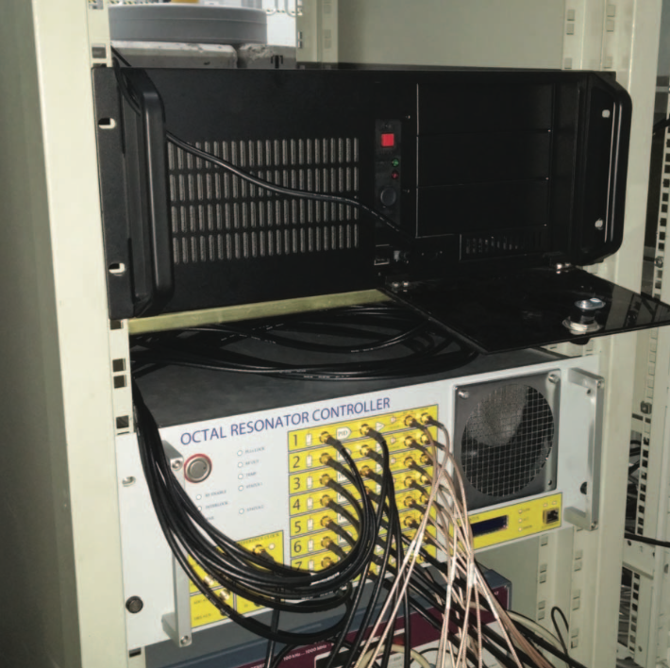
System block diagram
Adapt amplitude levels of RF signals
Measure reflected and forward powers

Slide 5
Algorithm block diagram

Slide 6
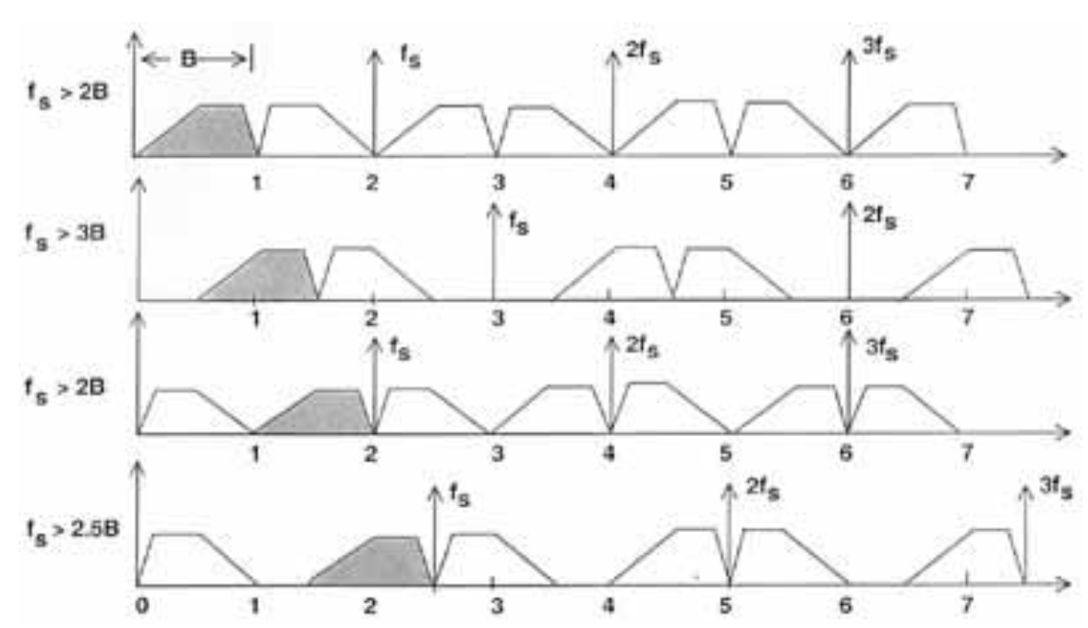
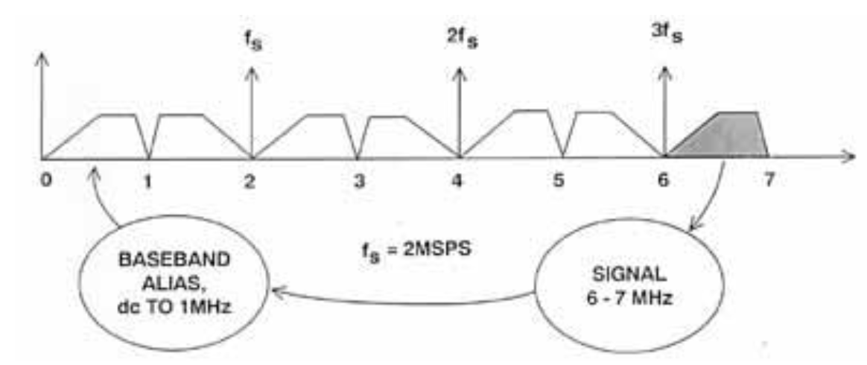
RF ADCs
ADS42JB69, 16 bit, 250 MSPS
Undersampling at 121.9 MHz
Noise is dominated by clock jitter
16 bit ADC SNR_{max} = 98dB
tj_{min} ~ 0.016 ps
10 bit -> 62dB -> ~1.04 ps

Slide 7
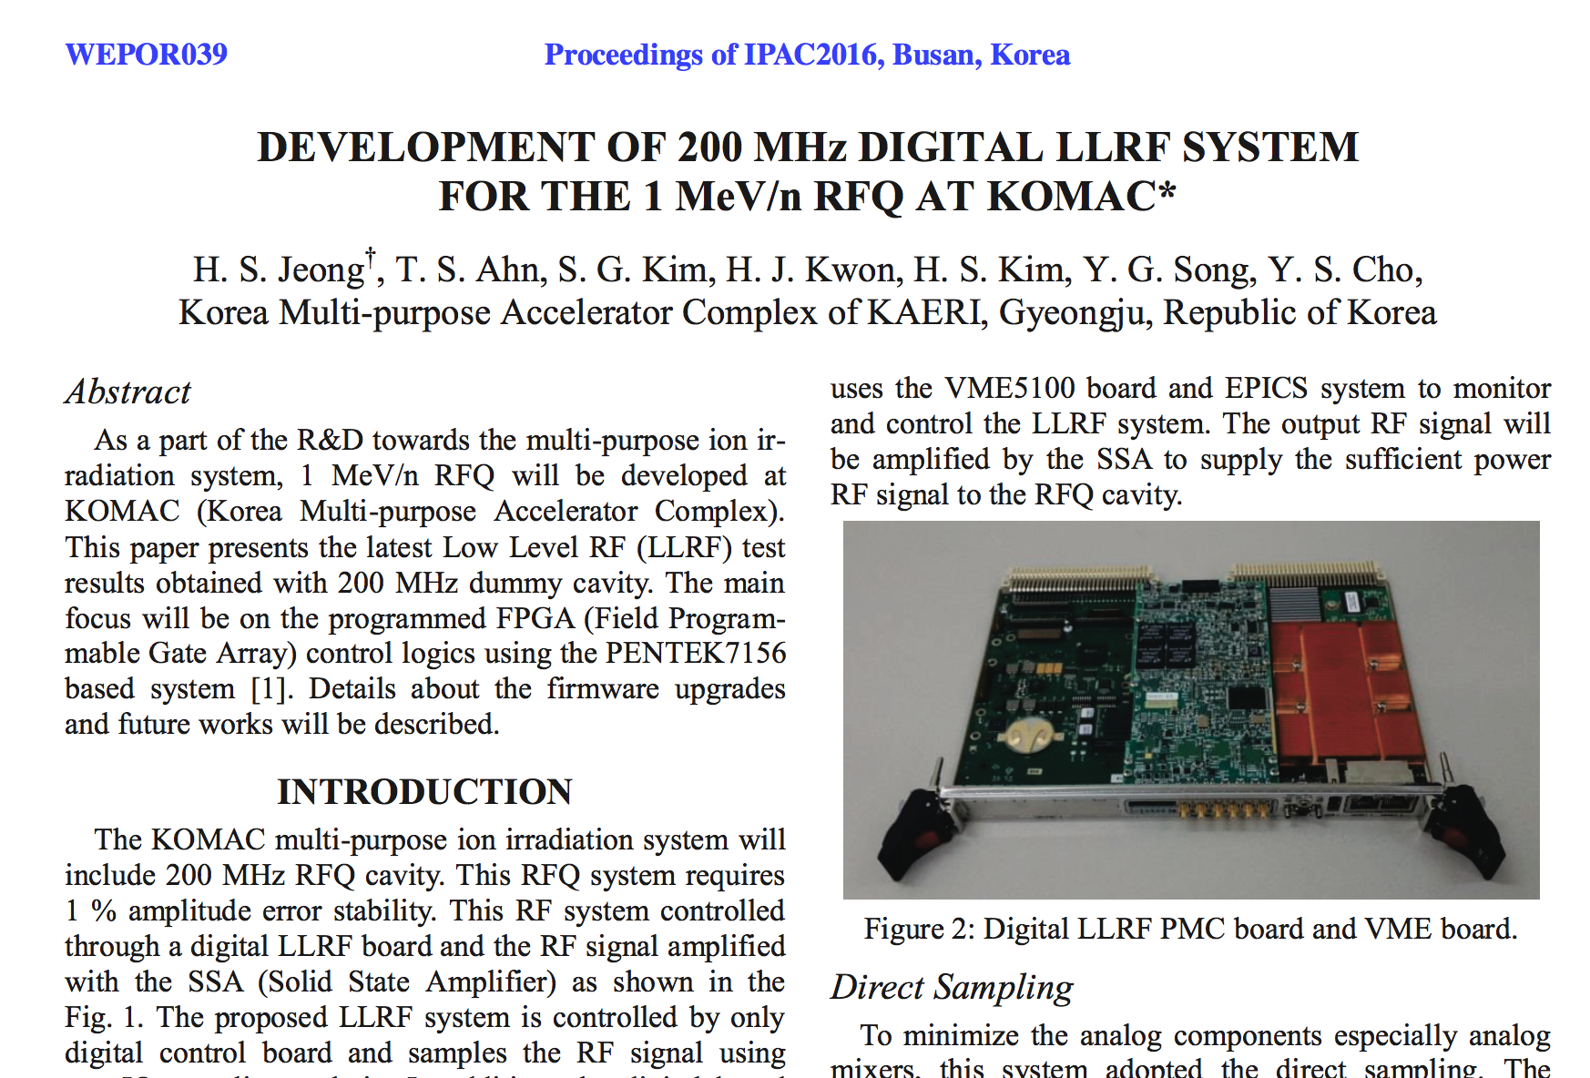

Slide 8
System block diagram

Slide 9
RF DACs
200 MHz signal
Direct Digital Synthetizer (FPGA) generates 40 MHz
Numerical Controlled Oscillator (DAC) generates 160MHz
DAC acts as Digital Up Converter mixing the 40MHz and 160MHz to produce the 200MHz

Slide 10
Algorithm block diagram

Slide 11
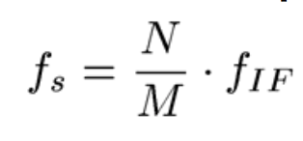
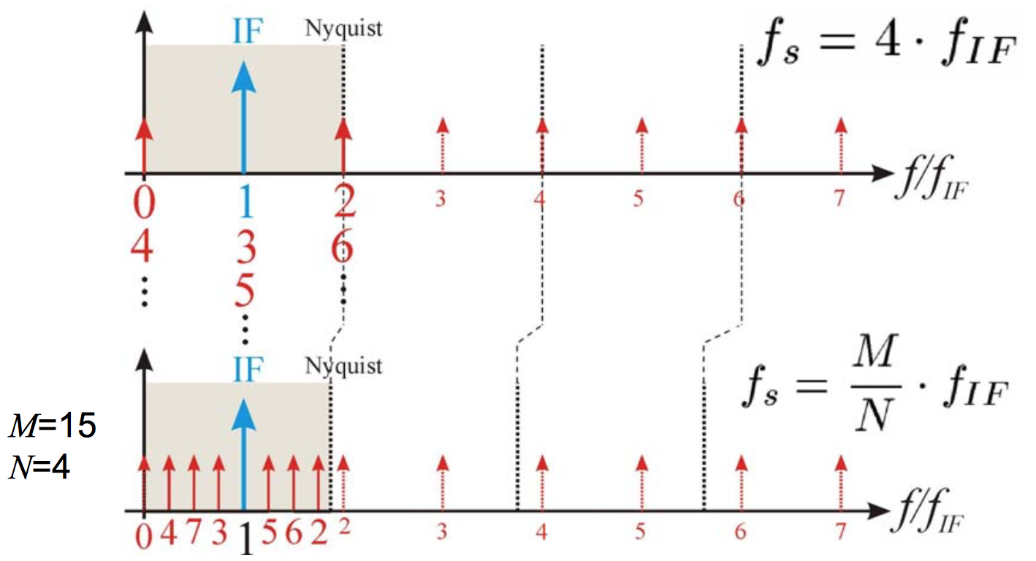
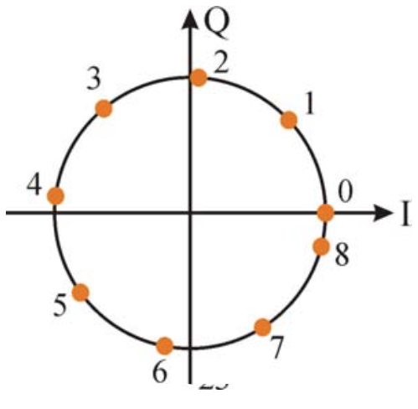
Non-IQ sampling
The sampling frequency is
N samples in M IF periods
Example M=3, N=25
errors from DC offsets, clock jitter, ADC quantization, noise reduced
but more latency due to sampling M IF periods

