Slide 1
Cryogenic Pressure Safety with Emphasis on Overpressure Protection of Low Temperature Helium Vessels
Part 1
Pressure Safety Fundamentals
Tom Peterson (SLAC)
CSA Webinar
February 2018

Slide 2
Many Thanks to Our Sponsors for Making This Class Possible
& Free to the Students
Acme Cryogenics Inc.
Circor Cryogenics-CPC Cryolab
HPD (High Precision Devices)
Cryoworks Inc.
Tempshield Cryo-Protection
WEKA AG

Slide 3
Introduction
The purpose of this lecture is to provide a review of cryogenic pressure safety and pressurized gas hazards
A lecture in two parts
  Pressure safety fundamentals
  Impact of pressure safety on design
Pressure safety in cryogenics involves all the usual pressurized gas concerns, plus:
  The possibility of pressurizing a closed volume via warm-up
  Possible embrittlement and resulting fracture of materials
We start with some examples of incidents and “lessons learned”
3

Slide 4
Topics in cryogenic pressure safety
Part 1, this week – fundamentals
  Compliance with consensus standards, exceptional vessel methodology
  Sources of pressure
  Thermodynamics of cryogen expansion and venting
  Analytical methods for vent line and relief sizing
  Relief devices
  Conclusions and references
Part 2, next week, impact on design
  Example of a venting system analysis
  Examples of the impact on cryostat design
  Conclusions and references

Slide 5
Two MRI system event videos
http://www.youtube.com/watch?v=1R7KsfosV-o
http://www.youtube.com/watch?v=sceO38idjic&feature=related

Slide 6
Risks of excessive pressure
Vessel rupture, explosion
Freezing, burns, due to plume of cold gas or liquid
Discharge of fittings, pipe caps, valves

Slide 7
Over Pressurization or explosion due to rapid expansion
Without adequate venting or pressure-relief devices on the containers, enormous pressures can build up which can cause an explosion.
Unusual or accidental conditions such as an external fire, or a break in the vacuum which provides thermal insulation, may cause a very rapid pressure rise.
The pressure relief valve must be properly installed and free from obstruction.
4/22/21
7

Slide 8
Lessons Learned
The following are a few “lessons learned” which have been compiled from various sources. One source of examples is the American Industrial Hygiene Association, which has a section of their website describing accidents and “lessons learned” including several cryogenic accidents: https://www.aiha.org/get-involved/VolunteerGroups/LabHSCommittee/Pages/Lessons-Learned.aspx

Slide 9
Lessons Learned
Empty 55 gallon drum (1999)
  At the Nevada Test Site, a waste handler was opening new, empty 55 gallon open-top drums. Upon removing the bolt from the drum lid clamp, the ring blew off and the lid was ejected approximately 5 to 10 feet in the air, just missing the Waste Handler's face. The drum did not hiss or show signs of pressurization.
  Because the Waste Handler had been properly trained to stand away from the drum while opening it, he was not injured.
  The event was caused by the drums being manufactured and sealed at sea level in Los Angeles and subsequently shipped to a much higher elevation of approximately 6,000 feet at the Nevada Test Site. The increased elevation, combined with the midday heat, created sufficient pressure buildup to cause the lid to blow off when the ring was being released.
  Lesson -- large force with small pressure times large area

Slide 10
Lessons learned (continued)
50 liter LN2 laboratory dewar explosion
  Transfer of LN2 from 160 liter dewar to 50 liter “laboratory” dewar
  Flex hose end from 160 l dewar would not fit in lab dewar neck (normally a “wand” is inserted for filling), so a connection was made with rubber hose over the OUTSIDE of the lab dewar neck and transfer hose end
  “Slot” cut in rubber hose for vent
  Failure not initially caused by overpressure, but by cooling of upper part of neck during fill! Seal between neck and vacuum jacket broke due to differential thermal contraction.
  Seal to vacuum jacket broke after lab dewar nearly full, subsequent overpressure with lack of sufficient vent caused explosion of lab dewar
  One person badly injured
  Lesson -- rupture of insulating vacuum with restricted venting resulted in explosion

Slide 11
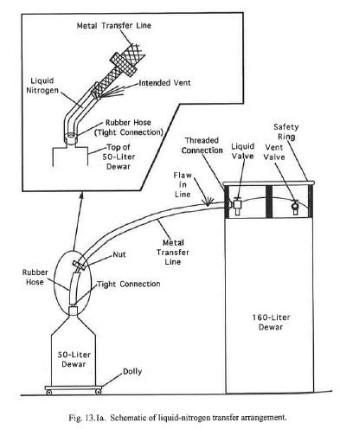
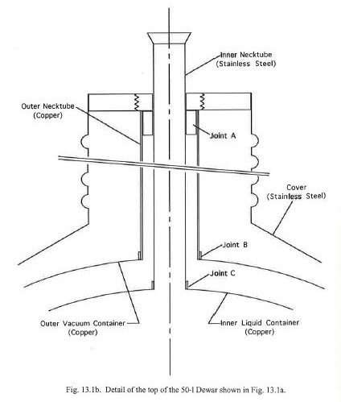
50 liter LN2 dewar explosion
Figures from “Safety in the Handling of Cryogenic Fluids,” by F. J. Edeskuty
and W. F. Stewart, Plenum Press, NY, 1996.

Slide 12

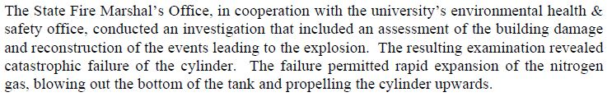
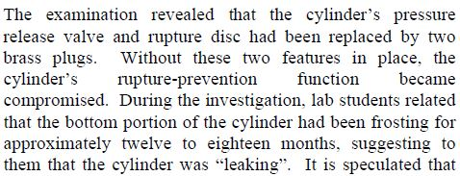
Another LN2 dewar explosion, for the report, see http://www.tdi.texas.gov/fire/documents/fmred022206.pdf

Slide 13

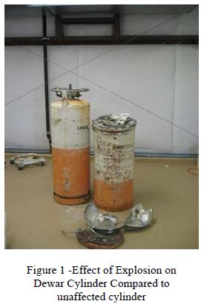
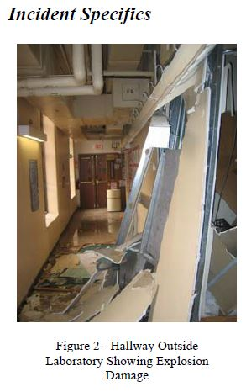
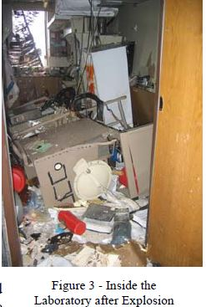

Slide 14
Pressure vessel and piping codes and national laboratory standards
ASME Boiler and Pressure Vessel Code and ASME B31 Piping Codes
  In general, we try to purchase vessels built to the code from code-authorized shops
  Where code-stamping is not possible, we design (or specify designs) to the intent of the code and note implications of exceptions to the code
10 CFR 851 requirements for pressure systems for DOE contractors
SLAC’s ES&H Manual Chapter 14, “Pressure Safety”
Fermilab’s ES&H Manual (FESHM) pressure vessel standards
  FESHM 5031 (general pressure vessel standard)
  FESHM 5031.6 (dressed cavity standard)

Slide 15
10 CFR part 851

Slide 16
10 CFR part 851
Appendix A (4) (c)
If codes to not apply,
we must provide a
level of safety greater
than or equal to the
applicable code.

Slide 17
From SLAC’s ES&H Manual Chapter 14, “Pressure Safety”

Slide 18
Issues for code compliance for SRF dressed cavities
Cavity design that satisfies level of safety equivalent to that of a consensus pressure vessel code is affected by
  use of the non-code material (niobium),
  complex forming and joining processes,
  a shape that is determined entirely by cavity RF performance,
  a thickness driven by the cost and availability of niobium sheet,
  and a possibly complex series of chemical and thermal treatments.
Difficulties emerge pressure vessel code compliance in various areas
  Material not approved by the pressure vessel code
  Loadings other than pressure
    Thermal contraction
    Tuning
  Geometries not covered by rules
  Weld configurations difficult to inspect

Slide 19
Safety/compliance issue summary
In the U.S., Europe, and Japan, SRF helium containers and part or all of the RF cavity fall under the scope of the local and national pressure vessel rules.
Thus, while used for its superconducting properties, niobium ends up also being treated as a material for pressure vessels.
For various reasons, it is not possible to completely follow all the rules of the pressure vessel codes for most of these SRF helium vessel designs
Thus, we have to invoke the “equivalent level of safety” allowed by 10 CFR 851.

Slide 20
General solution
In applying ASME code procedures, key elements demonstrating the required level of design safety are
  the establishment of a maximum allowable stress
  And for external pressure design, an accurate approximation to the true stress strain curve
Apply the ASME Boiler and Pressure Vessel Code as completely as practical
  Exceptions to the code may remain
  We have to show the risk is minimal
Satisfy the requirement for a level of safety greater than or equal to that afforded by ASME code.
Fermilab, Brookhaven, Jefferson Lab, Argonne Lab, and others in the U.S. have taken a similar approach

Slide 21
Fermilab developed a standard and guidelines for vessels which cannot fully meet the pressure vessel code (FESHM 5031.6)
Design drawings, sketches, and calculations are reviewed and approved by qualified independent design professionals.
Only qualified personnel must be used to perform examinations and inspections of materials, in-process fabrications, non-destructive tests, and acceptance tests.
Documentation, traceability, and accountability is maintained for each pressure vessel and system, including descriptions of design, pressure conditions, testing, inspection, operation, repair, and maintenance.

Slide 22
FESHM 5031.6
The chapter applies to any Dressed SRF Cavity that is designed or used at Fermilab
    “Dressed SRF Cavity –An integrated assembly wherein a niobium cavity has been permanently joined to a cryogenic containment vessel, such that niobium is part of the pressure boundary and the cavity is surrounded by cryogenic liquid during operation.”
The chapter references specially developed engineering guidelines
An Engineering Note is prepared for all Dressed SRF cavities
  I will describe such an engineering note in detail in the next talk
A panel specifically assigned to SRF cavity engineering note reviews ensures uniformity in preparation and review

Slide 23
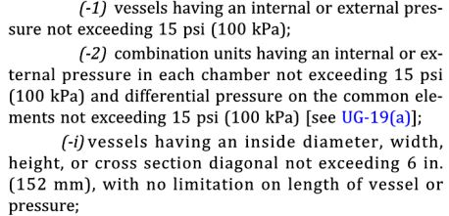
Pressure Vessel Code Scope
ASME Section VIII, Division 1, describes scope in terms of what is excluded. Key general exclusions are copied here from U-1(c)(2)(-h) and U-1(c)(2)(-i):
Hence the fundamental rule for the scope (with some specific exceptions, e.g., pumps, compressors, piping systems, water tanks):
15 psi or more, and 6 inches cross section or more.

Slide 24
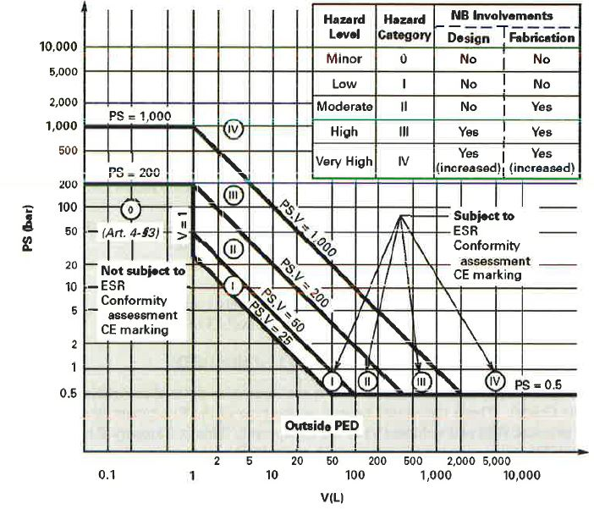
PED Classification Chart from "Guide for ASME Section VIII, Division 1 Stamp Holders“

Slide 25
ASME Section VIII, Division 1 versus PED version 2014/68/EU
Note that the scopes of the ASME BPVC and PED version 2014/68/EU codes differ
Differences between PED requirements and ASME requirements are described the document, "Guide for ASME Section VIII, Division 1 Stamp Holders“, which compares ASME Section VIII, Division 1 with PED version 2014/68/EU
The comparisons indicate equivalent or higher level of requirements for the EU standards for Category III vessels.
In general, material requirements, design requirements including formal design review and approval, allowable stresses, construction, inspection, and test requirements are similar or sometimes include more stringent requirements than ASME and also sometimes more responsibility placed on the manufacturer.

Slide 26
Use of CE stamped vessel at SLAC
We have an electron microscope pressure vessel of 283.6 liters volume with CE stamp
The gas is sulfur hexafluoride at a pressure up to 5 bar
Temperature range is ambient (5 C to 40 C).
The pressure-volume product of 1418 bar-liters places this vessel in PED Hazard Category III
A review concluded that this Category III CE-stamped vessel has a level of safety equivalent to what would have been provided by ASME pressure vessel codes for this vessel.

Slide 27
Pressure protection
Vessel and piping have a Maximum Allowable Working Pressure (MAWP) defined by the design of the vessel or system
  A venting system and relief devices must be in place to prevent any event from pressurizing the vessel or piping above the MAWP (plus whatever code allowance may be available)
Evaluate all pressure sources and possible mass flow rates
Size the vent line to the relief device
  Temperature and pressure of flow stream
  Typically a pressure drop analysis for turbulent subsonic flow
Size the relief device
Size downstream ducting, if any
  Downstream piping may be necessary to carry inert gas safely away from an occupied area or sensitive equipment

Slide 28
ASME pressure vessel code -- relief devices
Section VIII of the ASME Code provides fundamental guidance regarding pressure relief requirements.
  ASME Section VIII, Division 1, UG-125 through UG133, for general selection, installation and valve certification requirements
  ASME Section VIII, Appendix 11 for flow capacity conversions to SCFM-air
For Div. 2, relevant information is found in Part 9.

Slide 29
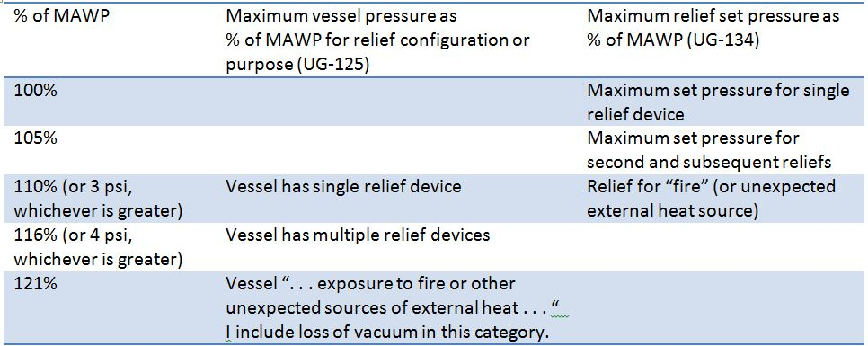
Vessel pressures and relief set pressures allowed per ASME Section VIII, Division 1

Slide 30
Compressed Gas Association publication,
CGA S-1.3, “Pressure Relief Device Standards”
Extensive guidance on requirements for relief devices consistent with ASME code
  Applicable where MAWP and venting pressure exceed 15 psig
I will not provide a detailed discussion of CGA S-1.3, but rather just point to a few key issues and most useful elements of the standard

Slide 31
Note: we take exception to paragraph 2.2 in CGA S-1.3
“CGA believes that reclosing PRDs on a container shall be able to handle all the operational emergency conditions except fire, for which reclosing or nonreclosing PRDs shall be provided. The operational emergency conditions referred to shall include but not be limited to loss of vacuum, runaway fill, and uncontrolled operation of pressure buildup devices.”
Exception: we treat loss of vacuum to air, with the very high heat flux resulting from condensation on the liquid helium temperature surface of a container, like the fire condition and may use nonreclosing relief devices for that situation
This interpretation is consistent with wording in the ASME code, Section VIII, Division I, UG-125, which refers to “. . . exposure to fire or other unexpected sources of external heat.“

Slide 32
Compressed Gas Association publication,
CGA S-1.3, “Pressure Relief Device Standards”
From CGA S-1.3: Among the particular issues which must be addressed for low temperature vacuum jacketed helium containers are
  the temperature at which liquid-to-gas evolution should be estimated for the supercritical fluid at its venting pressure (CGA S-1.3 is very useful here; I’ll discuss this)
  the warming of the cold fluid passing through a long vent line (CGA S-1.3 also provides useful practical approximation methods here which I will discuss)
  the volume generated per unit heat added (we have data from lab tests about this which provide useful numbers)

Slide 33
Sources of pressure -- mechanical
Compressors, pumps
  Screw compressors are positive displacement devices
  Worst case flow may be with high suction pressure as limited by inlet-side reliefs or pump/compressor motor power
    Calculate worst-case flow as highest inlet density combined with known displacement volume
    Or consider power limitations of pump or compressor motor
Connection to a higher pressure source, such as a tube trailer
  Evaluate the mass flow as determined by the pressure drop from the highest possible source pressure to the MAWP of vessel to be protected

Slide 34
Sources of pressure -- heat
Trapped volume, slow warm-up and pressurization with normal heat inleak
  All possible volumes which may contain “trapped” (closed off by valves or by other means) cold fluid require small reliefs
  Rate of warm-up may be evaluated, generally slow enough that trapped volume reliefs are not individually analyzed.
Loss of vacuum to helium with convection and conduction through helium gas
Sudden large heat influx to a liquid-helium temperature container due to condensation of nitrogen or air on the surface
  Either through MLI or, worst-case, on a bare metal surface
Stored energy of a magnetic field
  May provide a larger flow rate than loss of insulating vacuum
Fire, with heat transport through the gas-filled insulation space

Slide 35
Nominal heat loads
Working numbers for making heat load estimates
  ~1.5 W/m² from 300 K to MLI-insulated (typically about 30 layers) cold surface
  ~50 mW/m² from 80 K to MLI-insulated (typically about 10 layers) 4.5 K or 2 K surface
Note that support structures and “end effects” may dominate the total heat load

Slide 36
Heat flux due to loss of insulating vacuum as a source of pressure
W. Lehman and G. Zahn, “Safety Aspects for LHe Cryostats and LHe Transport Containers,” ICEC7, London, 1978
G. Cavallari, et. al., “Pressure Protection against Vacuum Failures on the Cryostats for LEP SC Cavities,” 4th Workshop on RF Superconductivity, Tsukuba, Japan, 14-18 August, 1989
M. Wiseman, et. al., “Loss of Cavity Vacuum Experiment at CEBAF,” Advances in Cryogenic Engineering, Vol. 39, 1994, pg. 997.
T. Boeckmann, et. al., “Experimental Tests of Fault Conditions During the Cryogenic Operation of a XFEL Prototype Cryomodule,” DESY.

Slide 37
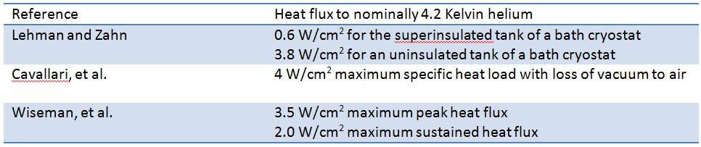
Heat flux conclusions
T. Boeckmann, et. al. (DESY)
  Air inflow into cavity beam vacuum greatly damped by RF cavity structures
Various authors also comment about layer of ice quickly reducing heat flux
Heat flux curves for liquid helium film boiling with a delta-T of about 60 K agree with these heat flux numbers (next slides)
I use 4 W/cm² for bare metal surfaces

Slide 38
Underlying thermodynamics
Nitrogen freezes at 63 K
Oxygen freezes at 55 K
So heat flux for air condensation begins to become large with condensing surface temperatures under 63 K
Delta-T to liquid helium will be around 58 K or less
Film boiling of helium with 50 K to 60 K delta-T will provide about 4 W/cm²

Slide 39
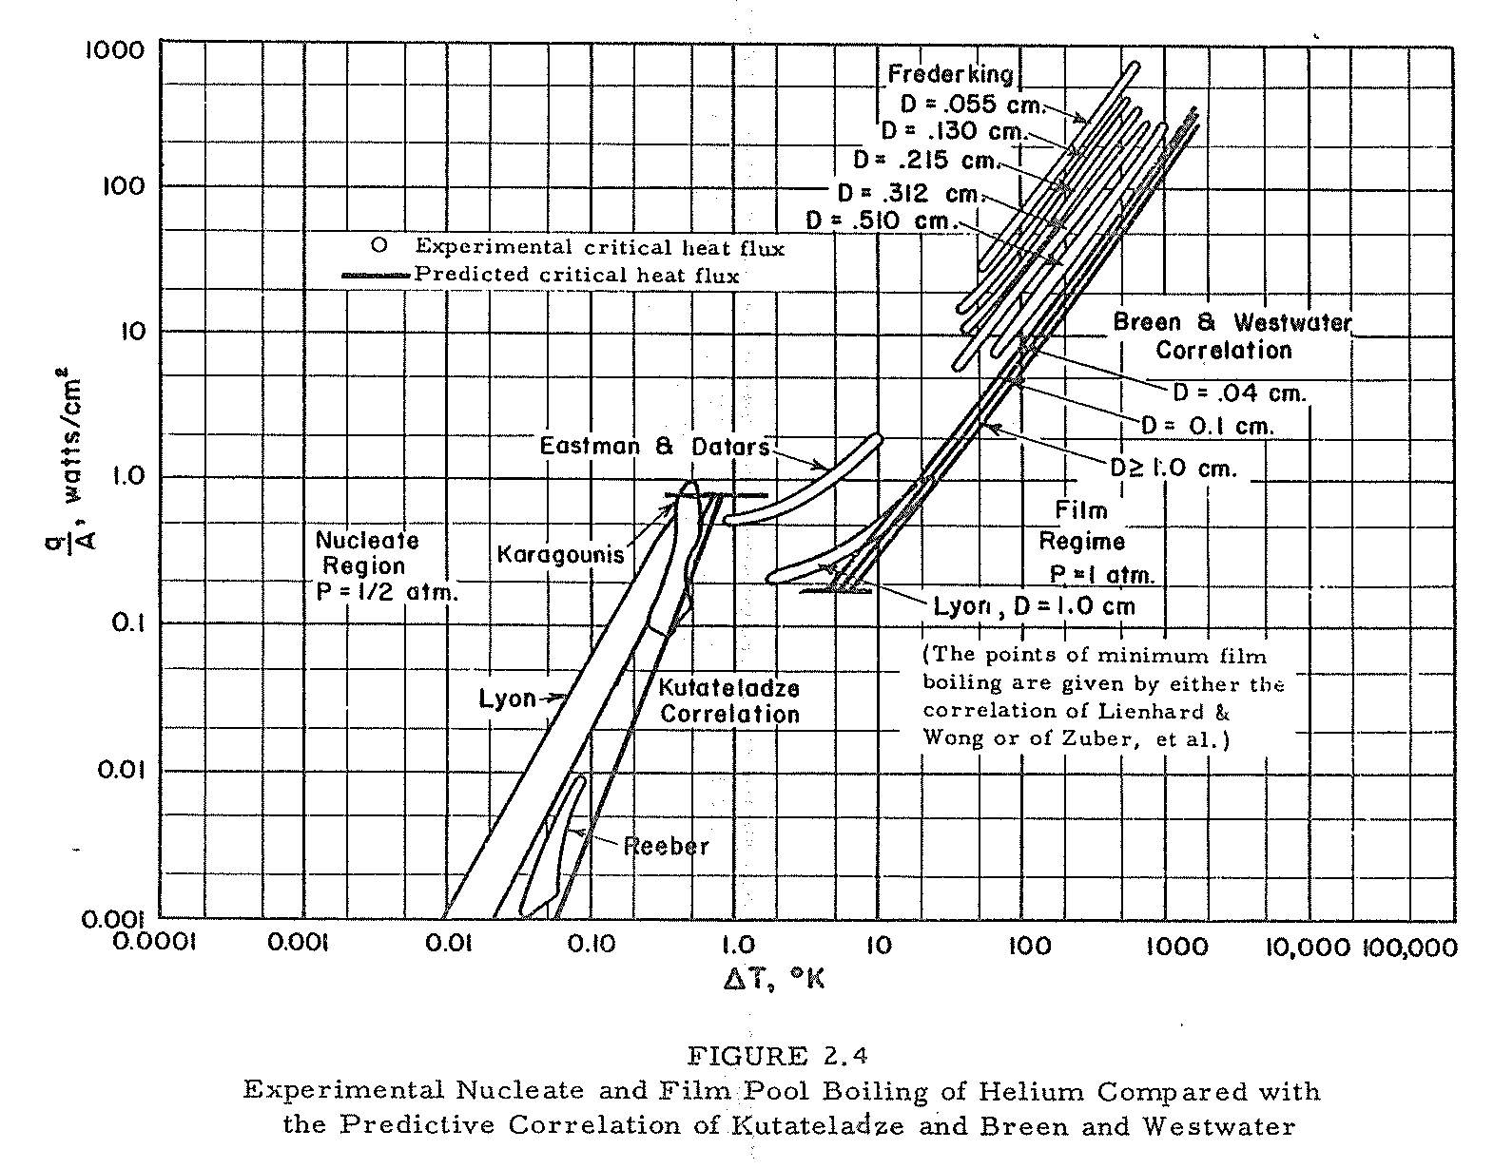
E. G. Brentari, et. al.,
NBS Technical Note 317

Slide 40
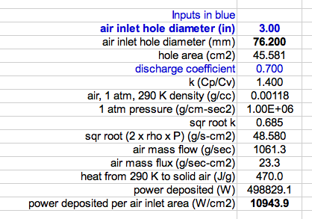
Atmospheric air rushing into a vacuum space and condensing on a surface deposits about 11 kW per cm² of air hole inlet area. In many cases, heat flux will be limited by this air hole inlet size rather than low-temperature surface area.

Slide 41
Conversion of heat to mass flow
Low pressures, below the critical pressure
  Latent heat of vaporization
  Net flow out is vapor generated by the addition of heat minus the amount of vapor left behind in the volume of liquid lost
  For helium at pressures approaching the critical pressure (2.3 bar), the density and mass of vapor “left behind” in the volume formerly occupied by the boiled liquid can be significant, so this may be an important factor in reducing mass flow to a net mass flow out.
High pressures, above the critical pressure
  Heat added results in fluid expelled
  A “pseudo latent heat” can be evaluated

Slide 42
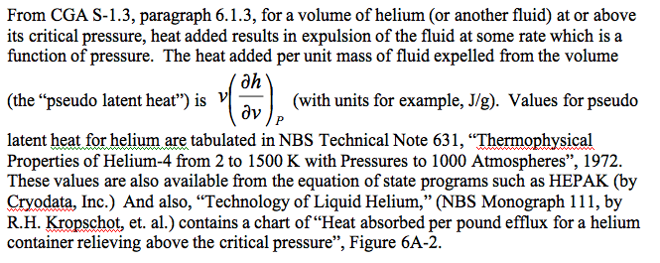
Supercritical fluid -- energy added per unit mass expelled
The pressure of a liquid helium container during venting will often exceed the critical pressure of helium (2.3 bar)

Slide 43
Pseudo latent heat heat – 4 atm helium
Temperature (K) | Density (g/liter) | v(dh/dv)_{p} (J/g) (heat aborbed per unit of mass expelled)
5.0 | 124.2 | 29.8
5.5 | 109.4 | 24.6
6.0 | 82.6 | 19.8
6.5 | 55.0 | 21.4
7.0 | 42.7 | 24.8
Venting occurs at a temperature near (not exactly, but
close, more later) where v(dh/dv)_{p} is at a minimum, so
for our 4.1 bar venting with loss of vacuum, around 6 K.

Slide 44
Relief venting
Up to now, we have discussed estimation of the venting flow rate
In summary
  We have a vessel or piping MAWP
  We have a mass flow rate provided either by compressors/pumps or heating of low temperature fluid which must be removed from that vessel at or below the MAWP

Slide 45
Berkeley MRI magnet quench
https://www.youtube.com/watch?v=QRahBusouRs

Slide 46
Venting flow analyses
Size piping to the relief device
Size the relief device
  Typically using the vendor-provided or standard relief device formulas and charts
Size piping downstream of the relief device
A somewhat different venting flow analysis -- estimate flow from a rupture or open valve into a room for an ODH analysis

Slide 47
Constraints and assumptions
For relief and vent pipe sizing
  Typically flow driven by a Maximum Allowable Working Pressure (MAWP, as defined by code requirements) at the vessel
  Pipe size and relief device size are the free parameters
    Perhaps also pipe routing
  Flow rate may be determined by a compressor or pump capacity or heat flux to a low temperature vessel

Slide 48
Venting and relief sizing analysis
Conservative, err on the safe side
  Venting is typically not steady-state, very dynamic
  Make simplifying assumptions on the safe side
    For example, flow rate estimate should be safely on the high side for relief sizing
Reviewable
  Simplest and most straightforward analysis which demonstrates requirement
  Of course, more sophisticated analysis (such as FEM fluid dynamic simulation may be necessary for a system with sever constraints)

Slide 49
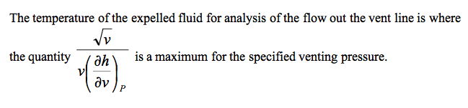
Vent line flow temperature
This exit temperature will typically be 5 K - 6 K
for a liquid helium container venting at a somewhat
supercritical pressure.
The temperature into the relief device may be higher than the exit
temperature due to heat transfer to the flow via the vent pipe. For
very high flow rates and a relatively short vent line, this temperature
rise may be insignificant. A simple energy balance on the flow and
stored energy in the vent line, with an approximate and conservatively
large convection coefficient may provide a safely conservative
estimate of the temperature rise. For a long vent line, a more detailed
analysis may be required in sizing the relief device. CGA S1.3,
paragraph 6.1.4 and following, provides some guidance for this analysis.

Slide 50
Vent line pressure drop evaluation

Slide 51
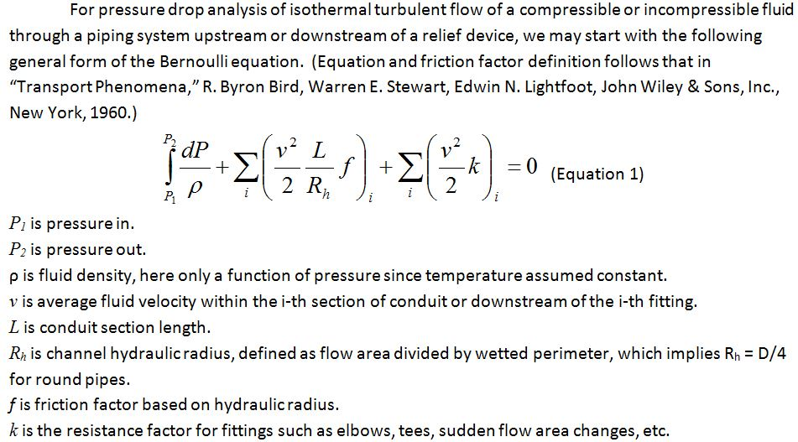
General form of Bernoulli Equation

Slide 52
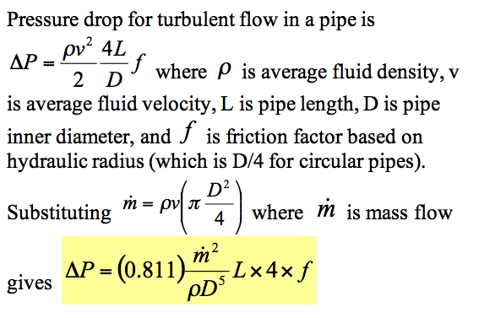
Pressure drop analysis, working formula for round pipes
This is a form of the D'Arcy-Weisbach formula. With pressure drop expressed as head loss, this is sometimes called simply the Darcy formula.
(Note that delta-P changed signs here, to a positive number.)

Slide 53
Crane Technical Paper #410
Crane Technical Paper #410 “Flow of Fluids through Valves, Fittings, and Pipes”
A classic reference, still available in updated forms
Contains many forms of Bernoulli Equation and other formulas for both compressible and incompressible flow
Relief valve and rupture disk catalogue formulas often reference Crane Technical Paper #410
My only criticism (and strictly my personal opinion) -- I do not like the incorporation of unit conversions into formulas, which is too common in these engineering handbooks

Slide 54
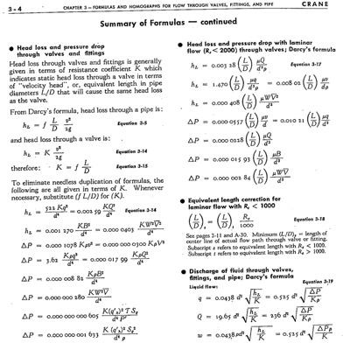
Crane Technical Paper #410 “Flow of Fluids through Valves, Fittings, and Pipes”

Slide 55


For example from previous list
Where ΔP is pressure drop in psi, V is the specific volume (in³/lbm), K is the total resistance coefficient = fL/d so is dimensionless, W is the mass flow rate (lbm/hr), and d is the pipe inner diameter (in).
Compare to
from slide 34 -- no unit conversions, and a different definition of
friction factor. Note! Some sources define f based on hydraulic
radius and some on diameter, a factor 4 difference for pipes!

Slide 56
Rupture disk and relief valve sizing
Flow will typically be choked (sonic) or nearly choked in a relief valve or rupture disk
  Inlet pressure is at least 15 psig (1 atm gauge) for ASME approved relief devices
  Discharge is to atmosphere
This makes analysis relatively simple
  Relief valve catalogues and rupture disk catalogues have good, practical working formulas and charts for sizing relief devices

Slide 57
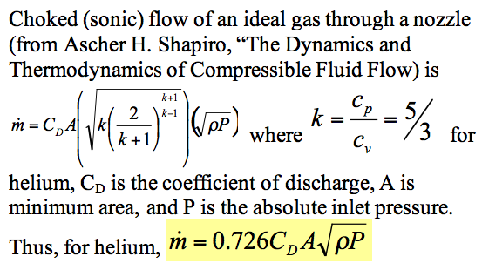
Choked flow in a nozzle

Slide 58
Relief devices
For cracking pressures of 15 psig or higher, ASME-approved (UV- or UD-stamped) pressure relief devices may be used.
For vessels with a differential pressure of more than 15 psid within the vacuum jacket but a gauge pressure of less than 15 psig, ASME-approved reliefs are not available.

Slide 59
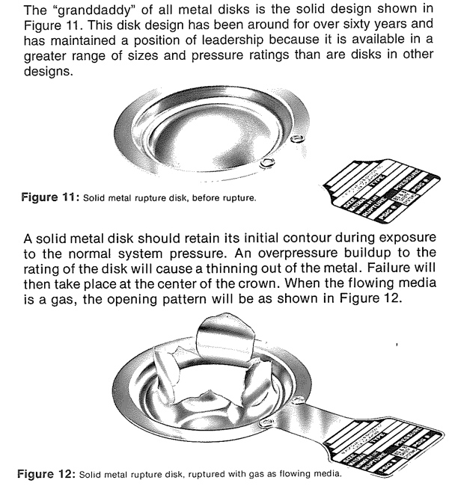
From the BS&B rupture disk catalogue

Slide 60
Rupture disks
Various types, some pre-etched or with knife edge, or failure in collapse (pressure on the dome) and other designs and materials
  Difficult to set a precise opening pressure
A last resort device since they do not close
  You don’t want these opening in normal operations
  Switching valves available for dual disks such that one can be replaced while the other holds pressure and provides protection
Inexpensively provide very large capacity, so typical for the worst-case loss of vacuum
  Operational reclosing relief valves set at a safely lower pressure (80% of RD or less) prevent accidental opening of the rupture disk

Slide 61
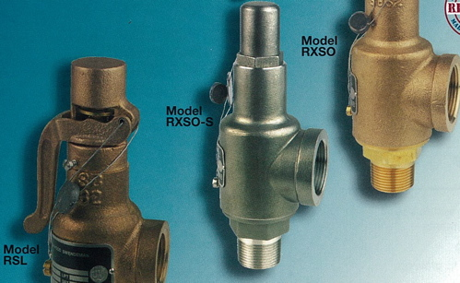
Relief valves
Even though valve at room temperature, will cool upon relieving, so need cold-tolerant material and design
Take care to provide
ASME UV-stamped valves for code-stamped vessels
Image from
Rockwood Swendeman
brochure

Slide 62
Relief valves
Sizing best done via valve manufacturer information
  Shape of valve body, type of plug make sizing unique to the valve design
  Manufacturers certify flow capacity for UV-stamped (ASME approved) valves

Slide 64
Conclusions for piping and emergency venting
Cryogenic vessels and piping generally fall under the scope of the ASME pressure vessel and piping codes
Protection against overpressure often involves not only sizing a rupture disk or relief valve but sizing vent piping between those and the vessel, and also perhaps further ducting downstream of the reliefs
Loss of vacuum to air with approximately 4 W/cm² heat flux on bare metal surfaces at liquid helium temperatures can drive not only the design of the venting system but pipe sizes within the normally operational portions of the cryostat
Piping stability due to forces resulting from pressure around expansion joints is sometimes overlooked and may also significantly influence mechanical design

Slide 65
References – Standards and Codes
ASME Boiler and Pressure Vessel Code, Section VIII, Division 1 and Division 2, 2015, Rules for Construction of Pressure Vessels
ASME B31.3-2014, Process Piping, ASME Code for Pressure Piping
CGA S-1.3, “Pressure Relief Device Standards”, Compressed Gas Association, 2005.
EUD 2014/68/EU DIRECTIVE — Directive 2014/68/EU of the European Parliament and of the Council of 15 May 2014 on the harmonisation of the laws of the Member States relating to the making available on the market of pressure equipment
ASME Document PTB-10-2015, "Guide for ASME Section VIII, Division 1 Stamp Holders”

Slide 66
References – National Lab Standards
SLAC ES&H Manual, Chapter 14: Pressure Systems
  http://www-group.slac.stanford.edu/esh/hazardous_activities/pressure/
SLAC ES&H Manual, Chapter 36: Cryogenic and Oxygen Deficiency Hazard Safety
  http://www-group.slac.stanford.edu/esh/hazardous_substances/cryogenic/
Fermilab ES&H Manual, Chapter 5031: Pressure Vessels
  http://esh-docdb.fnal.gov/cgi-bin/ShowDocument?docid=456
Fermilab ES&H Manual, Chapter 5031.6: Dressed Niobium SRF Cavity Pressure Safety
  And associated document: “Guidelines for the Design, Fabrication, Testing and Installation of SRF Nb Cavities,” Fermilab Technical Division Technical Note TD-09-005
  http://esh-docdb.fnal.gov/cgi-bin/ShowDocument?docid=1097
Fermilab ES&H Manual, Chapter 5032: Cryogenic System Review
  http://esh-docdb.fnal.gov/cgi-bin/ShowDocument?docid=528

Slide 67
References – Heat Flux Measurements
W. Lehman and G. Zahn, “Safety Aspects for LHe Cryostats and LHe Transport Containers,” ICEC7, London, 1978
G. Cavallari, et. al., “Pressure Protection against Vacuum Failures on the Cryostats for LEP SC Cavities,” 4th Workshop on RF Superconductivity, Tsukuba, Japan, 14-18 August, 1989
M. Wiseman, et. al., “Loss of Cavity Vacuum Experiment at CEBAF,” Advances in Cryogenic Engineering, Vol. 39, 1994, pg. 997.
T. Boeckmann, et. al., “Experimental Tests of Fault Conditions During the Cryogenic Operation of a XFEL Prototype Cryomodule,” DESY.

Slide 68
References – Technical
“Flow of Fluids through Valves, Fittings, and Pipes,” Crane Technical Paper #410.
E. G. Brentari, et. al., “Boiling Heat Transfer for Oxygen, Nitrogen, Hydrogen, and Helium,” NBS Technical Note 317, 1965.
NBS Technical Note 631, “Thermophysical Properties of Helium-4 from 2 to 1500 K with Pressures to 1000 Atmospheres”, 1972.
Vincent D. Arp and Robert D. McCarty, “Thermophysical Properties of Helium-4 from 0.8 to 1500 K with Pressures to 2000 Atmospheres,” National Institute of Standards and Technology (NIST) Technical Note 1334, 1989.
HEPAK (by Cryodata, Inc.)

Slide 69
References – General
R. Byron Bird, Warren E. Stewart, Edwin N. Lightfoot, “Transport Phenomena,” John Wiley &Sons, 1960.
S. W. VanSciver, “Helium Cryogenics,” Plenum Press, 1986.
Frederick J. Edeskuty and Walter F. Stewart, “Safety in the Handling of Cryogenic Fluids,” Plenum Press, New York, 1996.
R.H. Kropschot, et. al., “Technology of Liquid Helium,” NBS Monograph 111
Ascher H. Shapiro, “The Dynamics and Thermodynamics of Compressible Fluid Flow,” Wiley, 1953.

